Slide 1
Notes:
This presentation is intended to provide a general overview of the epidemiology of Human Immunodeficiency Virus (HIV) Disease in Los Angeles County (LAC).
Data are provided by the Division of HIV and STD Programs (DHSP) located at 600 South Commonwealth Avenue, Suite 1260, Los Angeles, CA 90005.
Notes are provided for each slide, intending to provide proper interpretation of the data presented on the slides.
Please note that data for years 2019 through 2020 are provisional due to reporting delays.

Slide 2
Notes:
The HIV infection pandemic is a widespread disease that affects all parts of the globe. These first few slides are intended to put the local epidemic into a national and worldwide context.
It is important to note that the HIV infection epidemic in the U.S. is not uniform. The demographics and risk exposures of those affected by HIV infection in the U.S. vary greatly depending upon region.
Applying national statistics to localized communities is likely to lead to a misrepresentation of the local epidemic. Therefore, when referencing HIV infection data to describe local groups impacted by HIV infection, be sure to reference local data.

Slide 3
Notes:
This slide shows the estimated number of people living with HIV at the end of 2020, by region of the world.
Globally, Africa has been affected the greatest with an estimated 25.4 million people living with HIV infection at year-end 2020 followed by the Americas with 3.7 million and Europe with 2.6 million people affected.
Please note that this slide does not take into account the proportion of individuals affected within each region. The numbers and comparisons are based on total numbers by region.
Source: Global HIV, Hepatitis and STI Programmes (WHO). “Latest HIV estimates and updates on HIV policies uptake, July 2021” https://cdn.who.int/media/docs/default-source/hq-hiv-hepatitis-and-stis-library/2021-global-summary-web-v6.pdf?sfvrsn=4b8815ad_25

Slide 4
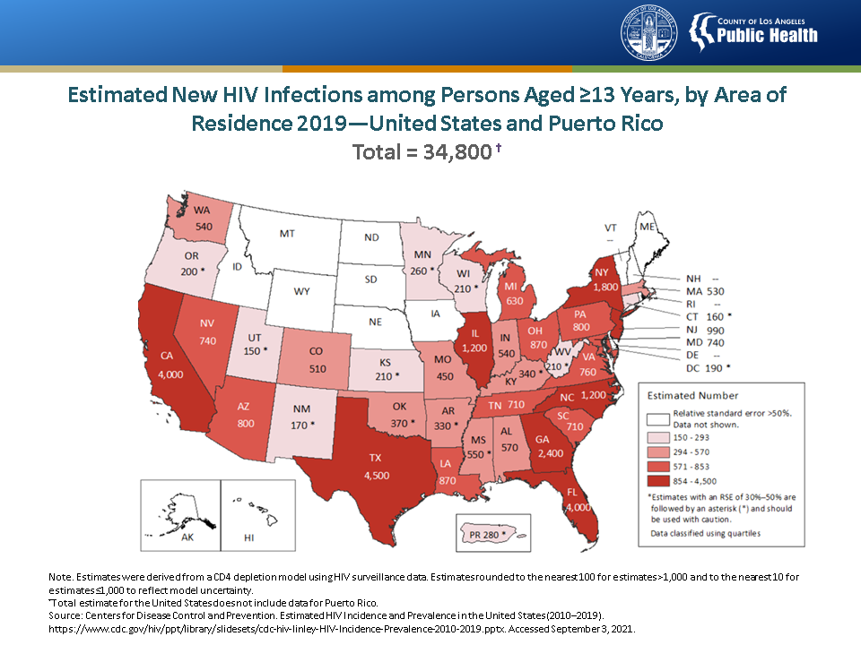
Notes:
This map presents the estimated number of HIV infections among persons aged ≥13 years in the United States for 2019. HIV incidence was highest in California, Florida, Georgia, Illinois, New York, North Carolina, and Texas.; these states accounted for approximately 55% of the estimated numbers of HIV infections.
Estimates were derived from a CD4 depletion model using HIV surveillance data. Estimates were rounded to the nearest 100 for estimates >1,000 and to the nearest 10 for estimates ≤1,000 to reflect model uncertainty. Estimates with a relative standard error (RSE) of 30%–50% are followed by an asterisk (*) and should be used with caution. Estimates with an RSE of >50% are not shown.
Estimates for the following jurisdictions should be interpreted with caution because they do not have laws requiring complete reporting of laboratory data or have incomplete reporting. Areas without laws: Idaho and New Jersey. Areas with incomplete reporting: Kansas, Kentucky, Pennsylvania, Vermont, and Puerto Rico.
Data presented in this slide are from the same dataset (reported to CDC through December 2020) and CD4 model used for the HIV Supplemental Surveillance Report “Estimated HIV Incidence and Prevalence in the United States 2015–2019”. Please see the Commentary and Technical Notes for information on the methods used to produce the estimates. The report can be found at: https://www.cdc.gov/hiv/library/reports/hiv-surveillance.html
Source: Centers for Disease Control and Prevention. Estimated HIV Incidence and Prevalence in the United States (2010–2019). https://www.cdc.gov/hiv/ppt/library/slidesets/cdc-hiv-linley-HIV-Incidence-Prevalence-2010-2019.pptx. Accessed September 3, 2021.

Slide 5
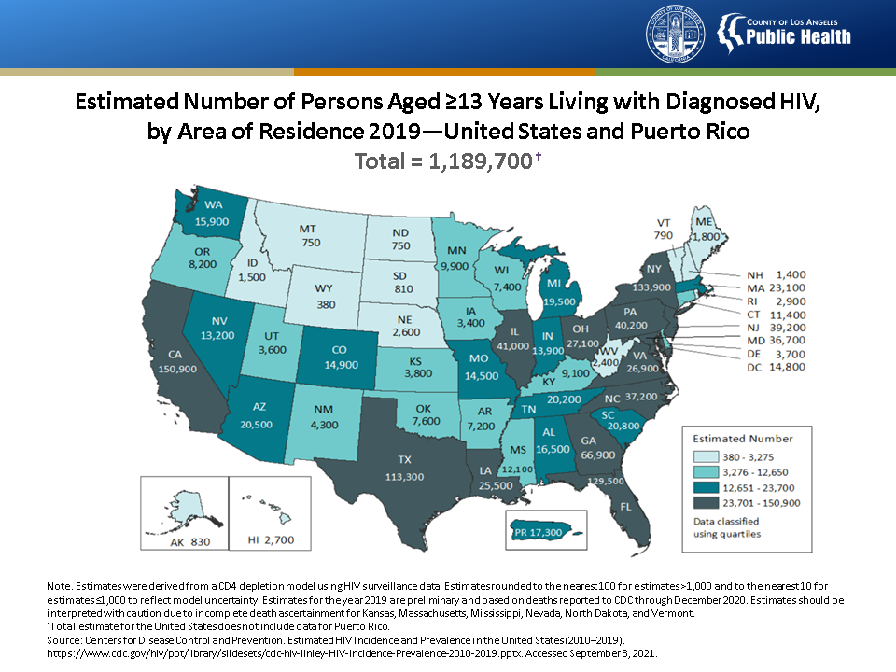
Notes:
This map presents the estimated number of persons aged ≥13 years living with diagnosed HIV in the United States for 2019. HIV prevalence was highest in California, Florida, Georgia, Illinois, Louisiana, Maryland, New Jersey, New York, North Carolina, Pennsylvania, Texas, Ohio, and Virginia.
Five states accounted for approximately 50% of persons living with HIV infection: California, Florida, Georgia, New York, and Texas.
Estimates for the year 2019 are preliminary and based on deaths reported to CDC through December 2020. Estimates for Kansas, Massachusetts, Mississippi, Nevada, North Dakota, and Vermont should be interpreted with caution due to incomplete death ascertainment.
Estimates were derived from a CD4 depletion model using HIV surveillance data. Estimates were rounded to the nearest 100 for estimates >1,000 and to the nearest 10 for estimates ≤1,000 to reflect model uncertainty.
Estimates for the following jurisdictions should be interpreted with caution because they do not have laws requiring complete reporting of laboratory data or have incomplete reporting. Areas without laws: Idaho and New Jersey. Areas with incomplete reporting: Kansas, Kentucky, Pennsylvania, Puerto Rico, and Vermont.
Data presented in this slide are from the same dataset (reported to CDC through December 2020) and CD4 model used for the HIV Supplemental Surveillance Report “Estimated HIV Incidence and Prevalence in the United States 2015–2019”. Please see the Commentary and Technical Notes for information on the methods used to produce the estimates. The report can be found at: https://www.cdc.gov/hiv/library/reports/hiv-surveillance.html
Source: Centers for Disease Control and Prevention. Estimated HIV Incidence and Prevalence in the United States (2010–2019). https://www.cdc.gov/hiv/ppt/library/slidesets/cdc-hiv-linley-HIV-Incidence-Prevalence-2010-2019.pptx.. Accessed September 3, 2021.

Slide 8
Notes:
This graph presents the number of HIV/AIDS diagnoses, persons living with AIDS and non-AIDS HIV, and deaths among persons living with diagnosed HIV in Los Angeles County (LAC) from 1982 to 2020. In LAC, AIDS reporting began in 1982 and peaked in 1992 with more than 4,000 cases reported that year. In 1994, deaths reached an all-time high followed by a dramatic decline that coincided with the introduction of highly active antiretroviral treatment (HAART) for HIV in 1996. In 2006, name-based HIV reporting began in California, allowing for better tracking of trends in diagnosed HIV infection irrespective of disease stage. HIV epidemic trends thereafter have declined for diagnosed HIV cases and deaths, the latter of which appear to have leveled out in more recent years.
Diagnoses of HIV infection include new diagnoses of HIV infection regardless of the disease stage at time of diagnosis.
Persons living with non-AIDS HIV and AIDS in LAC are based on last reported address at the end of each calendar year.
Deaths include persons whose residence at death was in LAC or whose most recent known address before death was in LAC, when residence at death is missing.
2019 data for diagnoses of HIV/AIDS and deaths and 2019/2020 data for persons living with non-AIDS HIV and AIDS data are provisional as indicated by the dashed line and pattern bar. 2020 diagnoses of HIV/AIDS and deaths are underreported/unreliable due to significant reporting delay, and therefore are not shown.

Slide 9
Notes:
The information from this slide was based on the CDC HIV Surveillance Report, Vol. 32.

Slide 11
Notes:
This slide presents the distribution of sex and race/ethnicity among Los Angeles County (LAC) residents in 2019. An estimated 10.3 million people resided in LAC in 2019. The Latinx population represents the largest population group (49%), followed by the White population (28%), the Asian population (15%), and the Black population (8%). Pacific Islanders (PI) and American Indian/Alaskan Natives (AI/AN) population represented <1% of the total LAC population. Population estimates for multi-racial persons are not available.
Population estimates are not currently available for transgender persons, therefore male and female categories are based on biological sex at birth.
Data are based on the 2019 population estimates provided by LAC internal Services Department and contracted through Hedderson Demographic Services.

Slide 12
Notes:
This slide presents the distribution of sex and race/ethnicity among persons living with diagnosed HIV (PLWDH) in Los Angeles County at year-end 2020. In contrast to the distribution of the total Los Angeles County, the populations most impacted by the HIV epidemic are Latinx males who represent 40% of all PLWDH followed by White males (25%) and Black males (16%). Combined, these groups of men represent > 80% of PLWDH in LAC. All together, American Indian/Alaskan Natives (AI/AN), Pacific Islanders (PI), and multi-racial men and women represented < 5% of PLWDH in LAC.
Population estimates are not currently available for transgender persons, therefore male and female categories are based on biological sex at birth.

Slide 14
Notes:
This map presents the geographic distribution of persons living with diagnosed HIV at year-end 2020 and persons newly diagnosed with HIV (2015-2019) in Los Angeles County by census tract. HIV infection is geographically focused in LAC, with the highest density of new HIV diagnoses residing in the central and southern regions. Among all 26 Health Districts, Hollywood-Wilshire, Central, and Long Beach Health Districts were identified as three epicenters for HIV, reporting the largest numbers of new HIV diagnoses in 2015-2019 and persons living with diagnosed HIV at year-end 2020.
Census tract and health district information was based on most recently reported residential addresses. Persons with no reported street address information were aggregated to the census tract or health district level data based on available ZIP code information.
Source: HIV Surveillance data as of December 31, 2020; U.S. Department of Commerce, 2010 U.S. Census Tract; U.S. Department of Housing and Urban Development, HUD USPS ZIP Code – Census Tract Crosswalk Files, 2nd quarter 2017 was used for HIV diagnoses 2015-2019 and 4th quarter 2020 was used for PLWDH at year-end 2020.

Slide 15
Notes:
This section presents information among persons newly diagnosed with HIV in LAC. Trends are presented from 2006 when name-based HIV reporting began in California through year-end 2019. Due to reporting delays, the 2019 and 2020 HIV diagnosis data are provisional as indicated by dashed lines or patterned bars.

Slide 16
Notes:
This slide compares the proportion of HIV diagnoses by gender among persons aged ≥ 13 years in Los Angeles County in 2018 to 2019. Males made up most of the new HIV diagnoses in 2019 (N=1,275, 85%). Females (N=171, 11%) and transgender persons (N=59, 4%) represented a much lower number and percentage of new HIV diagnoses in 2019. Among the 59 transgender persons newly diagnosed with HIV in 2019, 54 of these were among transgender women.

Slide 17
Notes:
This slide presents HIV diagnoses rates among persons aged ≥13 years in Los Angeles County from 2006 to 2019, by gender. HIV diagnoses rates remain substantially higher among males than females but rates among men are on the decline. Rates among females have remained low and stable since 2016.
HIV diagnoses rates were not calculated for transgender persons due to lack of reliable population estimates for this population.
Due to reporting delay, 2019 HIV diagnosis data are provisional as indicated by the dashed line.

Slide 18
Notes:
This slide presents HIV diagnoses rates among males aged ≥13 years in Los Angeles County from 2006 to 2019, by age group. Since 2006, HIV diagnoses rates have declined among males across age groups. Rates among males aged 20-29 years increased after 2006 and decreased since 2014.
Data are based on biological sex at birth.
Due to reporting delay, 2019 HIV diagnosis data are provisional as indicated by the dashed line

Slide 19
Notes:
This slide presents HIV diagnoses rates among males aged ≥13 years in Los Angeles County from 2006 to 2019 by race/ethnicity. Between 2006 to 2013, HIV diagnoses rates declined for males in all race/ethnicity groups. After 2013, HIV diagnoses rates increased among Black, Latinx, and Asian males, and after 2015, rates declined in these groups. Though Blacks have higher HIV diagnoses rates than other race/ethnicity groups, the difference is narrowing.
Data are based on biological sex at birth.
Pacific Islanders and American Indians/Alaskan Natives (AI/AN) were not included in the analysis due to small numbers, while persons of multiple race/ethnicities were not included due to lack of denominator data to calculate rates. In 2019, Pacific Islanders, AI/AN and multi-racial persons represented 0.2%, 0.2%, and 2.1% of males newly diagnosed with HIV, respectively.
Due to reporting delay, 2019 HIV diagnosis data are provisional as indicated by the dashed line.

Slide 20
Notes:
This graph presents transmission risks among males newly diagnosed with HIV in Los Angeles County from 2006 to 2019. The primary HIV transmission risk for males is having sex with other men.
Other transmission risk was identified for <1% of new diagnoses. Other includes perinatal exposure and risk factor not reported/identified. Persons without an identified risk factor were assigned a risk factor using CDC-recommended multiple imputation methods.
Data are based on biological sex at birth.
Due to reporting delay, 2019 HIV diagnosis data are provisional as indicated by the patterned bar.

Slide 21
Notes:
This slide presents HIV diagnoses rates among females aged ≥13 years in Los Angeles County from 2006 to 2019, by age group. Across female age groups, HIV diagnoses rates have declined for persons between the ages of 20 and 59 years. Rates have remained low and stable among persons aged 13-19 years and persons aged 60 years and older.
Data are based on biological sex at birth.
Due to reporting delay, 2019 HIV diagnosis data are provisional as indicated by the dashed line.

Slide 22
Notes:
This slide presents HIV diagnoses rates among females aged ≥13 years in Los Angeles County from 2006 to 2019, by race/ethnicity. Between 2006 to 2019, HIV diagnoses rates declined by 55% among Black females and by 70% among Latinx females. Still rates were highest among Black females.
Data are based on biological sex at birth.
Pacific Islanders and American Indians/Alaskan Natives (AI/AN) were not included in the analysis due to small numbers, while persons of multiple race/ethnicities were not included due to lack of denominator data to calculate rates. In 2019, Pacific Islanders and AI/AN represented 0% of females newly diagnosed with HIV, while multi-racial persons represented 6% of females newly diagnosed with HIV.
Due to reporting delay, 2019 HIV diagnosis data are provisional as indicated by the dashed line and patterned bar.

Slide 23
Notes:
This graph presents transmission risks among females newly diagnosed with HIV in Los Angeles County from 2006 to 2019. The primary HIV transmission route among females newly diagnosed with HIV was heterosexual contact followed by injection drug use. Since 2017, the percentage of cases with heterosexual contact as the primary transmission route has increased.
Not presented in the chart are other risks, which include perinatal, hemophilia, coagulation disorder, blood transfusion, and risk factor not reported/identified, due to small numbers. Persons without an identified risk factor were assigned a risk factor using CDC-recommended multiple imputation methods.
Data are based on biological sex at birth.
Due to reporting delay, 2019 HIV diagnosis data are provisional as indicated by the dashed line and patterned bar.

Slide 24
Notes:
This graph presents the number of children aged <13 years newly diagnosed with HIV in Los Angeles County between 2007 and 2020. New HIV diagnoses in children peaked in 2010. Since 2016, we observed general increases in new HIV diagnoses among children.
Year of diagnosis may not indicate year of birth, nor indicate infants newly diagnosed with HIV at birth. Data include children who were born in a foreign country and/or who may have first been diagnosed in a foreign country before moving to Los Angeles County.
Due to reporting delay, 2019 and 2020 HIV data are provisional as indicated by the patterned bar.

Slide 25
Notes:
This graph shows the number of infants with perinatal HIV exposure and the number with perinatally acquired HIV from 2006 to 2020. The number of infants with perinatal HIV exposure declined from 107 in 2006 to 50 in 2020. However, the number of infants with perinatally acquired HIV has increased since 2017.
Due to reporting delay, 2019 and 2020 HIV data are provisional as indicated by the patterned bar and dashed line.
The number of infants with perinatally acquired HIV includes perinatal transmissions among babies born and/or diagnosed in LAC for a given birth year. The number of infants with perinatal HIV exposure was derived from 7 pediatric HIV-specialty sites which serve over 90% of HIV-positive pregnant women who seek care in Los Angeles County. This is an underestimate of the total number of infants with a perinatal HIV exposure in the County.

Slide 26
Notes:
This table presents HIV incidence and transmission among infants aged <18 months in Los Angeles County between 2006 and 2020. Los Angeles County is not on track to eliminate mother-to-child transmission of HIV. In 2020, the perinatal HIV incidence rate and HIV transmission rate reached the highest level since monitoring began in 2006.
The number of infants with perinatal HIV exposure was derived from 7 pediatric HIV-specialty sites which serve over 90% of HIV-positive pregnant women who seek care in the County. This is an underestimate of the total number of infants with a perinatal HIV exposure in Los Angeles County. For this reason, perinatal HIV transmission rates are not generalizable to Los Angeles County. Data for 2019 and 2020 are provisional due to reporting delay. Live birth data for 2006-2017 were derived from the Los Angeles Almanac and live birth data after 2017 were derived from the California Department of Public Health-California Vital Data (Cal-ViDa) Query Tool since this tool was not available for birth years prior to 2018. At the time of writing the vital registry match for 2020 was pending, therefore the number of 2020 live births may be an underestimate and by extension the perinatal transmission rate in 2020 may be an overestimate.

Slide 27
Notes:
This graph presents the number and percentage of persons aged ≥13 years newly diagnosed with HIV who were unhoused at the time of diagnosis by gender in Los Angeles County between 2006 and 2019. Since 2006, the percentage of persons newly diagnosed with HIV who were unhoused increased from 1.3% to 7.3%. In 2019, among 110 unhoused persons with a new HIV diagnosis, 76 (69%) were male, 22 (20%) were female, and 12 (11%) were transgender.
Due to reporting delay, 2019 HIV diagnosis data are provisional as indicated by the patterned bar and dashed line.

Slide 28
Notes:
This graph presents HIV diagnoses rates among persons aged ≥13 years experiencing homelessness in Los Angeles County between 2010 and 2019. HIV diagnoses rates have increased among persons experiencing homelessness in the past three years.
Due to reporting delay, 2019 HIV diagnosis data are provisional as indicated by the dashed line.
Data are from the Greater Los Angeles County Homeless Count, 2018 Results (https://www.lahsa.org/documents?id=2059-2018-greater-los-angeles-homeless-count-presentation.pdf) and 2019 Results (https://www.lahsa.org/documents?id=3437-2019-greater-los-angeles-homeless-count-presentation.pdf).

Slide 30
Notes:
To end the HIV epidemic, diagnosis and treatment of PLWH need to occur soon after infection to ensure that viral suppression is achieved and sustained in the early stage of infection and that forward transmission of HIV is interrupted.
Information on stage of HIV disease at the time of diagnosis provides direct insight into the timeliness of a HIV diagnosis. The HIV surveillance case definition of HIV infection has four stages of HIV infection: Stage 0, 1, 2, and 3. Stage 0 HIV disease is designed to capture early HIV infection which includes acute infections within 60 days before HIV diagnosis and early but not acute infections within 61-180 days before HIV diagnosis.

Slide 31
Notes:
This table presents the stages of HIV disease and the criteria for each stage.
The date of the last HIV-negative test is based on a laboratory result, or client’s self-report of last HIV-negative test date when laboratory information is not available.

Slide 32
Notes:
This table shows the HIV disease stage among persons aged ≥13 years newly diagnosed with HIV in Los Angeles County in 2019, by selected demographic and risk characteristics. In 2019, nearly 1 in 5 new HIV diagnoses were diagnosed at Stage 0 (an indicator of early disease). Over half of those diagnosed at Stage 0 were acutely infected at diagnosis. The proportion of acute HIV infection was highest among males, transgender persons, Whites, Latinx, persons aged <30 years, and MSM.
The criteria for stage 0 infection is a sequence of discordant HIV test results in which a negative or indeterminate result was within 180 days of a positive result. The date of negative HIV test is based on laboratory documentation and, for this analysis, patient’s self-report of last negative test in the absence of laboratory documentation. Stage 0 includes those acutely infected at diagnoses (Acute Infection) and those with no evidence of acute infection at diagnosis (Not Acute). Acute infection is based on the difference in days between the first HIV-positive test result and last documented HIV-negative test result. If the difference falls within 60 days, HIV infection is classified as acute. Not Acute is based on the difference in days between the first HIV-positive test result and last documented HIV-negative test result. If the difference falls between 61 and 180 days, HIV infection is classified as stage 0 disease, unknown if acute at diagnosis. The number of newly diagnosed persons with stage 0 HIV disease are likely underestimated due to under-reporting of HIV-negative test results.
Stage 1 and 2 disease is based on the earliest CD4 test result within 90 days of HIV diagnosis. The criterion for Stage 1 disease is CD4 ≥ 500 cells/µL and the criterion for Stage 2 is CD4 between 200-499 cells/µL.
Stage 3 criteria include either CD4 < 200 cells/µL within 90 days of HIV diagnosis or a diagnosis of an opportunistic illness within 90 days of HIV diagnosis.
Unknown stage includes persons without a CD4 test within 90 days of HIV diagnosis.
American Indians and Alaskan Natives were not included in the analysis because of small numbers. Nine individuals with unknown race/ethnicity were not included.
Five individuals with unknown transmission category were not included.

Slide 33
Notes:
One approach for evaluating the timeliness of HIV diagnosis is based on baseline CD4+ T-cell counts within 1 month of HIV diagnosis. Early disease is defined as CD4 > 500 cells/µL within 1 month of HIV diagnosis, and late stage disease is defined as CD4 < 200 cells/µL within this timeframe.
This graph presents CD4+ T-cell counts within 1 month of HIV diagnosis in Los Angeles County between 2014 and 2019. One in five new HIV diagnoses presented with CD4+ T-cells < 200 cells/µL at the time of diagnosis, indicative of late HIV disease. However, the percentage of persons presenting with late HIV disease has been decreasing, albeit slowly, since 2016.
These results are based on the first CD4 test within 1 month of HIV diagnosis. Among persons newly diagnosed with HIV between 2014-2019, 54% had a CD4 test within this period. Sum of percentages in 2016 and 2019 do not add to 100% due to rounding error.

Slide 35
Notes:
Several indicators important for planning, monitoring, and evaluating the local HIV response are not directly measured through HIV surveillance: (1) the number of persons who acquired HIV each year, regardless of whether they had received an HIV diagnosis and (2) the number of PLWH but do not yet know they are HIV-positive (i.e., undiagnosed HIV). An estimate of these indicators can be computed using a mathematical model developed by the Centers for Disease Control and Prevention. In this section, we present estimates of newly acquired HIV (new HIV infection) and undiagnosed HIV among PLWH in LAC based on this model.

Slide 36
Notes:
This slide compares the annual number of new HIV diagnoses with the estimated annual number of new HIV infections among persons aged ≥13 years in Los Angeles County from 2010 to 2019. The number of persons newly diagnosed with HIV and the estimated number of persons who acquired HIV (new infection) have declined between 2010 and 2019. In 2019, 1,505 persons were newly diagnosed with HIV, reflecting both new and old infections. An estimated 1,200 persons acquired HIV in 2019, reflecting new infections, some of whom were not diagnosed.
The estimated number of new HIV infections was calculated using the CD4-based model developed by the Centers for Disease Control and Prevention, modified for use by Los Angeles County.
2019 incidence estimates are preliminary.
The annual number of new HIV diagnoses is the number of PLWH who received a HIV diagnosis in a calendar year. This information is used to monitor trends in new HIV diagnosis and quantify the need for HIV care. A new HIV diagnosis is not equivalent to a new infection that was acquired in a calendar year. Many people live years before they are diagnosed and some are diagnosed soon after acquiring HIV. Based on local data, the majority of new HIV diagnoses each year were infections acquired over a year ago.
The annual number of new HIV infections reflect infections acquired in a single calendar year. Some new infections are diagnosed soon after acquiring HIV, but the majority are not. When the number of new HIV infections is high, HIV continues to spread because most people with a new infection are not aware they are living with HIV. New infections provide information on recent transmission and serve as a barometer to assess whether HIV prevention programs are reducing transmission. Trends in new infections generally track similarly with trends in new diagnoses unless transmission is very low or high in the population.

Slide 37
Notes:
This graph presents the estimated rate of new HIV infections (incidence) among persons aged ≥13 years in Los Angeles County between 2010 and 2019, by sex. Between 2010 and 2019, HIV incidence rates declined approximately 40% among males and females.
Biological sex at birth was used in this analysis due to small numbers among transgender persons.
Estimated HIV incidence rates were calculated using the CD4-based model developed by the Centers for Disease Control and Prevention, modified for use by Los Angeles County.
2019 incidence estimates are preliminary.

Slide 38
Notes:
This graph presents the estimated rate of new HIV infections (incidence) among persons aged ≥13 years in Los Angeles County between 2010 and 2019, by age group. HIV incidence is highest among persons aged 25-34 years. Since 2015, declines in HIV incidence have been observed among persons across all age groups.
Estimated HIV incidence rates were calculated using the CD4-based model developed by the Centers for Disease Control and Prevention, modified for use by Los Angeles County.
2019 incidence estimates are preliminary.

Slide 39
Notes:
This graph presents the estimated rate of new HIV infections (incidence) among persons aged ≥13 years in Los Angeles County between 2010 and 2019, by race/ethnicity. Since 2015, HIV incidence declined among Black, Latinx and White populations. Blacks continue to have the highest incidence rate compared with other race/ethnicity groups.
Pacific Islanders, American Indians, Alaskan Natives and persons of multiple race/ethnicities were not included in the analysis because of unstable results due to small numbers.
Estimated HIV incidence rates were calculated using the CD4-based model developed by the Centers for Disease Control and Prevention, modified for use by Los Angeles County.
2019 incidence estimates are preliminary.

Slide 40
Notes:
This graph presents the awareness of HIV-positive serostatus among persons living with HIV (PLWH) aged ≥13 years in Los Angeles County from 2010 to 2019. In 2019, an estimated 91% of PLWH were aware of their HIV-positive status, surpassing the national benchmark of 90%. Still approximately 5,100 PLWH remained unaware of their HIV-positive status.
Estimated awareness of HIV-positive serostatus among PLWH was calculated using the CD4-based model developed by the Centers for Disease Control and Prevention, modified for use by Los Angeles County.
2019 incidence estimates are preliminary.

Slide 41
Notes:
This graph presents the awareness of HIV-positive serostatus among persons living with HIV (PLWH) aged ≥13 years in Los Angeles County by sex at birth, age, and race/ethnicity, in 2019. The greatest disparities in awareness of HIV-positive status were among young PLWH and Latinx PLWH.
Asians, Pacific Islanders, American Indians, Alaskan Natives and persons of multiple race/ethnicities were not included in the analysis due to small numbers.
Estimated awareness of HIV-positive serostatus among PLWH was calculated using the CD4-based model developed by the Centers for Disease Control and Prevention, modified for use by Los Angeles County.
2019 incidence estimates are preliminary.

Slide 42
Notes:
This figure shows the percentage of persons living with HIV (PLWH) who were aware of their HIV-positive status by health district in 2019 in Los Angeles County. The percentage of PLWH who are aware of their HIV-positive status varies by location. Locations where less than 90% of persons living with HIV were aware that they were HIV-positive are outlined in red and located in the San Fernando Health District and Health Districts located in the Eastern and Southeastern regions of the County.
Data are based on HIV surveillance data as of December 31, 2020 for persons aged ≥ 13 years at year-end 2019.
Estimates are based on the CD4-Based Model v3.0 developed by CDC, which derived by using HIV surveillance and CD4 data for persons aged ≥ 13 years at diagnosis. Estimates are rounded to the nearest 100 for estimates of >1,000 and to the nearest 10 for estimates of ≤ 1,000 to reflect model uncertainty. Circles outlined in red represent Service Planning Areas where less than 90% of HIV-infected persons were aware of their infection.

Slide 43
Notes:
Molecular HIV Surveillance (MHS) is a method of cluster detection that builds upon HIV genotype surveillance. Medical providers routinely obtain laboratory HIV viral genotype testing to determine whether an individual’s HIV strain is resistant to certain drugs. The genotype testing, which results in a genetic sequence report about the individual’s HIV viral strain, is reported to Public Health along with all laboratory and clinical test results. Through a comparison of the viral genotype reports of PLWDH in the local area, it can be determined if there are multiple people with a highly similar HIV strain. Because the HIV virus’ genetic sequence constantly evolves, people whose viral strains are highly similar are likely to be in the same social HIV transmission network (i.e., transmission cluster).
Transmission clusters with numerous newly diagnosed HIV individuals may indicate that recent and rapid HIV transmission is occurring among a group of individuals. When a cluster is identified, it can inform the delivery of services and interventions to stop the chain of transmission in a geographic area and prioritize efforts to those who need them the most.

Slide 44
Notes:
This figure shows molecular HIV clusters by zip code and priority level from 2018-2020 in Los Angeles County. The highest number of high priority clusters were in West Hollywood, Downtown, and South Los Angeles zip codes.

Slide 46
Notes:
The HIV Care Continuum is a series of steps starting from when a person living with HIV receives a HIV-positive diagnosis through the achievement of viral suppression. By monitoring these steps at a population level, we are able to quantify progress at the local and national level. A deeper analysis of the steps along the HIV continuum of care can identify gaps in HIV care delivery. Knowing where and among whom the shortfalls persist along the HIV care cascade can inform where improvements are needed to support individuals in achieving and maintaining viral suppression, improving their health, and effectively eliminating further transmission to others.
The HIV care continuum includes the following: (1) among persons receiving a diagnosis of HIV in a given calendar year, the percentage of persons who were linked to HIV care within 1 month of diagnosis (defined as ≥ 1 CD4/VL/Genotype test reported within 1 month of HIV diagnosis); and (2) among all persons living with diagnosed HIV, the percentage of persons who (a) received HIV care (defined as ≥ 1 CD4/VL/Genotype test per year), (b) were retained in HIV care (defined as ≥ 2 CD4/VL/Genotype tests at least three months apart per year), and (c) were virally suppressed (defined using most recent viral load) per year.
The base population for measuring linkage to HIV care is persons who received a HIV-positive diagnosis in a given calendar year, whereas the base population for the downstream steps in the continuum of care is all persons who were diagnosed with HIV through the prior calendar year and living in LAC with diagnosed HIV in the current year. The latter ensures that there is at least one year of follow-up to measure receipt in care, retention in care, and viral suppression.

Slide 48
Notes:
This graph presents the HIV care continuum among persons aged ≥13 years in Los Angeles County, 2018-2019 and 2019-2020. Though linkage to care within 1 month of diagnosis improved slightly for persons diagnosed with HIV in 2019 compared to persons diagnosed in 2018, progress along the subsequent steps in the care cascade in 2020 reversed for receipt of care, retention in care, and viral suppression.
The HIV care continuum include the following steps in the care cascade: 1) the percentage of persons receiving a diagnosis of HIV in a given calendar year who were linked to HIV care within 1 month of diagnosis (defined as ≥ 1 CD4/VL/Genotype test reported within 1 month of HIV diagnosis) ; and the percentage of all persons living with diagnosed HIV who (1) received HIV care (defined as ≥ 1 CD4/VL/Genotype test per year, (2) were retained in HIV care (defined as ≥ 2 CD4/VL/Genotype tests at least three months apart, per year), and (3) were virally suppressed (defined using most recent viral load, per year). PLWDH without a VL test in the measurement year were categorized as having unsuppressed viral load.
The 2018-2019 HIV care continuum denominator includes persons diagnosed in 2018 to calculate linkage to care ≤ 1 month of diagnosis, and all PLWDH through 2018 and living in LAC at year-end 2019 to calculate receipt of care, retention in care, and viral suppression.
The 2019-2020 HIV care continuum denominator includes persons diagnosed in 2019 to calculate linkage to care ≤ 1 month of diagnosis, and all PLWDH through 2019 and living in LAC at year-end 2020 to calculate receipt of care, retention in care, and viral suppression.

Slide 49
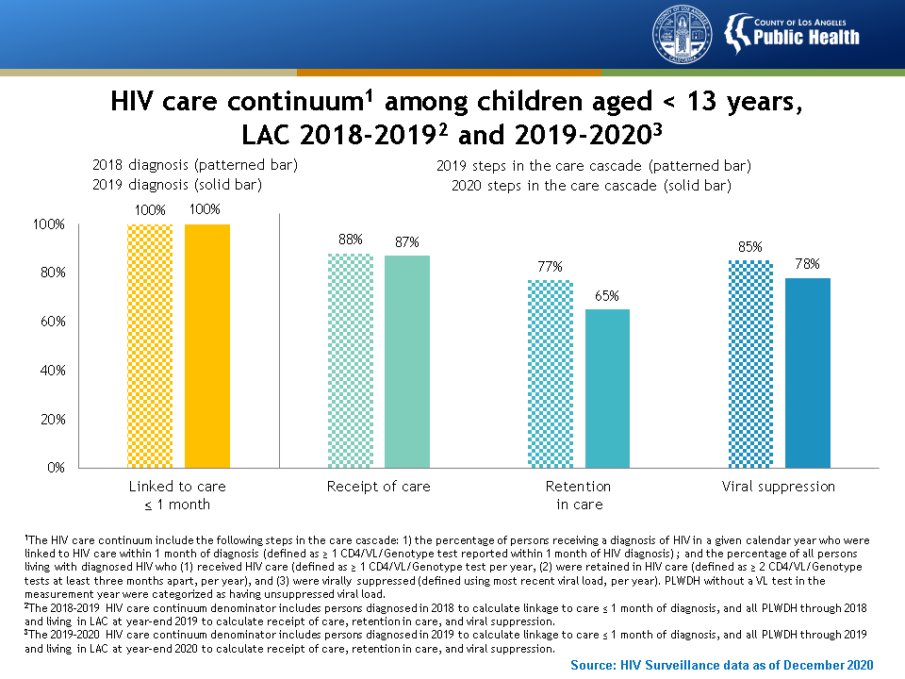
Notes:
This graph presents the HIV care continuum among children aged <13 years in Los Angeles County, 2018-2019 and 2019-2020. Children aged < 13 years fare better than adolescents and adults at key steps along the continuum of HIV care: 100% of children diagnosed with HIV in 2018 and 2019 were linked to HIV care within 1 month. However, similar to adults, receipt of care, retention in care, and viral suppression declined in 2020 compared to 2019.
The HIV care continuum include the following steps in the care cascade: 1) the percentage of persons receiving a diagnosis of HIV in a given calendar year who were linked to HIV care within 1 month of diagnosis (defined as ≥ 1 CD4/VL/Genotype test reported within 1 month of HIV diagnosis) ; and the percentage of all persons living with diagnosed HIV who (1) received HIV care (defined as ≥ 1 CD4/VL/Genotype test per year, (2) were retained in HIV care (defined as ≥ 2 CD4/VL/Genotype tests at least three months apart, per year), and (3) were virally suppressed (defined using most recent viral load, per year). PLWDH without a VL test in the measurement year were categorized as having unsuppressed viral load.
The 2018-2019 HIV care continuum denominator includes persons diagnosed in 2018 to calculate linkage to care ≤ 1 month of diagnosis, and all PLWDH through 2018 and living in LAC at year-end 2019 to calculate receipt of care, retention in care, and viral suppression.
The 2019-2020 HIV care continuum denominator includes persons diagnosed in 2019 to calculate linkage to care ≤ 1 month of diagnosis, and all PLWDH through 2019 and living in LAC at year-end 2020 to calculate receipt of care, retention in care, and viral suppression.

Slide 50
Notes:
This graph presents the HIV care continuum among persons aged ≥13 years in Los Angeles County, by housing status at the time of HIV diagnosis, 2019-2020. With the exception of linking to HIV care, unhoused persons had poorer outcomes in the HIV care continuum compared with housed persons, with greatest disparities observed in viral suppression.
Linkage to care: numerator includes persons newly diagnosed with HIV in 2019 with ≥1 CD4/VL/Genotype test reported within 1 month of HIV diagnosis; denominator includes persons who were diagnosed with HIV in 2019.
Receipt of care: numerator includes PLWDH with ≥1 CD4/VL/Genotype test in 2020; denominator includes PLWDH diagnosed through 2019 and living in LAC at year-end 2020 based on most recent residence.
Retention in care: numerator includes PLWDH with ≥2 CD4/VL/Genotype tests at least 3 months apart in 2020; denominator includes PLWDH diagnosed through 2019 and living in LAC at year-end 2020 based on most recent residence.
Viral suppression: numerator includes PLWDH whose last L test in 2020 was suppressed (HIV-1 RNA < 200 copies/mL); denominator includes PLWDH diagnosed through 2019 and living in LAC at year-end 2020 based on most recent residence. PLWDH without a VL test in 2020 were categorized as having unsuppressed viral load.

Slide 51
Notes:
Linkage to HIV care is the first step in the HIV care continuum. It is the necessary precursor for receiving antiretroviral therapy to treat HIV infection. Linkage to HIV care is typically tracked as being linked to HIV care within 1 month of HIV diagnosis. However, initiating HIV care services should occur faster, ideally within days, to ensure that treatment of HIV infection can be started immediately.
The national goal for linkage to HIV care is to increase the percentage of newly diagnosed persons that are linked to care within 1 month to at least 85%. This means that the percentage of newly diagnosed persons that are not linked to care within 1 month should not exceed 15%. The local target for Los Angeles County is for at least 85% of persons with diagnosed HIV to be linked to care within 1 week.

Slide 52
Notes:
This graph presents time from HIV diagnosis to linkage to care among persons aged ≥13 years in Los Angeles County from 2010 to 2019, by year of HIV diagnosis. Though timeliness of linkage to care has improved over time, only 77% of persons who were newly diagnosed in 2019 were linked to HIV care within 1 month and only 54% were linked to HIV care within 1 week.
Data includes persons diagnosed with HIV in each calendar year with ≥1 CD4/VL/Genotype test reported within 1 and 2 weeks, as well as 1, 3, 6, and 12 months of diagnosis.
Due to reporting delay, 2019 HIV linkage to care data are provisional as indicated by the dashed line.

Slide 53
Notes:
This graph presents persons not linked to care within 1 month of HIV diagnosis among those aged ≥13 years newly diagnosed with HIV in Los Angeles County in 2019, by selected demographic and risk characteristics. Among persons newly diagnosed with HIV in 2019, groups that were more likely not to be linked to HIV care within 1 month of diagnosis were females (35%), Blacks (28%), persons aged >19 years (22% to 25%) and persons with heterosexual (34%) and IDU (32%) transmission risk.
Not linked to care: numerator includes persons newly diagnosed with HIV in 2019 with no CD4/VL/Genotype test reported within 1 month of HIV diagnosis; denominator includes persons who were diagnosed with HIV in 2019.
Other race/ethnicity includes American Indians, Alaskan Natives, Pacific Islanders, persons of multiple race/ethnicities, and persons with unknown race/ethnicity.

Slide 54
Notes:
This graph presents the persons aged ≥13 years newly diagnosed with HIV in 2019 and the percent not linked to care within 1 month in Los Angeles County, by Health District. Only one of twenty-six Health Districts (Glendale) met the national target for timely linkage to HIV care (no less than 15% of persons newly diagnosed with HIV not linked to care within 1 month). Lowest achievement in linkages was observed in Northeast Health District where > 30% of cases were not linked within 1 month of HIV diagnosis. However, solutions for improving linkage to care are needed across LAC.
Not linked to care: numerator includes persons newly diagnosed with HIV in 2019 with no CD4/VL/Genotype test reported within 1 month of HIV diagnosis; denominator includes persons who were diagnosed with HIV in 2019.
Health Districts are based on 2012 boundaries.

Slide 55
Notes:
Entering and staying in HIV care is necessary to ensure that adherence to HIV treatment occurs and viral suppression is achieved. The following figures track how LAC performed with respect to receipt of care, retention in care, and viral suppression in 2020 across different populations of PLWDH. Identifying disparities allows us to determine whether interventions are needed to help people stay in care, get back in care, and ensure they are taking their medication as prescribed.

Slide 56
Notes:
This graph presents receipt of care, retention in care, and viral suppression by gender among persons aged ≥13 years diagnosed with HIV through 2019 and living in LAC at year-end 2020. The percentage of PLWDH who were receiving HIV care, retained in care, and virally suppressed in 2020 were similar across gender groups.
Receipt of care: numerator includes PLWDH with ≥1 CD4/VL/Genotype test in 2020; denominator includes PLWDH diagnosed through 2019 and living in LAC at year-end 2020 based on most recent residence.
Retention in care: numerator includes PLWDH with ≥2 CD4/VL/Genotype tests at least 3 months apart in 2020; denominator includes PLWDH diagnosed through 2019 and living in LAC at year-end 2020 based on most recent residence.
Viral suppression: numerator includes PLWDH whose last VL test in 2020 was suppressed (HIV-1 RNA < 200 copies/mL); denominator includes PLWDH diagnosed through 2019 and living in LAC at year-end 2020 based on most recent residence. PLWDH without a VL test in 2020 were categorized as having unsuppressed viral load.

Slide 57
Notes:
This graph presents receipt of care, retention in care, and viral suppression by age group among persons aged ≥13 years diagnosed with HIV through 2019 and living in LAC at year-end 2020. Adolescents had better HIV care outcomes than their counterparts in 2020, while persons aged 30-39 years and 40-49 years had the poorest outcomes across the care cascade.
Receipt of care: numerator includes PLWDH with ≥1 CD4/VL/Genotype test in 2020; denominator includes PLWDH diagnosed through 2019 and living in LAC at year-end 2020 based on most recent residence.
Retention in care: numerator includes PLWDH with ≥2 CD4/VL/Genotype tests at least 3 months apart in 2020; denominator includes PLWDH diagnosed through 2019 and living in LAC at year-end 2020 based on most recent residence.
Viral suppression: numerator includes PLWDH whose last VL test in 2020 was suppressed (HIV-1 RNA < 200 copies/mL); denominator includes PLWDH diagnosed through 2019 and living in LAC at year-end 2020 based on most recent residence. PLWDH without a VL test in 2020 were categorized as having unsuppressed viral load.

Slide 58
Notes:
This graph presents receipt of HIV care, retention in HIV care, and viral suppression by race/ethnicity among persons aged ≥13 years diagnosed with HIV through 2019 and living in LAC at year-end 2020. Across the continuum, Blacks had the worst HIV care outcomes compared with other groups.
Other race/ethnicity includes American Indians, Alaskan Natives, Pacific Islanders, persons of multiple race/ethnicities, and persons with unknown race/ethnicity.
Receipt of care: numerator includes PLWDH with ≥1 CD4/VL/Genotype test in 2020; denominator includes PLWDH diagnosed through 2019 and living in LAC at year-end 2020 based on most recent residence.
Retention in care: numerator includes PLWDH with ≥2 CD4/VL/Genotype tests at least 3 months apart in 2020; denominator includes PLWDH diagnosed through 2019 and living in LAC at year-end 2020 based on most recent residence.
Viral suppression: numerator includes PLWDH whose last VL test in 2020 was suppressed (HIV-1 RNA < 200 copies/mL); denominator includes PLWDH diagnosed through 2019 and living in LAC at year-end 2020 based on most recent residence. PLWDH without a VL test in 2020 were categorized as having unsuppressed viral load.

Slide 59
Notes:
This graph presents the percentage of persons with receipt of HIV care, retention in care, and viral suppression by transmission risk among persons aged ≥13 years diagnosed with HIV through 2019 and living in LAC at year-end 2020. Persons whose HIV transmission risk is IDU, followed by MSM-IDU, had the greatest disparities in HIV care, with lowest levels of receipt of care, retention in care, and viral suppression.
Receipt of care: numerator includes PLWDH with ≥1 CD4/VL/Genotype test in 2020; denominator includes PLWDH diagnosed through 2019 and living in LAC at year-end 2020 based on most recent residence.
Retention in care: numerator includes PLWDH with ≥2 CD4/VL/Genotype tests at least 3 months apart in 2020; denominator includes PLWDH diagnosed through 2019 and living in LAC at year-end 2020 based on most recent residence.
Viral suppression: numerator includes PLWDH whose last VL test in 2020 was suppressed (HIV-1 RNA < 200 copies/mL); denominator includes PLWDH diagnosed through 2019 and living in LAC at year-end 2020 based on most recent residence. PLWDH without a VL test in 2020 were categorized as having unsuppressed viral load.
Other transmission risk includes perinatal, hemophilia, coagulation disorder, blood transfusion, and risk factor not reported/identified. Persons without an identified risk factor were assigned a risk factor using CDC-recommended multiple imputation methods.

Slide 60
Notes:
This graph presents trends in receipt of care, retention in care, and viral suppression between 2010 and 2020 among persons aged ≥13 years living in LAC at calendar year-end and diagnosed with HIV through the previous calendar year. There has been minimal improvement in the HIV continuum of care over the last decade, with improvements only seen in viral suppression (+6 points). Due to the impact of COVID-19 on health care service delivery, the percentage for all HIV care outcomes declined from 2019 to 2020.
Receipt of care: numerator includes PLWDH with ≥1 CD4/VL/Genotype test in the calendar year; denominator includes PLWDH diagnosed through the previous calendar year and living in LAC at calendar year-end based on most recent residence.
Retention in care: numerator includes PLWDH with ≥2 CD4/VL/Genotype tests at least 3 months apart in the calendar year; denominator includes PLWDH diagnosed through the previous calendar year and living in LAC at calendar year-end based on most recent residence.
Viral suppression: numerator includes PLWDH whose last VL test in the calendar year was suppressed (HIV-1 RNA<200 copies/mL); denominator includes PLWDH diagnosed through the previous calendar year and living in LAC at calendar year-end based on most recent residence. PLWDH without a VL test in the calendar year were categorized as having unsuppressed viral load.
Due to reporting delay, 2020 HIV data are provisional as indicated by the dashed line.

Slide 61
Notes:
Antiretroviral therapy (ART) coverage is not routinely monitored as a step in the HIV care continuum as treatment is presumed to occur once a patient is linked to care. Public Health collects supplemental information on a subset of persons newly diagnosed with HIV through the National Medical Monitoring Project (MMP) to better understand achievements and gaps in HIV treatment and other HIV care services for PLWDH.
The MMP is a national HIV surveillance system funded by the Centers for Disease Control and Prevention and implemented by local health departments. The aim of MMP is to provide locally and nationally representative data on behavioral and clinical outcomes in a sample of persons receiving HIV medical care. MMP uses a two-stage probability-based sampling strategy that draws from the National HIV Surveillance System (NHSS) to select survey participants. The first stage is selecting the geographic areas to participate, and the second stage is selecting adults diagnosed with HIV and reported to NHSS within those participating areas.

Slide 62
Notes:
This table presents antiretroviral therapy (ART) use among a sample of persons living with diagnosed HIV in Los Angeles County, by demographic and risk characteristics, Medical Monitoring Project (MMP). Between 2015-2018, there was high coverage of antiretroviral treatment (ART) and adherence to ART in a representative sample of PLWDH. Treatment uptake was lower than average for persons aged < 40 years and Blacks while adherence was lower than average among females, persons aged < 40 years, Blacks, and heterosexual persons.
From 2015 to 2018 MMP interviewed 647 adult persons living with HIV in Los Angeles County. Their responses reflect their experiences during the 12 months before their interview, unless otherwise noted. All data presented are weighted.

Slide 63
Notes:
This graph presents the percentage of newly diagnosed people who initiated ART treatment within 1 and 3 months of diagnosis among persons aged ≥ 13 years newly diagnosed with HIV in Los Angeles County from 2012 to 2019, by year of diagnosis. The time from diagnosis to starting HIV treatment is getting shorter. The probability of starting ART within 1 month of diagnosis increased from 26% in 2012 to 70% in 2019. The probability of initiating ART within 3 months of diagnosis increased from 59% in 2012 to 90% in 2019.
Data represent a subset of persons newly diagnosed with HIV and reported in LAC. It includes 4,616 persons newly diagnosed with HIV between 2012 and 2019 for whom ART initiation date is complete and excludes 10,081 persons newly diagnosed with HIV between 2012 and 2019 for whom ART initiation date is incomplete.

Slide 64
Notes:
Only 60% of PLWDH achieved viral suppression in 2020, highlighting the substantial shortfall we have in reaching the national goal of ≥ 80%. For maximum impact, viral suppression should be reached soon after HIV diagnosis, but this is dependent on how rapidly HIV-positive persons are linked into HIV care and receive HIV treatment.
Viral suppression is measured using the last viral load test for PLWDH in HIV care. However, this metric does not consider how soon after an HIV diagnosis PLWDH are reaching viral suppression and whether viral suppression is maintained over time. Moreover, it does not identify population disparities in viral suppression, all of which are needed to ensure that PLWDH can access and use the HIV services needed to achieve sustained viral suppression.
The following slides highlight where we are locally in our viral suppression achievements and highlights opportunities for where to target interventions to improve viral suppression in the population.

Slide 65
Notes:
This graph presents the time from diagnosis to viral suppression among persons aged ≥ 13 years living with diagnosed HIV in Los Angeles County from 2011 to 2019, by year of HIV diagnosis. Though time from HIV diagnosis to viral suppression has improved over time, LAC is still underperforming in this area, with only 55% of persons newly diagnosed with HIV in 2019 achieving viral suppression within 3 months.
Analysis includes persons newly diagnosed with HIV in each calendar year and living in LAC at year-end 2020 with or without VL testing. Numerator includes persons who achieved viral suppression within 3, 6, or 12 months of diagnosis. Denominator includes persons newly diagnosed with HIV in select calendar year, with or without a viral load test result in the observed months.
Due to reporting delay, 2019 HIV data are provisional as indicated by the dashed line.

Slide 66
Notes:
This graph presents the percentage of persons aged ≥ 13 years diagnosed with HIV through 2019 and living in LAC at year-end 2020 who had unsuppressed viral load, by selected demographic and risk characteristics. LAC is not within the target for viral suppression for PLWDH. In 2020, the largest disparities were observed among Blacks, persons aged 30-49 years, and persons with IDU and MSM-IDU transmission risk.
Unsuppressed viral load: numerator includes PLWDH whose last VL test in 2020 was unsuppressed (HIV-1 RNA ≥ 200 copies/mL); denominator includes PLWDH diagnosed through 2019 and living in LAC at year-end 2020 based on most recent residence. PLWDH without a VL test in 2020 were categorized as having unsuppressed viral load.
Other race/ethnicity includes American Indians, Alaskan Natives, Pacific Islanders, persons of multiple race/ethnicities, and persons with unknown race/ethnicity.

Slide 67
Notes:
This graph presents the number of persons aged ≥ 13 years diagnosed with HIV through 2019 and living in LAC at year-end 2020 and the percent with unsuppressed viral load, by LAC Health District. Unsuppressed viral load varies widely across LAC Health Districts. In 2020, no Health District achieved the national target for viral suppression (<20% with unsuppressed viral load). In several areas: Central, South, West, Southeast, and Hollywood-Wilshire Health Districts, over 40% of PLWDH were virally unsuppressed and therefore capable of transmitting HIV infection to others.
Unsuppressed viral load: numerator includes PLWDH whose last VL test in 2020 was unsuppressed (HIV-1 RNA ≥ 200 copies/mL); denominator includes PLWDH diagnosed through 2019 and living in LAC at year-end 2020 based on most recent residence. PLWDH without a VL test in 2020 were categorized as having unsuppressed viral load.
Health Districts are based on 2012 boundaries.

Slide 68
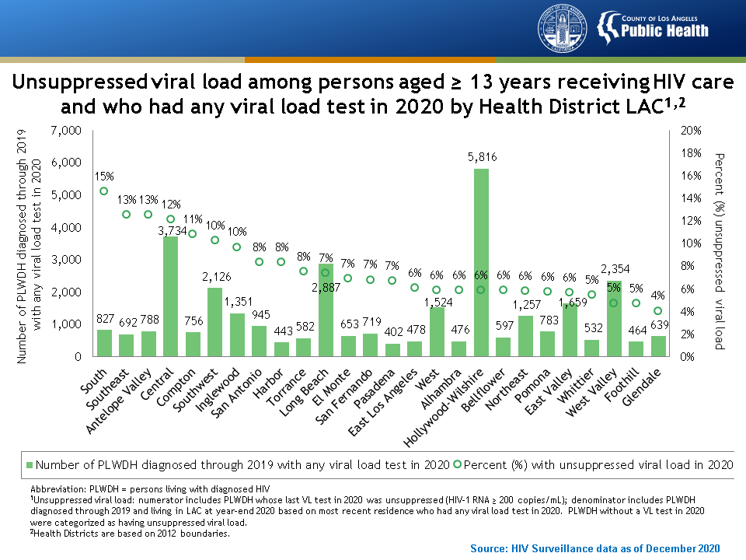
Notes:
This graph presents unsuppressed viral load among persons aged ≥ 13 years who had any viral load test in 2020, by LAC Health District. Once in care, the goal is for all PLWDH to achieve viral suppression as soon as possible. PLWDH do relatively well once they are receiving HIV care services. On average, nine in ten PLWDH with at least one viral load test in 2020 were suppressed. However, geographic analysis revealed disparities in South, Southeast, Antelope Valley, Central, Compton, Southwest, and Inglewood Health Districts, where higher percentage of PLWDH are virally unsuppressed.
Unsuppressed viral load: numerator includes PLWDH whose last VL test in 2020 was unsuppressed (HIV-1 RNA ≥ 200 copies/mL); denominator includes PLWDH diagnosed through 2019 and living in LAC at year-end 2020 based on most recent residence who had any viral load test in 2020. PLWDH without a VL test in 2020 were categorized as having unsuppressed viral load.
Health Districts are based on 2012 boundaries.

Slide 69
Notes:
This map presents unsuppressed viral load among those aged ≥ 13 years diagnosed with HIV through 2019 and living in Los Angeles County at year-end 2020, by census tract. Census tracts located in Central and Hollywood-Wilshire Health Districts had the highest levels of unsuppressed viral load. These are locations where a robust public health response is needed to identify networks of ongoing transmission and deploy rapid interventions to stop the chain of transmission. Other emerging hotspots of transmission that require close monitoring are in Southwest, Southeast, South, and Long Beach Health Districts.
Unsuppressed viral load: numerator includes PLWDH whose last VL test in 2020 was unsuppressed (HIV-1 RNA ≥ 200 copies/mL); denominator includes PLWDH diagnosed through 2019 and living in LAC at year-end 2020 based on most recent residence. PLWDH without a VL test in 2020 were considered virally unsuppressed. Analysis excludes PLWDH diagnosed through 2019 and living at year-end 2020 who (1) had missing census tract information, (2) were receiving care but never had a viral load test, (3) were not receiving care for >12 months at year-end 2020, or (4) were in census tracts with small sample sizes (<5 persons with unsuppressed viral load or population size <100 persons). Exclusions represented 69% of PLWDH diagnosed through 2019 and living in 2020 whose last viral load was unsuppressed.

Slide 70
Notes:
This table presents viral load dynamics among those aged ≥ 13 years living with diagnosed HIV and receiving HIV care in Los Angeles County between 2018 and 2020. Using the last viral load test, 91% of PLWDH in HIV care were virally suppressed. However, using the results of all viral load tests in a 3-year period, only 72% had sustained viral suppression (i.e., all viral loads suppressed). Populations with lowest levels of sustained viral suppression were transgender persons, Blacks, American Indians/Alaskan Natives (AI/AN) and persons aged 20-39 years.
Analysis includes PLWDH diagnosed through 2017, had ≥ 1 viral load test in 2018-2020 and living in LAC at year-end 2020.

Slide 71
Notes:
This section presents trends in cause of death and death rates among PLWDH.

Slide 72
Notes:
One of the most important goals in the public health response to HIV is for persons living with HIV to live long and healthy lives. Rapid access to and consistent use of high-quality services across the HIV care continuum is fundamental to achieving this goal.

Slide 73
Notes:
This graph presents age-adjusted death rates among persons aged ≥ 13 years living with diagnosed HIV in Los Angeles County, by cause of death, from 2006 to 2019. The age-adjusted death rate among persons diagnosed with HIV dropped 48% from 2006 to 2019. The rate attributed to HIV-related and non-HIV-related death declined by 69% and 13%, respectively.
Death rates were age-adjusted to the LAC 2010 population estimates. Persons newly diagnosed with HIV at death were excluded from the numerator. Includes persons with unknown cause of death (2.2% of all deaths).
Due to reporting delay, 2019 death rate data among PLWDH are provisional as indicated by the dashed line.

Slide 74
Notes:
This graph presents trends in main causes of death among persons aged ≥ 13 years living with diagnosed HIV in Los Angeles County from 1995 to 2019. The number of deaths among PLWDH decreased sharply following the introduction of highly active antiretroviral treatment and has remained stable at approximately 500-600 deaths per year for the past decade. HIV as the leading cause of death among PLWDH declined from 88% of deaths in 1995 to 35% of deaths in 2019. In contrast, diseases of the heart increased from 1% in 1995 to 17% in 2019, followed by cancer from 2% to 14%, and unintentional injuries from <1% to 11%.
Annual percentages may not add to 100% due to rounding error.

