Slide 1
Spatial Analysis of HIV and STD Disease Burden
Mike Janson, MPH
Chief, Research & Evaluation Division
Office of AIDS Programs and Policy

Slide 2
HIV Prevention Strategy
Assessing effective interventions tell us which strategies will make the most impact
Where should we focus our prevention efforts to make the largest impact with resources we have?

Slide 3
Spatial Analysis Background
Services historically prioritized by Service Planning Area (SPA)
  Disease burden geographical differences are not explained by SPA boundaries
  The use of GIS allows for small-area analysis and spatial epidemiological techniques
  Recent agreements to share HIV and STD case data have allowed for a more accurate picture of overall HIV/STD disease burden

Slide 4
Spatial Analysis Background
Opportunity to examine disease burden without regard to arbitrary boundaries
Analysis conducted without preconceived ideas about where clusters would occur related to SPAs

Slide 5

Service Planning Areas (SPAs)

Slide 6
HIV Positivity Rates by Service Planning Area (SPA), 2007
Source: HIRS, Calendar Year 2007
Notes:
This is an optional map slide. This map shows New Positivity HIV Rates by Service Planning Area for Calendar Year 2007.

Slide 7
SPA Planning Model
Assumes that burden of disease is fairly equal across the area of a given SPA

Slide 8
HIV Case Density, 2009, SPA 8
Very Low Density
Very High Density
Source: 2009 New HIV Cases, HIV Epidemiology Program

Slide 9
Syndemic Planning Model
Focuses on connections among cofactors of disease
Considers those connections when developing health policies
Aligns with other avenues of social change to assure the conditions in which all people can be healthy.
Notes:
Two or more afflictions, interacting synergistically, contributing to excess burden of disease in a population
Linked epidemics, interacting epidemics, connected epidemics, co-occurring epidemics, co-morbidities, and clusters of health-related crises

Slide 10
Syndemic Spatial Analysis
Analyze spatial relationships between multiple co-occurring epidemics
  HIV
  Syphilis
  Gonorrhea
  Hepatitis
Notes:
Two or more afflictions, interacting synergistically, contributing to excess burden of disease in a population
Linked epidemics, interacting epidemics, connected epidemics, co-occurring epidemics, co-morbidities, and clusters of health-related crises

Slide 11
Data Sources
Notes:
Two or more afflictions, interacting synergistically, contributing to excess burden of disease in a population
Linked epidemics, interacting epidemics, connected epidemics, co-occurring epidemics, co-morbidities, and clusters of health-related crises

Slide 12
2009 New HIV Cases
2,036 HIV cases
  1,858 (91.2%) provided some type of residence address
    1,731 (93.2% match rate) could be geocoded to exact location
    127 (6.8%) could be geocoded to the zip code centroid (included homeless and those who gave a PO Box)
  Exact location cases were included in the cluster analysis
  Centroid cases were not included in the preliminary analysis

Slide 13
2009 STD Cases
Syphilis
  2,641 cases geocoded by residence address
    1,042 (39.5%) reported HIV co-infection (self-report)
    1,597 (60.5%) reported no HIV
    2 cases had missing HIV results
Gonorrhea
  7,918 geocoded by residence address
  No HIV results available for this analysis

Slide 14
Cluster Analysis Methodology
Assess spatial distributions of HIV and STD cases
  Average Nearest Neighbor (ANN) statistic
    Calculates actual mean distance between cases and compares that mean to a hypothetical random distribution
    Statistic used to describe the variation in spatial data
    Are cases clustered or dispersed???

Slide 15
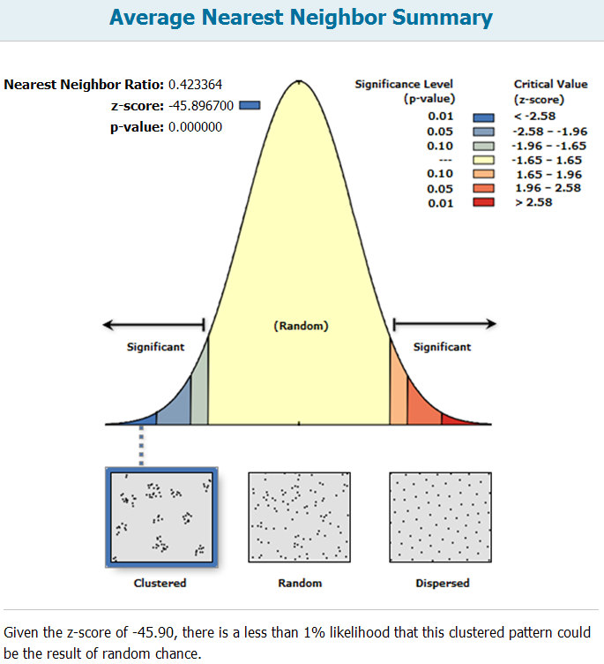
HIV Case Distribution,
2009

Slide 16
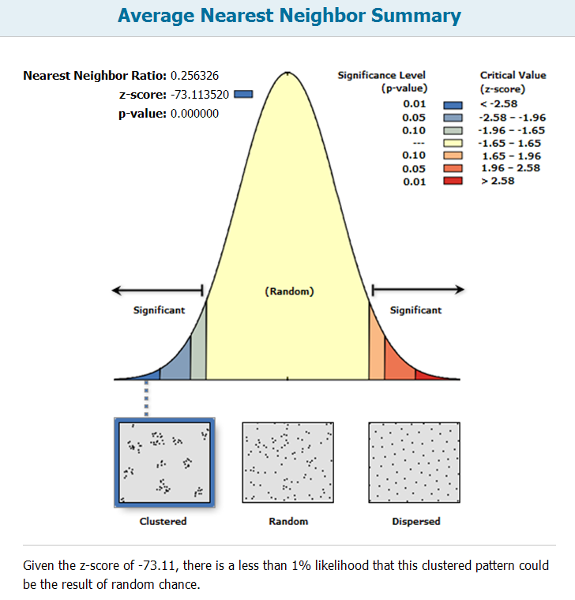
Syphilis Case
Distribution

Slide 17
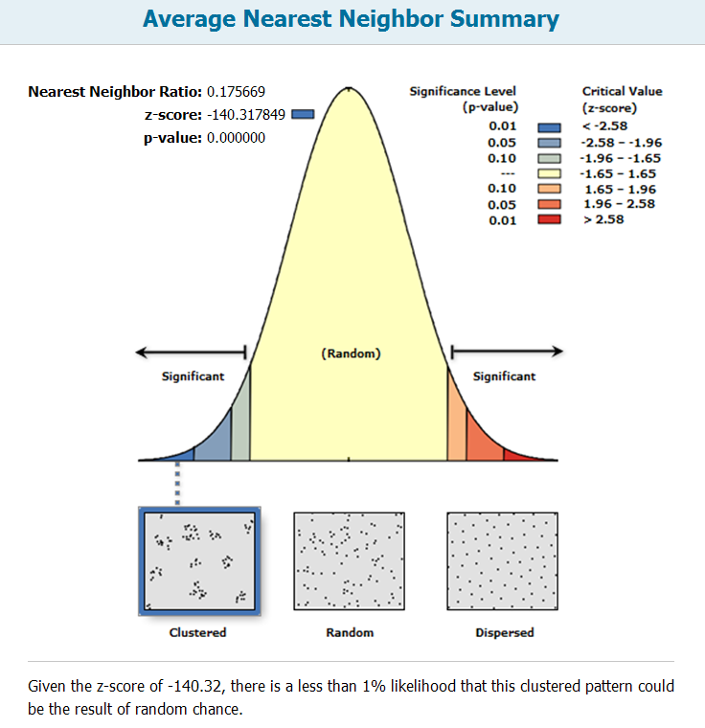
Gonorrhea Spatial Distribution

Slide 18
Cluster Analysis Methodology
Conclude that HIV and STD cases are clustered and that the clusters can not be explained by chance
Spatial characteristics are a factor in HIV and STD cases
Identify and locate clusters

Slide 19
Cluster Analysis Methodology
Nearest Neighbor Hierarchical Clustering (Nnh)
  Used when geographical characteristics are believed to be relevant to the health outcome (Smith, Goodchild, Longley, 2011)
  Cases are considered a cluster if they fall within the expected mean distance +/- a confidence interval obtained from the standard error (Mictchell, 2005)
  Can be single or multi-level

Slide 20
Nnh Clustering
Single-level
  Identifies the largest clusters at the County level
Multi-level
  Identifies multiple levels of clusters (County, city area, neighborhood)
Cluster Count Criteria
  Minimum 1% of cases

Slide 21
Preliminary Results

Slide 22
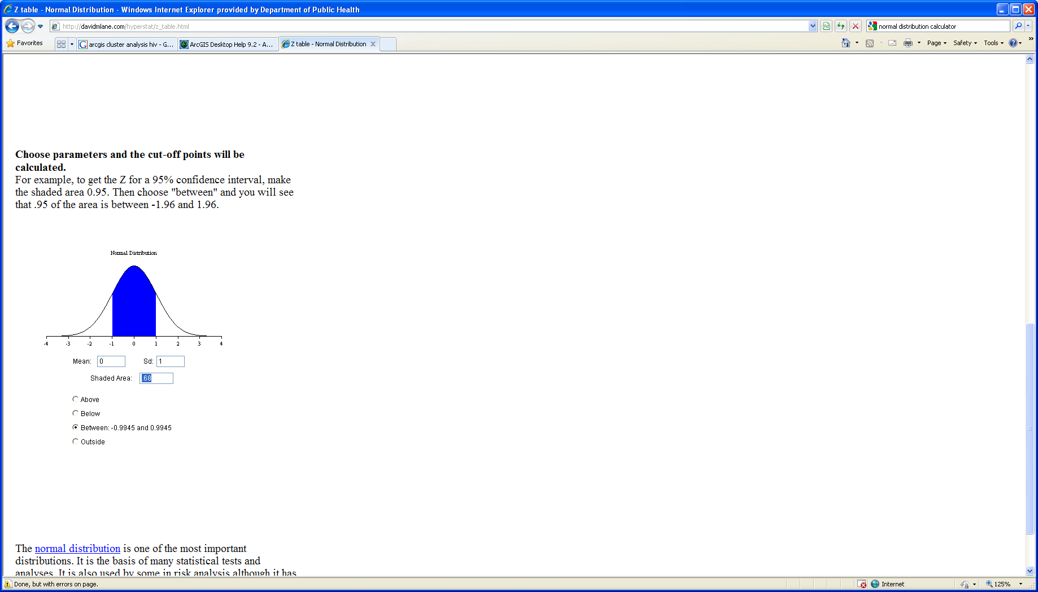
Nnh Cluster Analysis: 2009 New HIV Cases
68.2% of HIV Cases
Source: 2009 New HIV Cases, HIV Epidemiology Program
Notes:
This is an optional map slide. This map was developed from the HIV Epidemiology Program’s Semi Annual Surveillance Report and shows AIDS cases identified in CY2007 by Health District.

Slide 23
Nnh Cluster Analysis: 2009 Syphilis + HIV Cases*
68.2% of Syphilis-HIV Co-Infection Cases
Source: 2009 Syphilis Cases, STD Program
*HIV self-reported among Syphilis cases
Notes:
This is an optional map slide. This map was developed from the HIV Epidemiology Program’s Semi Annual Surveillance Report and shows AIDS cases identified in CY2007 by Health District.

Slide 24
Cluster Analysis: 2009 Syphilis w/o HIV Cases*
68.2% of Syphilis w/o HIV Cases
Source: 2009 Syphilis Cases, STD Program
*HIV self-reported among Syphilis cases
Notes:
This is an optional map slide. This map was developed from the HIV Epidemiology Program’s Semi Annual Surveillance Report and shows AIDS cases identified in CY2007 by Health District.

Slide 25
n=1,452
83.9% of HIV Cases in LAC
Source: 2009 new HIV cases, HIV Epidemiology Program; 2009 new STD cases, STD Program
Notes:
This is an optional map slide. This map was developed from the HIV Epidemiology Program’s Semi Annual Surveillance Report and shows AIDS cases identified in CY2007 by Health District.

Slide 26
Central Cluster, 2009 HIV and Syphilis Burden
HIV Demographic Summary
African-American | 27.8%
Men | 81.5%
Women | 18.5%
Latino | 44.4%
Men | 90.7%
Women | 9.3%
White | 23.8%
Men | 97.4%
Women | 2.6%
Disease Burden Summary
 | n | %
HIV | 861 | 46.3%
Syphilis + HIV | 642 | 58.5%
Syphilis no HIV | 712 | 44.6%
Gonorrhea | 3,330 | 42.1%
Notes:
This is an optional map slide. This map was developed from the HIV Epidemiology Program’s Semi Annual Surveillance Report and shows AIDS cases identified in CY2007 by Health District.

Slide 27
South Cluster, 2009 HIV and Syphilis Burden
HIV Demographic Summary
 | %
African-American | 24.5%
Men | 83.3%
Women | 16.7%
Latino | 44.2%
Men | 83.0%
Women | 17.0%
White | 26.7%
Men | 91.8%
Women | 8.2%
Disease Burden Summary
 | n | %
HIV | 318 | 18.4%
Syphilis + HIV | 94 | 9.0%
Syphilis no HIV | 222 | 13.9%
Gonorrhea | 1,613 | 20.4%
Notes:
This is an optional map slide. This map was developed from the HIV Epidemiology Program’s Semi Annual Surveillance Report and shows AIDS cases identified in CY2007 by Health District.

Slide 28
Northwest Cluster, 2009 HIV and Syphilis Burden
HIV Demographic Summary
African-American | 17.2%
Men | 64.3%
Women | 35.7%
Latino | 51.5%
Men | 89.4%
Women | 10.6%
White | 16.6%
Men | 84.4%
Women | 15.6%
Disease Burden Summary
 | n | %
HIV | 159 | 9.2%
Syphilis + HIV | 90 | 8.6%
Syphilis no HIV | 191 | 12.0%
Gonorrhea | 637 | 8.0%
Source: 2009 New HIV Cases, HIV Epidemiology Program; 2009 New Syphilis Cases, 2009 HIV Cases, STD Program
Notes:
This is an optional map slide. This map was developed from the HIV Epidemiology Program’s Semi Annual Surveillance Report and shows AIDS cases identified in CY2007 by Health District.

Slide 29
East Cluster, 2009 HIV and Syphilis Burden
HIV Demographic Summary
African-American | 11.5%
Men | 41.7%
Women | 58.3%
Latino | 52.0%
Men | 98.2%
Women | 1.8%
White | 26.9%
Men | 92.9%
Women | 7.1%
Disease Burden Summary
 | n | %
HIV | 114 | 6.6%
Syphilis + HIV | 61 | 5.8%
Syphilis no HIV | 118 | 7.4%
Gonorrhea | 439 | 5.5%
Source: 2009 New HIV Cases, HIV Epidemiology Program; 2009 New Syphilis Cases, 2009 HIV Cases, STD Program
Notes:
This is an optional map slide. This map was developed from the HIV Epidemiology Program’s Semi Annual Surveillance Report and shows AIDS cases identified in CY2007 by Health District.

Slide 30
North Cluster, 2009 HIV and Syphilis Burden
HIV Demographic Summary
African-American | 26.1%
Men | 66.7%
Women | 33.3%
Latino | 34.7%
Men | 87.5%
Women | 12.5%
White | 26.1%
Men | 67.7%
Women | 33.3%
Disease Burden Summary
 | n | %
HIV | 22 | 1.3%
Syphilis + HIV | <5 | -%
Syphilis no HIV | 14 | 1.0%
Gonorrhea | 237 | 3.0%
Notes:
This is an optional map slide. This map was developed from the HIV Epidemiology Program’s Semi Annual Surveillance Report and shows AIDS cases identified in CY2007 by Health District.

Slide 31
Additional Spatial Factors
Co-factors for HIV
  Meth use
  Alcohol use
  Poverty
Indicators of risk
  Community Viral Load

Slide 32
Source: American Community Survey, 5-year estimates, U.S. Census

Slide 33
Getis-Ord Gi* calculated at 6,000 foot threshold using the zone of indifference spatial conceptualization
Source: American Community Survey, 5-year estimates, U.S. Census

Slide 34
Community Viral Load (cVL)
Population-based measure of community’s viral burden (community = Ryan White patients)
Potential biologic indicator of effectiveness:
  Antiretroviral treatment
  HIV prevention
Definitions:
  Analysis of most recent VL of clients in the RW system
  Mean VL: Average of each clients most recent VL

Slide 35
Source: Ryan White Treatment Data, March, 2009 – February ,2010

Slide 36
Source: Ryan White Treatment Data, March, 2009 – February ,2010

Slide 37
Cluster Areas and HIV Testing Sites, 2009
Source: 2009 HIV Testing Sites, OAPP
Notes:
This is an optional map slide. This map was developed from the HIV Epidemiology Program’s Semi Annual Surveillance Report and shows AIDS cases identified in CY2007 by Health District.

Slide 38
Cluster Areas and Medical Outpatient Sites, 2009
Source: 2009 Ryan White Medical Outpatient Sites, OAPP
Notes:
This is an optional map slide. This map was developed from the HIV Epidemiology Program’s Semi Annual Surveillance Report and shows AIDS cases identified in CY2007 by Health District.

Slide 39
Central Cluster and HIV Testing Sites, 2009
Source: 2009 HIV Testing Sites, OAPP
Notes:
This is an optional map slide. This map was developed from the HIV Epidemiology Program’s Semi Annual Surveillance Report and shows AIDS cases identified in CY2007 by Health District.

Slide 40
Next Steps
Analyze additional co-factors
  Meth use
  Hepatitis B/C
Analyze service allocation and compare with disease burden

Slide 41
Limitations
Spatial Model limited to new cases for 2009
Assumes that infection occurs within resident case clusters
Co-infection data not included for all HIV cases

Slide 42
Recommendations
Include multiple years of new cases to assess trends
Include prevalence cases
Match STD case data with HIV case data for all HIV cases
Use multi-level clustering to identify smaller clusters within larger clusters

Slide 43
References
Mitchell, Andy. The ESRI Guide to GIS Analysis Volume 2: Spatial Measurements & Statistics. 1st Edition. Redlands (CA): ESRI Press; 2005.
2. de Smith, Michael J; Goodchild, Michael F; Longley, Paul A. Geospatial Analysis: A Comprehensive Guide to Principles, Techniques and Software Tools. 3rd Edition. UK: Splint Spatial Literacy in Teaching; 2011

