Slide 1
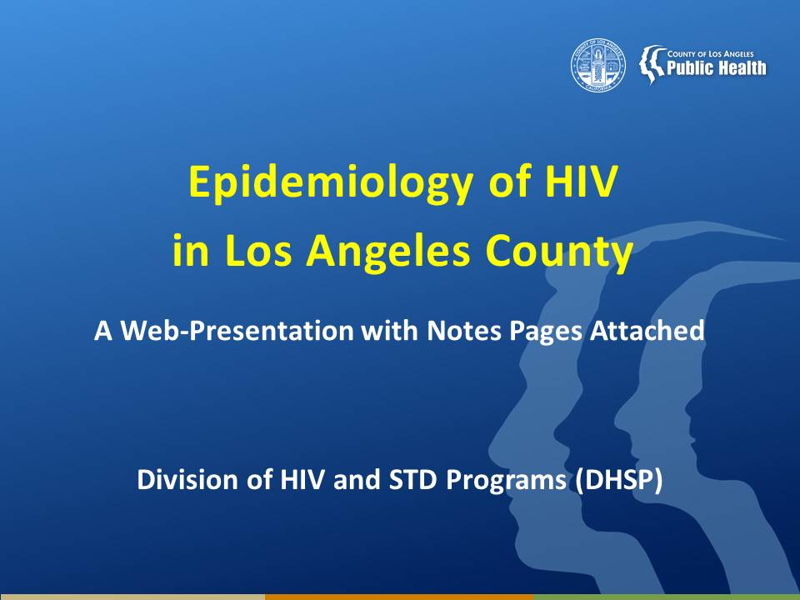
Notes:
This presentation is intended to provide a general overview of the epidemiology of Human Immunodeficiency Virus (HIV) Disease in Los Angeles County (LAC).
Data are provided by the Division of HIV and STD Programs (DHSP)/ HIV Epidemiology located at 600 South Commonwealth Avenue, Suite 1260, Los Angeles, CA 90005.
Notes are provided for each slide, intending to provide a clear interpretation of the data presented on the slides.
Please note that data for years 2011 through 2013 are provisional due to reporting delays.
If you need additional data, please complete our online data request form available on our website at http://publichealth.lacounty.gov/dhsp/DataRequest.htm

Slide 2
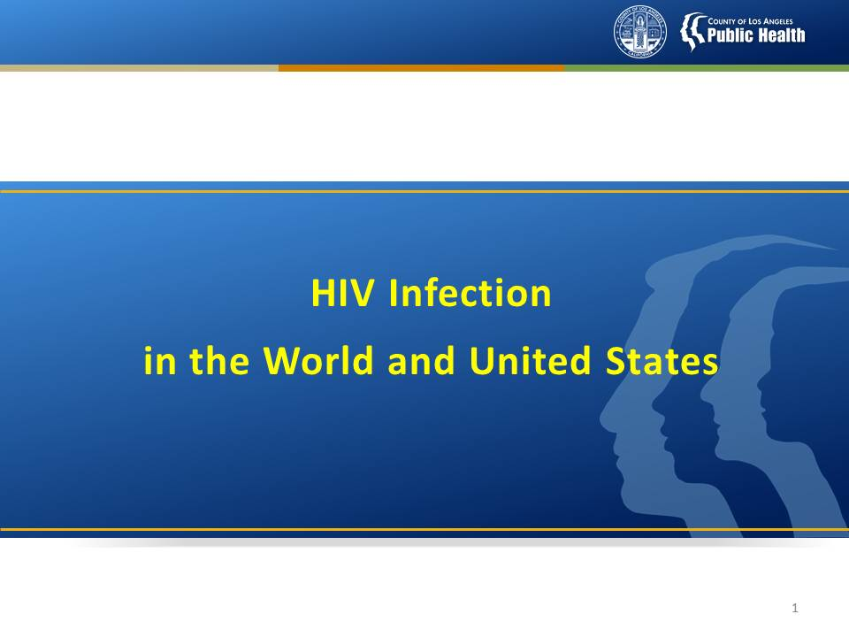
Notes:
The HIV infection pandemic is a widespread disease that affects all parts of the globe. These first few slides are intended to put the local epidemic into a national and worldwide context.
It is important to note that the HIV infection epidemic in the U.S. is not uniform. The demographics and risk exposures of those affected by HIV infection in the U.S. varies greatly depending upon region -- from injection drug users in the northeast cities to Blacks in the rural South to men who have sex with men (MSM) in the West.
So applying national statistics to localized communities is likely to lead to a misrepresentation of the local epidemic. Therefore, when referencing HIV infection data to describe local groups impacted by HIV infection, be sure to reference local data.

Slide 3
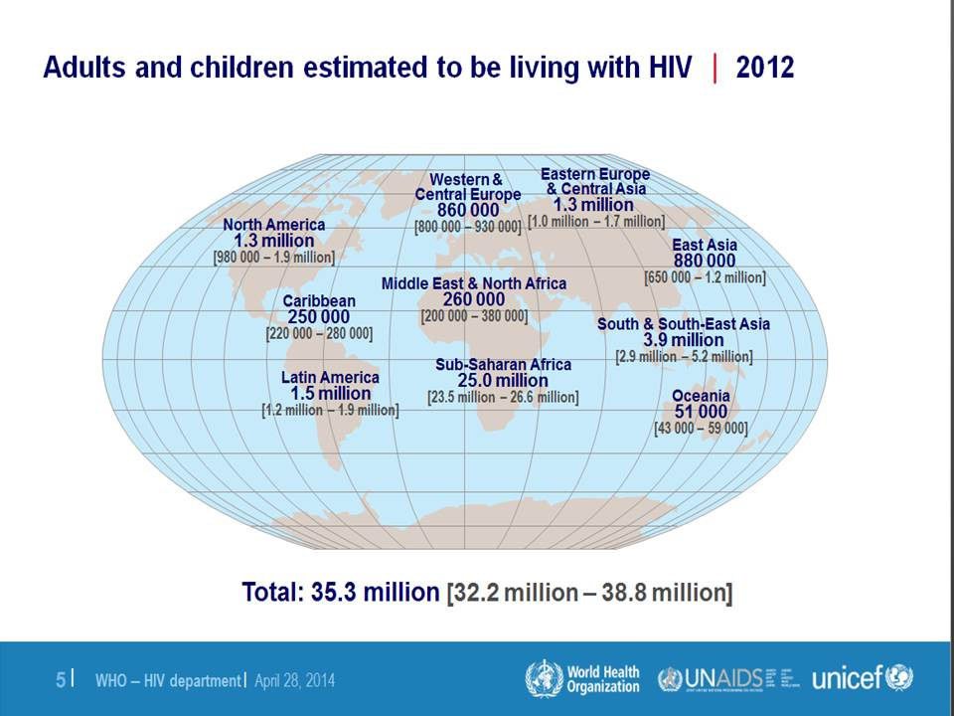
Notes:
This slide shows the estimated number of adults and children living with HIV at the end of 2012, by region of the world.
Globally, Sub-Saharan Africa has been affected the greatest with an estimated 25.0 million adults and children living with HIV infection at year-end 2012. As the reporting of HIV infection in Asian nations begins to gain momentum, higher numbers are expected from these regions as well. North America and Latin America have over one million people affected.
Please note that this slide does not take into account the proportion of individuals affected within each region. The numbers are total numbers by region. Comparisons are made based on total numbers.

Slide 4
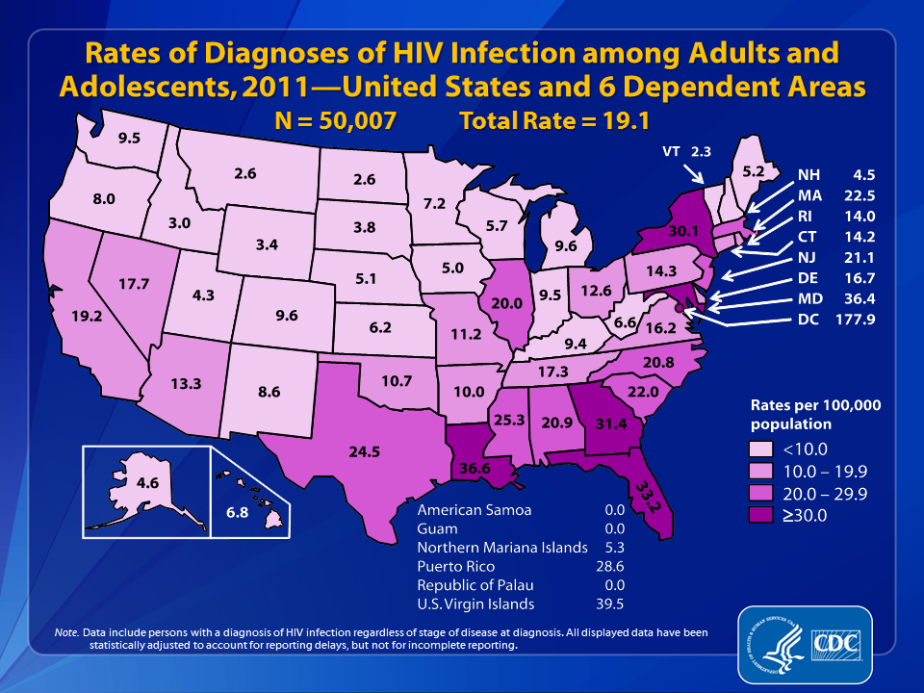
LAC*
23.3
* Based on LAC’s reported rate .
Notes:
This slide from the Centers for Disease Control (CDC) shows the estimated rates of diagnoses of HIV infection among adults and adolescents in 2011 for each state and six dependent areas expressed as the number of reported HIV cases per 100,000 persons.
In 2011, the estimated total rate (for the United States and six dependent areas) of diagnosed HIV infection among adults and adolescents was 19.1 per 100,000 population.
State rates (per 100,00) are displayed using shades of pink, with the darkest pink representing the highest rates (equal to or greater than 30.0 per 100,000), and the lightest pink representing the lowest rates (less than 10.0 per 100,000).
At the end of 2011, among states (not including dependent areas and D.C.), Louisiana had the highest rate of diagnoses of HIV infection with 36.6 cases per 100,000, while Vermont had the lowest rate with 2.3 cases per 100,000.
The diagnoses rate of HIV infection among adults and adolescents reported for 2011 in Los Angeles County (LAC) (23.3 per 100,000) is higher than that in California as a whole (19.2 per 100,000) and the national level (19.1 per 100,000).
The District of Columbia (i.e., Washington, DC) is a city; please use caution when comparing the HIV diagnoses rate in DC with the rates in states.
Data include persons with a diagnosis of HIV infection regardless of stage of disease at diagnosis. All displayed data are estimates. Estimated numbers resulted from statistical adjustment that accounted for reporting delays, but not for incomplete reporting.

Slide 5
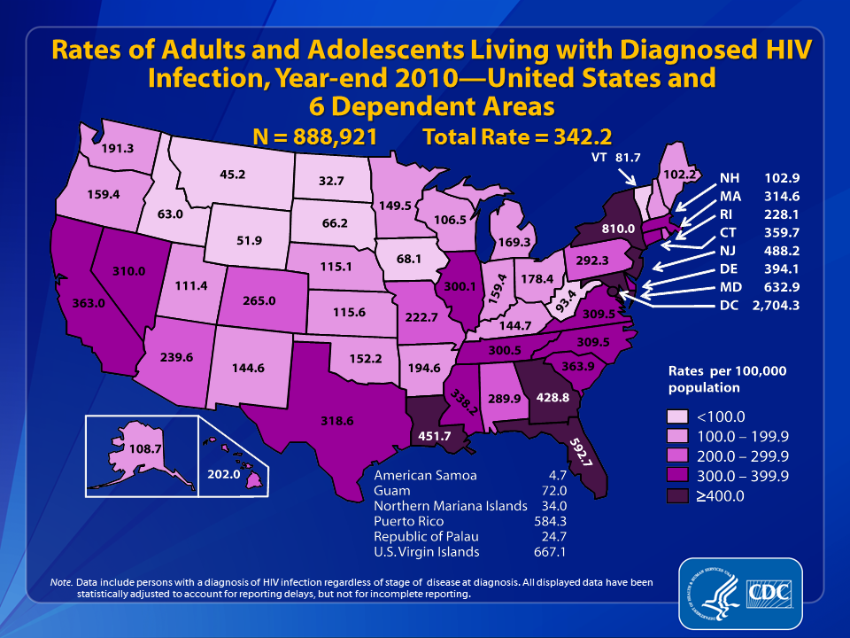
LAC*
532.0
* Based on LAC’s reported rate .
Notes:
This slide from the Centers for Disease Control (CDC) shows the estimated rate of adults and adolescents living with diagnosed HIV infection at year-end 2010 in each state and six dependent areas expressed as the number of people living with HIV infection per 100,000 persons.
At year-end 2010, the estimated total rate (for the United States and 6 dependent areas) of adults and adolescents living with diagnosed HIV infection was 342.2 per 100,000 population.
State rates (per 100,00) are displayed using a single hue sequential color scheme of pink, with the darkest pink representing the highest rates (equal to or greater than 400.0 per 100,000), and the lightest pink representing the lowest rates (less than 100.0 per 100,000).
At year-end 2010, among states (not including dependent areas and D.C.), New York had the highest rate of people living with diagnosed HIV infection (810.0 cases per 100,000), and North Dakota had the lowest rate (32.7 cases per 100,000). The rate of people living with a diagnosed HIV infection at year-end 2010 for Los Angeles County (LAC) (532 per 100,000) is much greater than that for California as a whole (363.0 per 100,000) and the national level (342.2 per 100,000).
The District of Columbia (i.e., Washington, DC) is a city; please use caution when comparing the rate of persons living with diagnosed HIV infection in DC with the rates in states.
Data include persons with a diagnosis of HIV infection regardless of stage of disease at diagnosis. All displayed data are estimates. Estimated numbers resulted from statistical adjustment that accounted for reporting delays, but not for incomplete reporting.
Persons living with a diagnosis of HIV infection are classified as adult or adolescent based on age at year-end 2010.

Slide 6
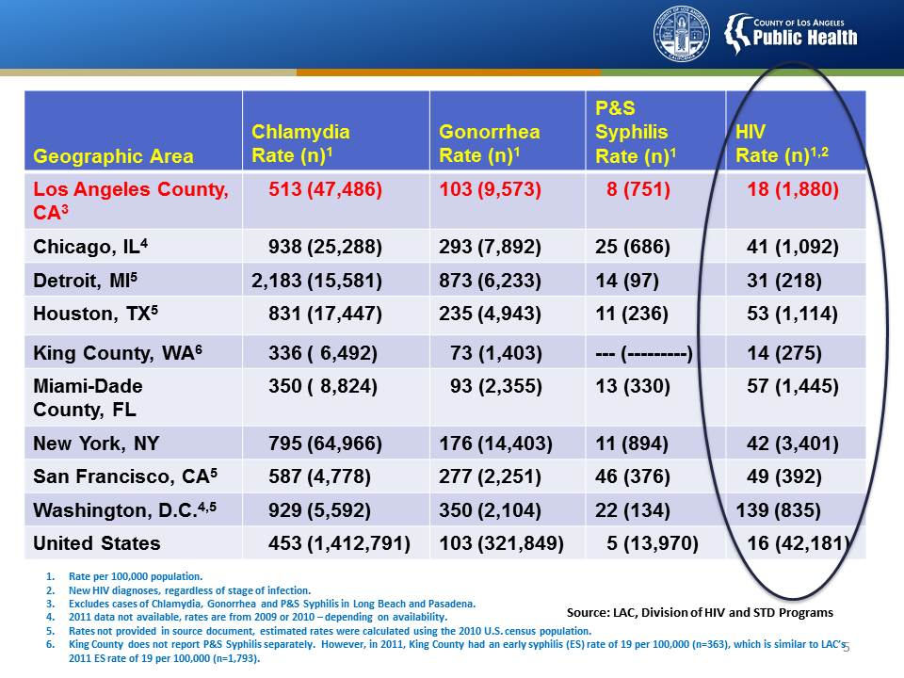
Notes:
This slide shows the numbers and rates (per 100,000) for CT, GC, P&S SY and HIV in 9 large urban cities or counties in the US in 2011, the latest year that data are available for many of these areas. Los Angeles County is shown at the top (in red) and the overall U.S. rates are shown at the bottom.
Of the areas shown, LAC and New York have the highest numbers of cases for all three STDs. The number of HIV cases are more evenly distributed with several cities reporting numbers similar to LAC, but well below New York.
However, if we look at rates of disease, which take into account population size, then we see that LAC has lower rates of STDs and HIV than most other large urban areas.
Overall, although LAC has a large HIV infection epidemic, we seem to be faring better than other big cities/counties in the US.

Slide 7
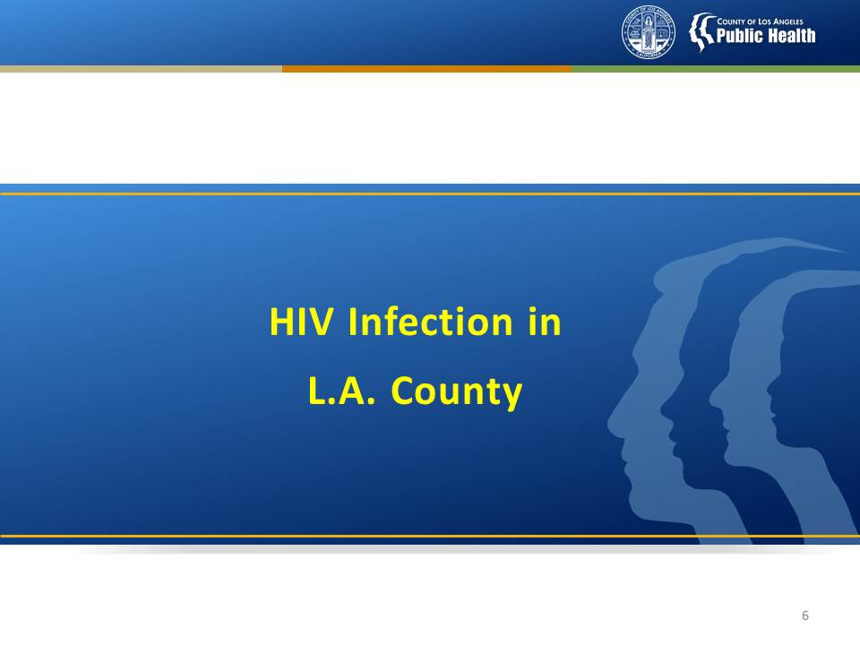

Slide 8
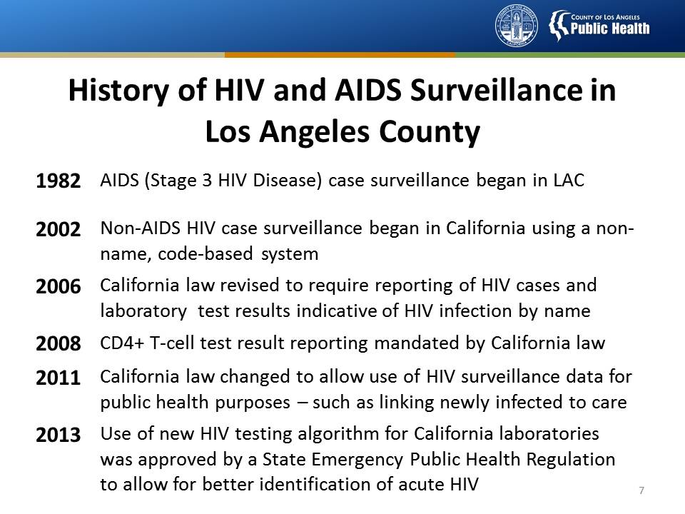

Slide 9
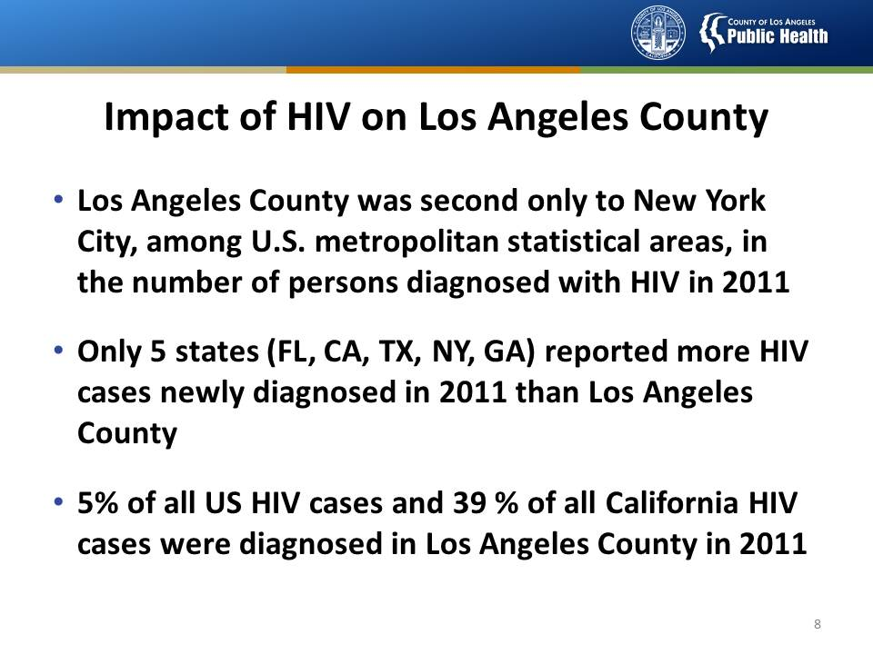
Notes:
Impact of HIV - Los Angeles County in 2011
In 2011, Los Angeles County is second only to New York among metropolitan areas in number of persons diagnosed with HIV infection.
In 2011, only five states have diagnosed more HIV cases than Los Angeles County (LAC): Florida (FL), California (CA), Texas (TX), New York (NY) and Georgia (GA).
In 2011, 39 percent (1,872/4785) of all California HIV cases were diagnosed in Los Angeles County
The above numbers and comparisons were based on CDC HIV Surveillance Report, Vol 23.

Slide 10
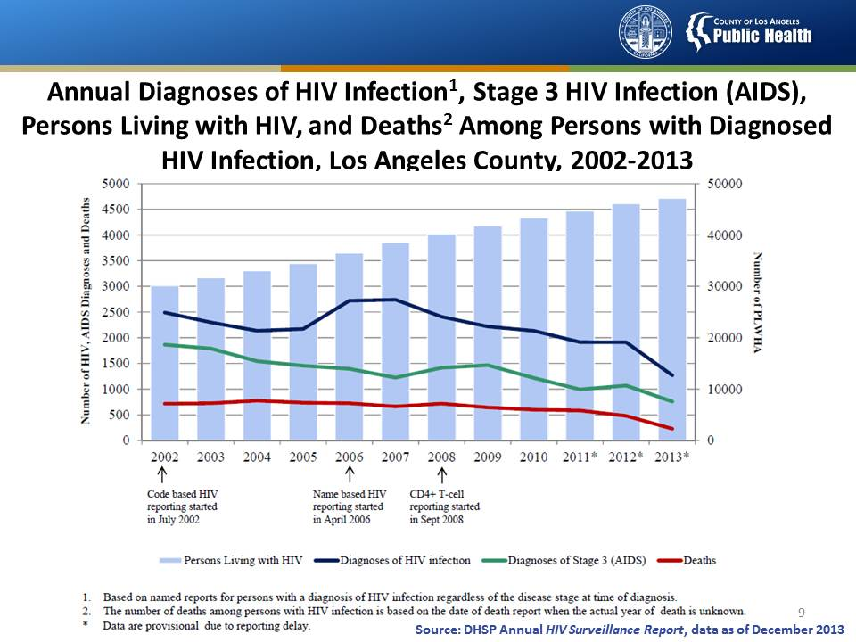
Notes:
This slide shows the trends of persons living with HIV, annual diagnoses of stage 3 (AIDS), annual diagnoses of HIV infection, and annual number of deaths among persons with an HIV infection (regardless of severity of disease) from 2002 through 2013 in Los Angeles County. Data for 2011 through 2013 are provisional due to reporting delays.
The number of persons living with HIV, depicted by the light blue vertical bars , has a steadily increasing trend from 30,000 in 2002 to 47,000 in 2013.
The annual number of persons diagnosed with an HIV infection are , depicted by the blue line , has fluctuated over time.
In California, non-named code HIV case reporting began in July 2002 and named HIV case reporting began in April 2006. During the first few years of HIV reporting, many HIV cases (persons who had been diagnosed with HIV prior to 2006) were likely misclassified as a new HIV diagnosis in recent years (especially in 2006 and 2007), since a complete patient history on HIV might not have been available to the persons who completed the case report forms. Therefore, the “bump” in the number of reported cases seen for years 2006 and 2007 could likely be caused by the change in reporting regulations and should not be interpreted as a real increase in newly diagnosed HIV disease. Therefore, the data cannot be used to draw conclusions on the trends for HIV infection.
Annual stage 3 (AIDS) diagnoses, depicted by the green line, have been steadily decreasing since 2002. A slight increase in the number of new stage 3 (AIDS) diagnoses 2008 through 2009 may be attributed to the implementation of CD4 T-cell count reporting in September 2008.
Annual death among persons diagnosed with HIV infection, depicted by the red line, has a decreasing trend since 2008.

Slide 11
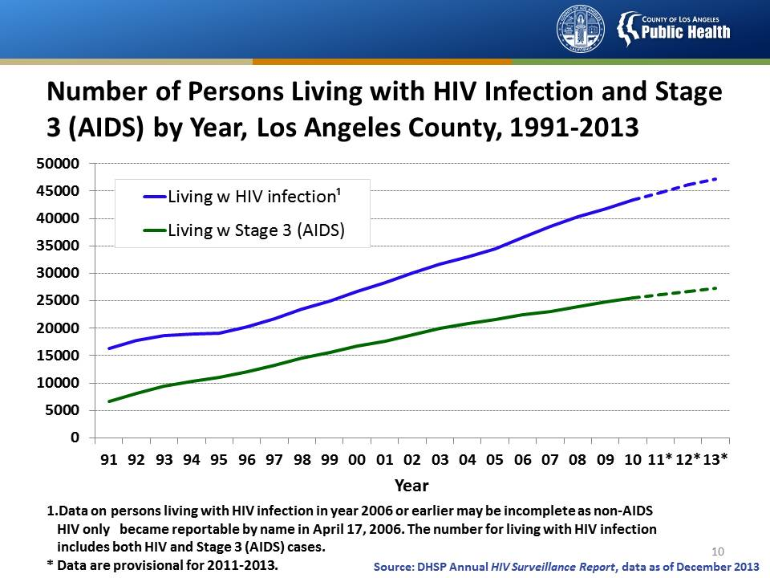
Notes:
This slide shows the trends of the number of persons living with HIV infection and stage 3 (AIDS) alone, by year, in Los Angeles County, from 1991 through 2013.
The number of persons living with HIV infection and stage 3 (AIDS) alone, depicted by the blue and green lines, respectively, has grown steadily since 1991.
Beginning in 1996, there is an increasingly widening gap between the number of persons living with stage 3 (AIDS) and those living with HIV infection. It is due in part to the success of highly active antiretroviral therapies, introduced in 1996, which has delayed the time of persons with HIV progress to stage 3 (AIDS). The other reason is in California, non-AIDS HIV case surveillance was not in place prior to 2002. Therefore, some reported persons diagnosed with HIV infection prior to 2002 may have been misclassified as recent HIV diagnoses (after 2002).
Data for 2011 through 2013 are provisional due to reporting delays.

Slide 12
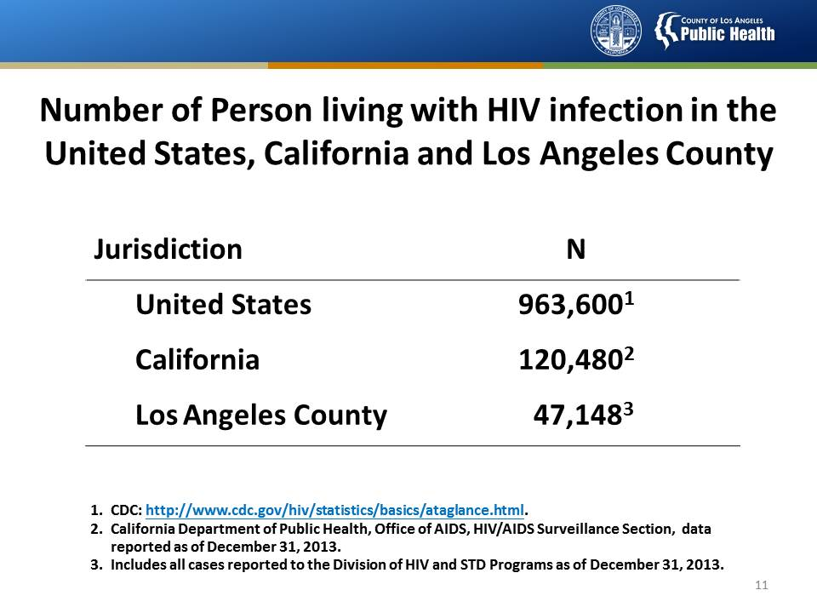
Notes:
This slide shows the number of persons living with diagnosed HIV infection, regardless of severity of disease, in the United States, California and Los Angeles County (LAC). Numbers for California and Los Angeles County are reported as of December 31, 2013.
According to the Centers for Disease Control and Prevention (CDC), Monitoring selected national HIV prevention and care objectives by using HIV surveillance data—United States and 6 U.S. dependent areas—2011. HIV Surveillance Supplemental Report 2013;18(No. 5). Published October 2013, CDC estimates that 1,144,500 persons aged 13 years and older are living with HIV infection, including 180,900 (15.8%) who are unaware of their infection. (1,144,500 - 180,900 = 963,600)
At year-end 2013, California reported 120,480 persons living with HIV infection, while Los Angeles County reported 47,148 persons living with HIV infection, which represents 39% of reported persons living with diagnosed HIV infection in California at year-end 2013.
Data for 2013 in LAC are provisional due to reporting delays.

Slide 13
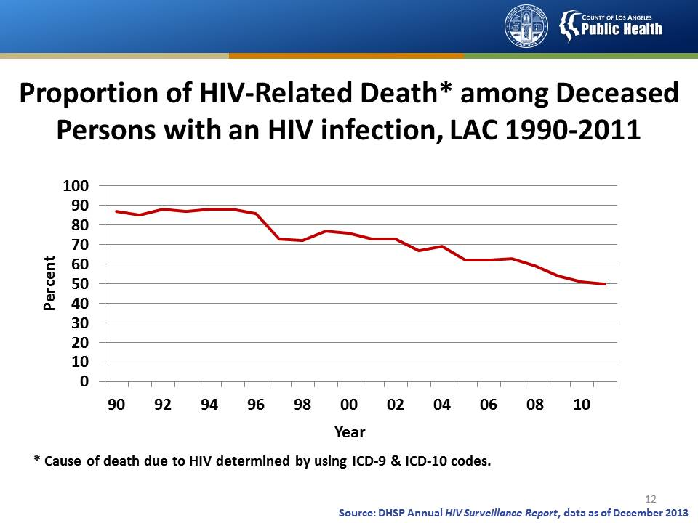
Notes:
This line graph shows the proportion of mortality among HIV infected individual with HIV selected as the underlying cause of deaths by year in LAC from 1990 to 2011 .
The proportion dropped from 87% in 1990 to 50% in 2011.
Data for recent years are provisional due to reporting delays.

Slide 14
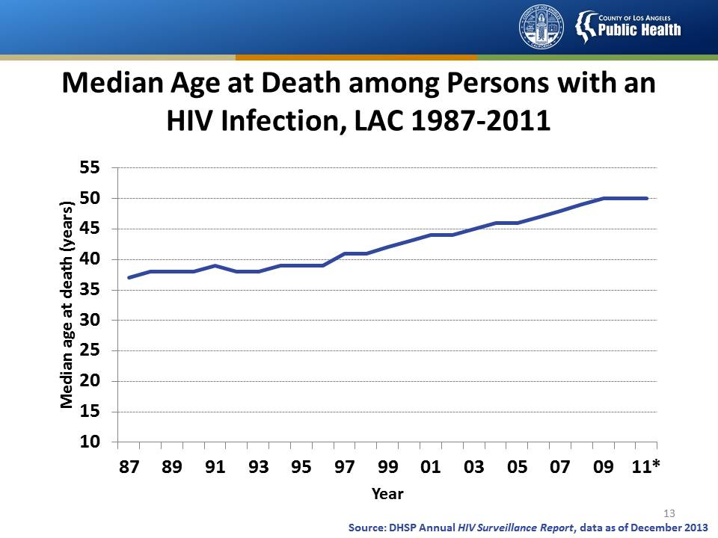
Notes:
This graph shows the median age at death among those who had been reported with an HIV infection and were deceased, by year in Los Angeles County from 1987 through 2011.
The median age at death increased almost linearly from 37 years in 1987 to 50 years in 2011. This is a reflection of the postponement to older ages among persons with HIV. The median age at death due to HIV infection varied little by racial/ethnic group.
Data for 2011 are provisional due to reporting delays.

Slide 15
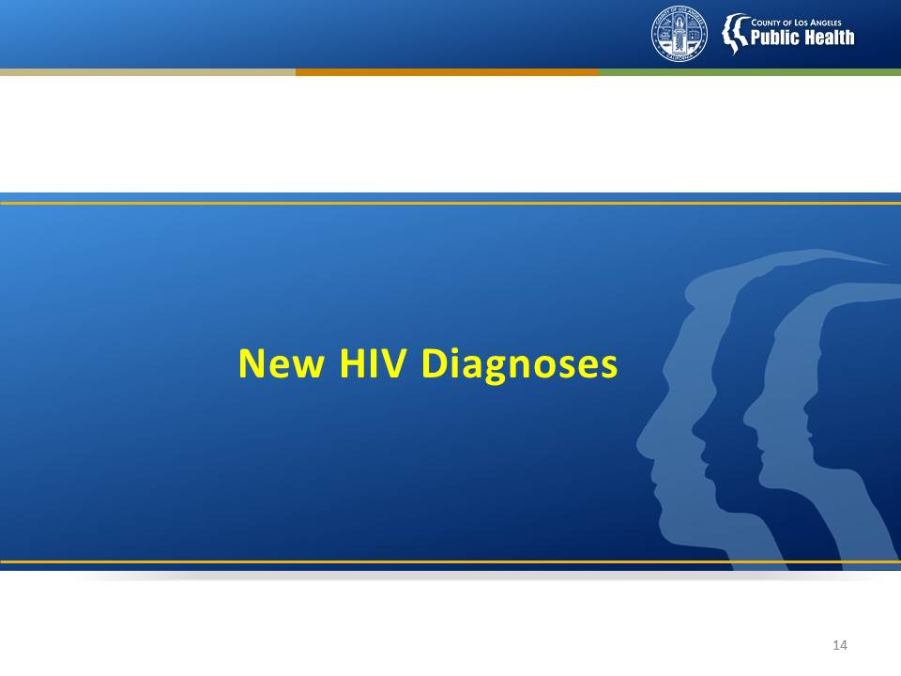

Slide 16
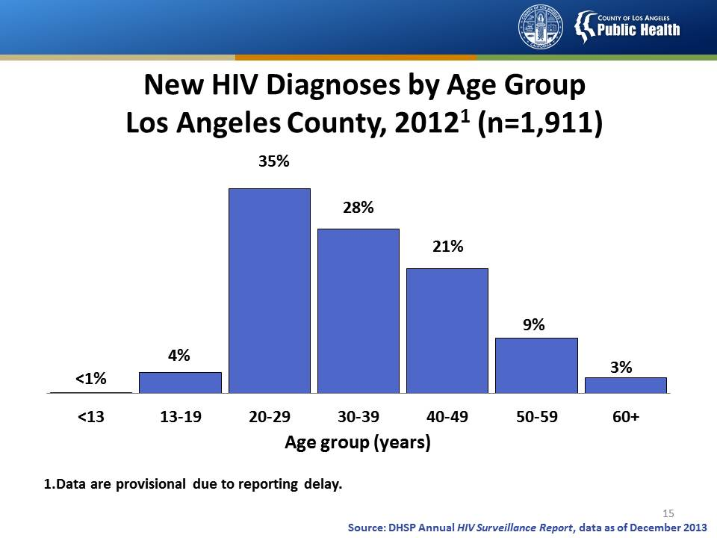
Notes:
This slide shows the age distribution of new HIV diagnoses in Los Angeles County in 2012, reported as of December 31, 2013.
There were 1,911 persons diagnosed with HIV infection in the year 2012. Most (63%) cases of HIV were diagnosed among persons 20-39 years of age, followed by persons 40-49 years of age (21%), and 12% among persons 50 years or older. Youth, age 13-19 years, represented only 4% of new diagnoses in 2011. Less than one percent were diagnosed with HIV infection before age 13 (pediatric HIV infection cases).

Slide 17
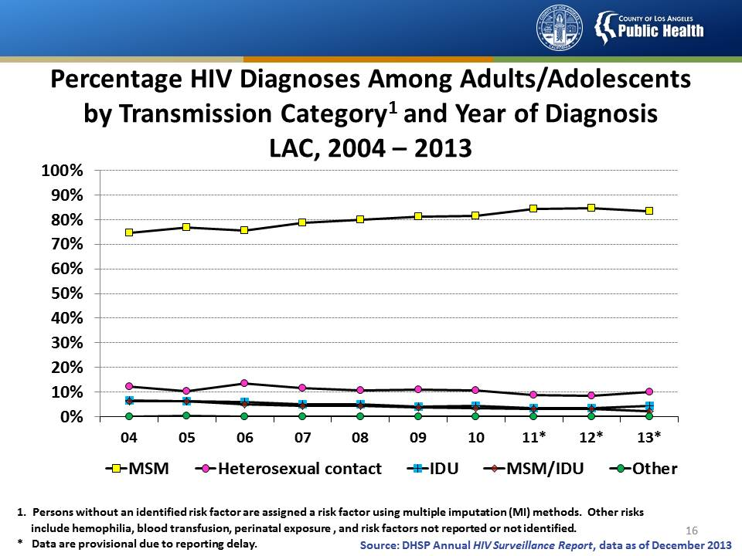
Notes:
This slide shows the proportion of HIV diagnoses among adults and adolescents in Los Angeles County from 2004 through 2013 by transmission category.
The percentage of adults and adolescents with diagnosed HIV infection attributed to male-to-male sexual contact increased from 75% in 2004 to 83% in 2013. The percentages of diagnosed HIV infections attributed to injection drug use, male-to-male sexual contact and injection drug use, and heterosexual contact remained relatively stable (less than a 5% increase or decrease) from 2004 through 2013. A very small percentage of diagnosed infections each year were attributed to other transmission categories.
Data include persons with a diagnosis of HIV infection regardless of stage of disease at diagnosis. All displayed data are statistically redistributed using the CDC-recommended multiple imputation methods to adjust for persons with risk factor not reported or not identified.
Heterosexual contact is with a person known to have, or to be at high risk for, HIV infection.
Other transmission categories include hemophilia, blood transfusion, perinatal exposure, and risk factors not reported or not identified.
Data are provisional for the years 2011 through 2013 due to reporting delays.

Slide 18
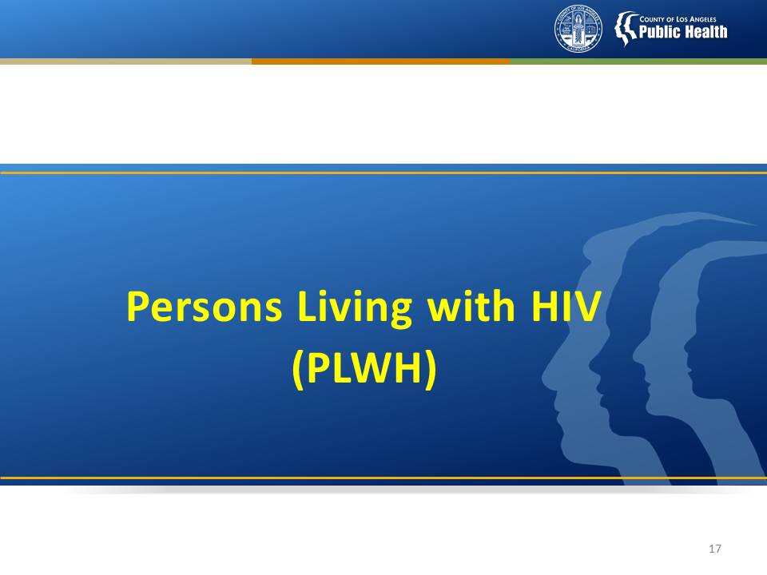

Slide 19
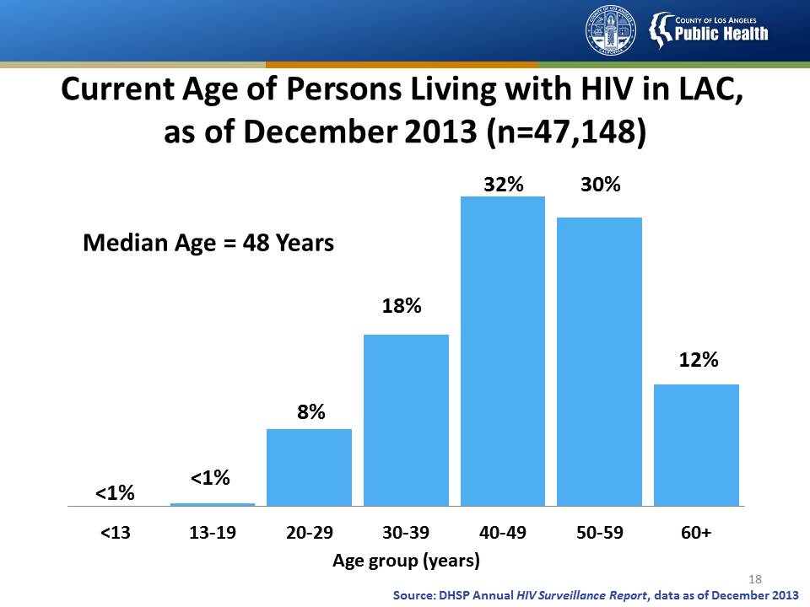
Notes:
This slide shows the current age of persons living with HIV infection in Los Angeles County (LAC) as of December 31, 2013.
At year-end 2013, a total of 47,148 persons were living with HIV infection in Los Angeles County. The largest proportion of persons living with HIV was among the 40 to 49 year-olds (32%), followed by the 50 to 59 year-olds (30%), 30 to 39 year-olds (18%), the 60 and over year-olds (12%), and the 20 to 29 year-olds (8%). The less-than-13 and the 13-to-19 age groups combined make up less than 1 percent of persons living with HIV infection.
The fact that almost three-fourths of all persons living with HIV infection in LAC were aged 40 years and over has implications for HIV care and treatment planning--especially with regard to combining care for HIV with care for other conditions associated with aging.

Slide 20
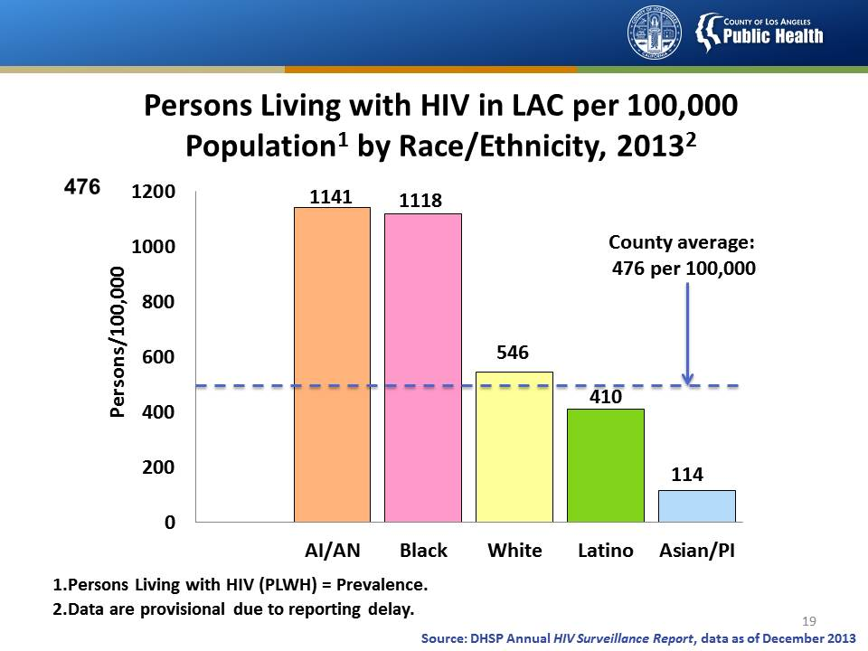
Notes:
This slide shows the number of persons living with diagnosed HIV infection at the end of 2013 by race/ethnicity in Los Angeles County, expressed as a “rate” per 100,000 population.
At year-end 2013, 47,148 persons were living with diagnosed HIV infection in Los Angeles County (LAC) with an average prevalence rate of 476 per 100,000 population.
Remember, a rate measures the impact of a disease in a given area because it takes into account the size of each population. Therefore, although far more Whites and Hispanics/Latinos are living with HIV infection in Los Angeles County, American Indians/Alaskan Natives, while comprising a very small percentage of the population, have been most impacted with the highest rate of persons living with HIV infection at 1,141 per 100,000 population. Blacks/African Americans who represent less than 10 percent of the general population in this county account for the second highest prevalence rate at 1,118 per 100,000 population, nearly twice the rate of Whites and almost three times that of Hispanics/Latinos.
Data include persons living with diagnosed HIV infection regardless of stage of disease at diagnosis.
Hispanics/Latinos can be of any race.

Slide 21
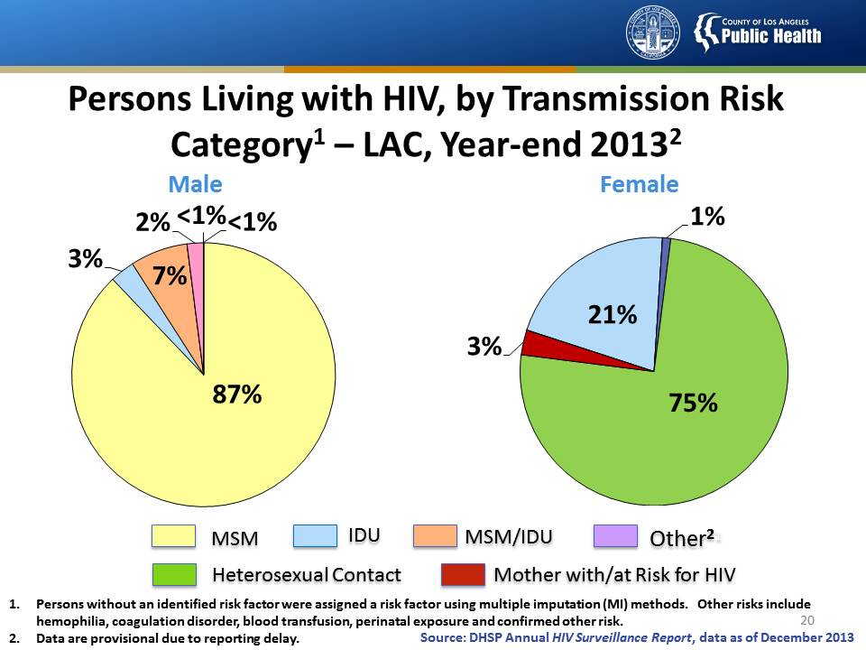
Notes:
This slide shows the distribution of transmission categories among males and females living with diagnosed HIV infection in Los Angeles County at year-end 2013.
All displayed data are statistically redistributed using the CDC-recommended multiple imputation methods to adjust for persons with risk factors not reported or not identified.
Among males living with diagnosed HIV infection at the end of 2013, 87% of infections were attributed to male-to-male sexual contact, 3% of infections were attributed to injection drug use, 7% to male-to-male sexual contact and injection drug use, and 2% to heterosexual contact. Approximately 1% of infections were attributed to perinatal exposure and other transmission categories.
Among females living with diagnosed HIV infection at the end of 2013, 75 percent were attributed to heterosexual contact, 21% were attributed to injection drug use, 3 percent were attributed to perinatal transmission—that is, from an HIV-infected mother, and 1 percent were attributed to other transmission categories.
Other transmission categories include hemophilia, blood transfusion, and risk factor not reported or not identified.
Data include persons with a diagnosis of HIV infection regardless of stage of disease at diagnosis.
Data are provisional due to reporting delays.

Slide 22
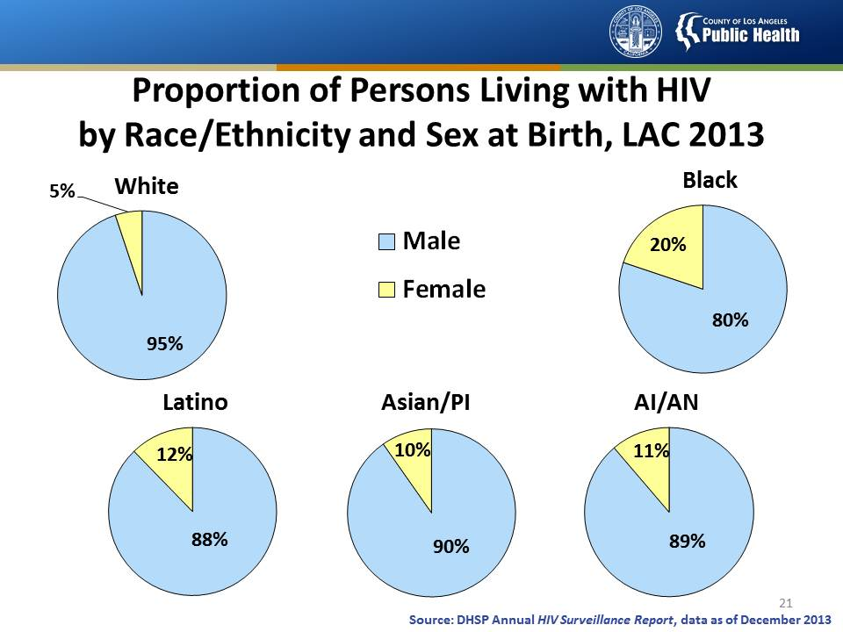
Notes:
This slide shows the proportion of males and females living with diagnosed HIV infection by race/ethnicity in LA County as of 2013.
Whites have the greatest proportion of males living with HIV infection (95%), and the smallest proportion of females affected (5%). Blacks have the greatest proportion of females affected (20%), and the smallest proportion of males affected (80%). Latinos, Asians/Pacific Islanders and American Indians/Alaska Natives have similar proportions of males and females affected. Ninety percent of Asians/Pacific Islanders living with HIV are men, and 10% are women. Eighty-nine percent of American Indians/Alaska Natives living with HIV are men, and 11% are women. Eighty-eight percent of Hispanics/Latinos living with HIV are men, and 12% are women.

Slide 23
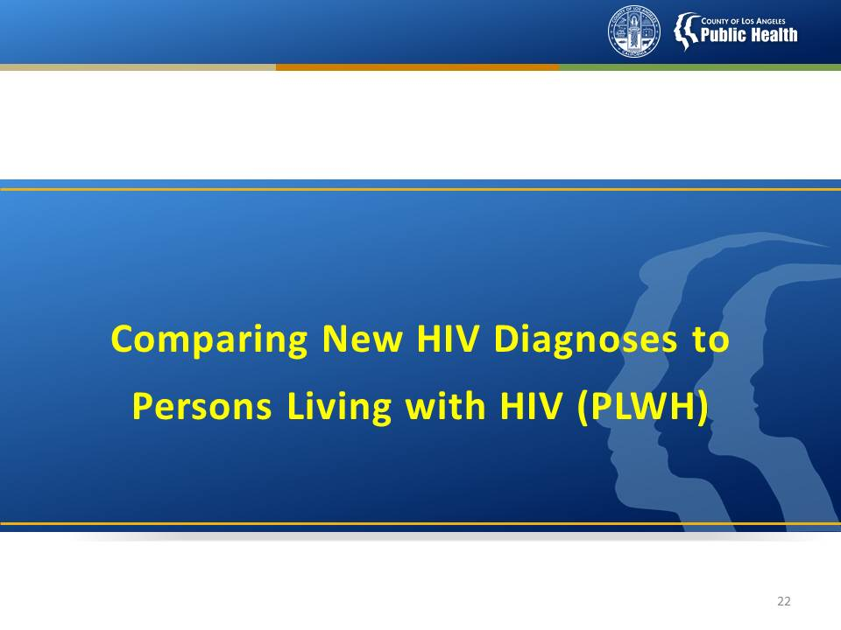

Slide 24
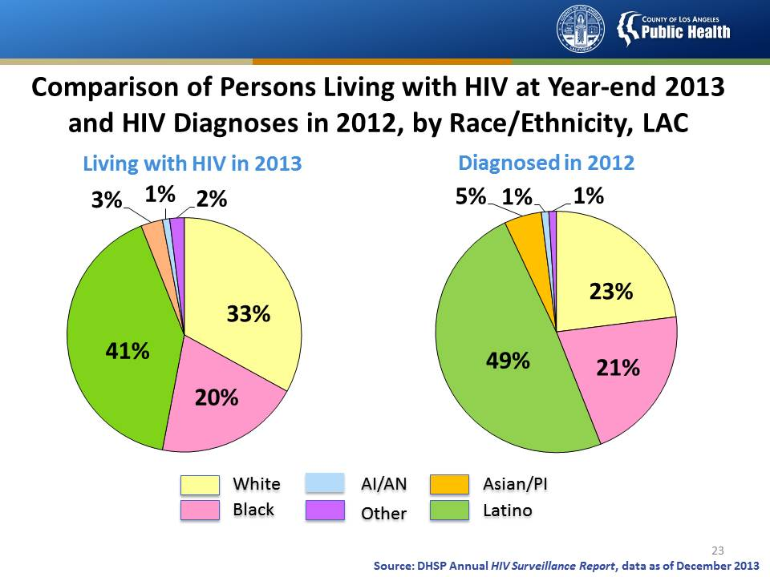
Notes:
This slide shows the percentage distribution of persons living with diagnosed HIV infection at year-end 2013 and persons diagnosed with HIV infection in 2012 by race/ethnicity in Los Angeles County.
Among persons living with HIV infection at year-end 2013, 41% were Latino, 33% White, 20% Black, 3% Asian/Pacific Islander (Asian/PI), less than 1% were American Indian/Alaska Native (AI/AN) and 2% were of Other races.
Persons newly diagnosed with HIV infection in 2012 follow a similar trend: Latinos comprised the largest proportion of cases and American Indian/Alaska Natives comprised the smallest proportion of cases. In 2012, Latinos accounted for 49% of the diagnosed cases, followed by Whites with 23%, Blacks with 21%, Asians/Pacific Islanders with 5% and American Indian/Alaska Natives with 1%. One percent were of Other race/ethnicity.
Overall, persons of color represented a larger proportion among persons newly diagnosed with HIV infection when compared to the proportion among persons living with HIV infection.
Data are provisional due to reporting delays.

Slide 25
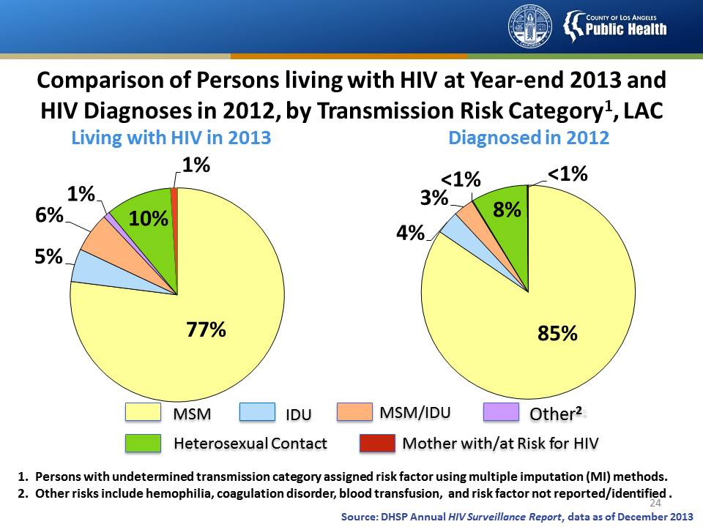
Notes:
This slide shows the distribution of transmission categories among persons living with HIV infection at year-end 2013 and persons diagnosed with HIV infection in 2012, in Los Angeles County.
All displayed data are statistically redistributed using the CDC-recommended multiple imputation methods to adjust for persons with unreported or unidentified risk factors.
Among persons living with diagnosed HIV infection at the end of 2013, 77% of infections were attributed to male-to-male sexual contact, 5% of infections were attributed to injection drug use, 6% to male-to-male sexual contact and injection drug use, and 10% to heterosexual contact. Approximately 1% of infections were attributed to perinatal exposure, and less than 1% of infections were attributed to other transmission categories.
In 2012, among persons diagnosed with HIV infection in Los Angeles County, 85% of infections were attributed to male-to-male sexual contact, 4% to injection drug use, 3% to male-to-male sexual contact and injection drug use, 8% to heterosexual contact, and less than 1% to perinatal exposure and other transmission categories.
Other transmission categories include hemophilia, blood transfusion, and risk factor not reported or not identified.
Data include persons with a diagnosis of HIV infection regardless of stage of disease at diagnosis.
Data are provisional due to reporting delays.

Slide 26
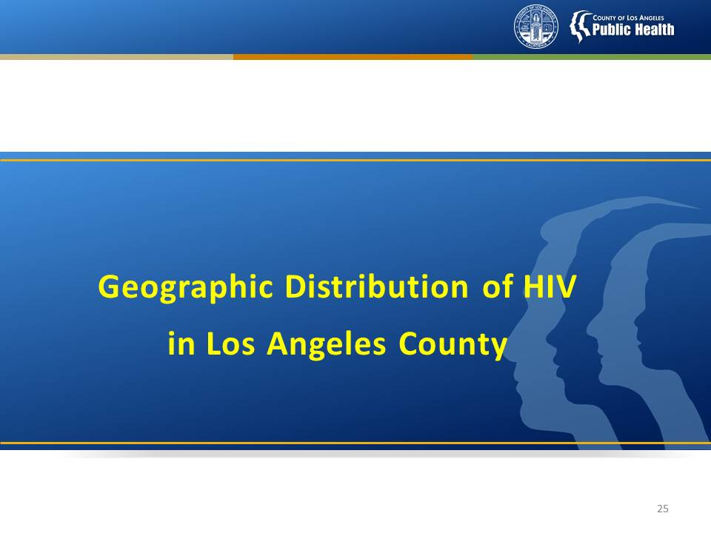

Slide 27
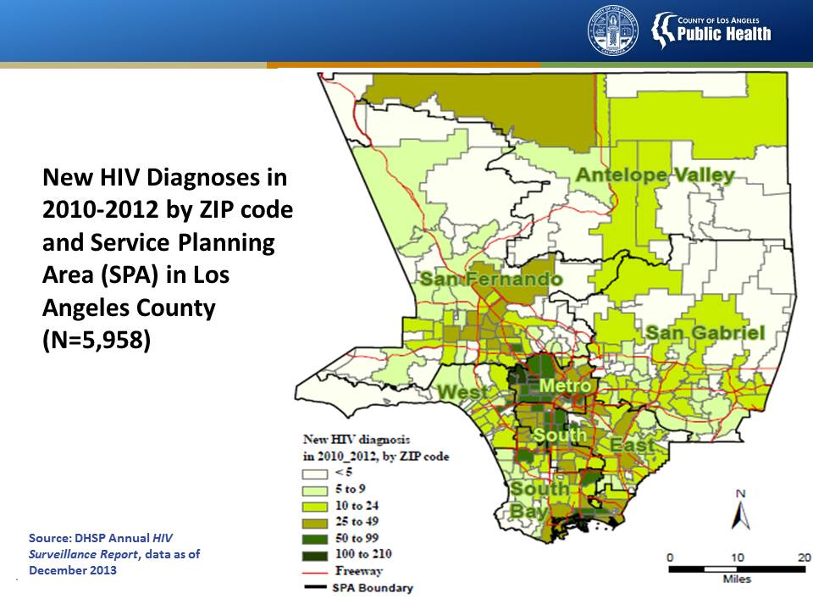
Notes:
This slide shows the number of new HIV diagnoses, regardless of stage of disease, by ZIP code and Service Planning Area (SPA) in Los Angeles County from 2010 through 2012.
The number of new HIV diagnoses by ZIP code are displayed using shades of green, with the darkest green representing the highest number (100 to 210) of new HIV diagnoses, and white representing the lowest (less than 5).
The largest number of persons diagnosed with HIV reside in the Metro and South Bay/Long Beach SPAs, followed by the San Fernando Valley and South SPAs.
Please note that data are provisional due to reporting delays. ZIP code information is based on the residence at the time of HIV or stage 3 (AIDS) diagnosis, or the most recently reported residential information.

Slide 28
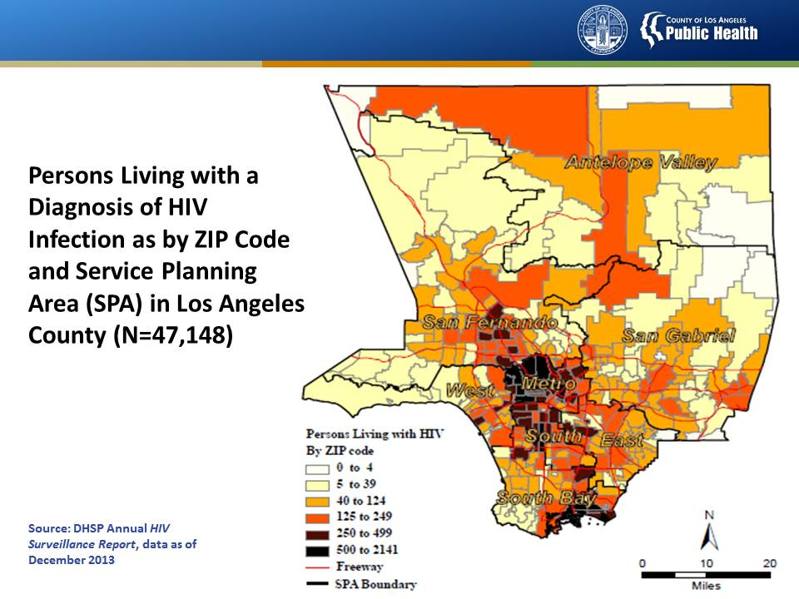
Notes:
This slide shows the number of persons living with a diagnosis of HIV infection by ZIP code and SPA in Los Angeles County as of December 31, 2013.
ZIP codes with the greatest number of people living with diagnosed HIV infection are shaded in black, as seen in SPA 4 (Metro) and in SPA 8 (South Bay/Long Beach).
Other zip codes that have less, but still large numbers of people living with HIV infection (shaded in brown and orange) are located in SPA 6 (South), and in parts of SPA 2 (San Fernando Valley), SPA 5 (West), and SPA 7 (East).
ZIP code information is based on the residence at the time of HIV or stage 3 (AIDS) diagnosis, or the most recently reported residential information.
Data are provisional due to reporting delays.

Slide 29
