Slide 1
State of the HIV/AIDS Epidemic: Future Directions for
Los Angeles County
Briefing to the Stakeholders
Mario J. Pérez, Director
Los Angeles County Department of Public Health
Division of HIV and STD Programs
December 1, 2011
Notes:
This is the main title slide. It should be amended to reflect the name of the person (or people) who is (or people who are) giving the presentation. It should also reflect title and division information for the presenter(s). The title (and subtitle, if appropriate) of the presentation should also be substituted where indicated (see next slide for example). Additional Title Slides should be used where appropriate if a new speaker is introduced within the course of a presentation.

Slide 2
Meeting Purpose
Offer a Comprehensive Review of the State of the HIV Epidemic
Keep Partners as Informed as Possible in Rapidly Changing Environment
Introduce New and Evolving Planning Tools
Review Paradigm Shifts and Areas of Focus Near and Medium-Term

Slide 3
Briefing Overview
Epidemiologic Overview
Changes in Response Development
Syndemic Planning and Geospatial Analysis
LAC Treatment Cascade Data
Blended Planning
Planning for Testing Services
New Directions in Program Financing
Pilot Project Review
Steps Moving Forward

Slide 4

 | Los Angeles County | California
Estimated living HIV/AIDS Cases | 61,700 | 134,303*
Reported HIV/AIDS Cases | 44,250 | 110,994
Estimated Undiagnosed HIV/AIDS Cases | 13,250 | 23,309*
Los Angeles County | California
9,848,011 | 36,961,664
Los Angeles County | California
4,060 sq mi | 155,959 sq mi
Data Source: Los Angeles County Department of Public Health, HIV Surveillance, 2011; California State Department of Public Health, State Surveillance Data, 2010
*133,705 calculated assuming 21% of HIV positive Californians are unaware of their status.
Notes:
(Optional slide): This slide shows Los Angeles County in comparison with the State of California. We are 2.6% of the state’s land area, 26.6% of the population, and 46.1% of the estimated living HIV/AIDS cases as of January 1, 2011.

Slide 5
Los Angeles County
Chicago
Houston
New York City
San Francisco
Philadelphia
Data Source: U.S. Census Bureau, Topologically Integrated Geographic Encoding and Referencing system, 2009. Maps Drawn at 1:750,000 scale.
District of Columbia
Notes:
(Optional slide): With over 4,000 square miles, Los Angeles County is larger than San Francisco (City and County), The District of Columbia, Philadelphia, Houston, Chicago, and all 5 boroughs of New York City combined.

Slide 6
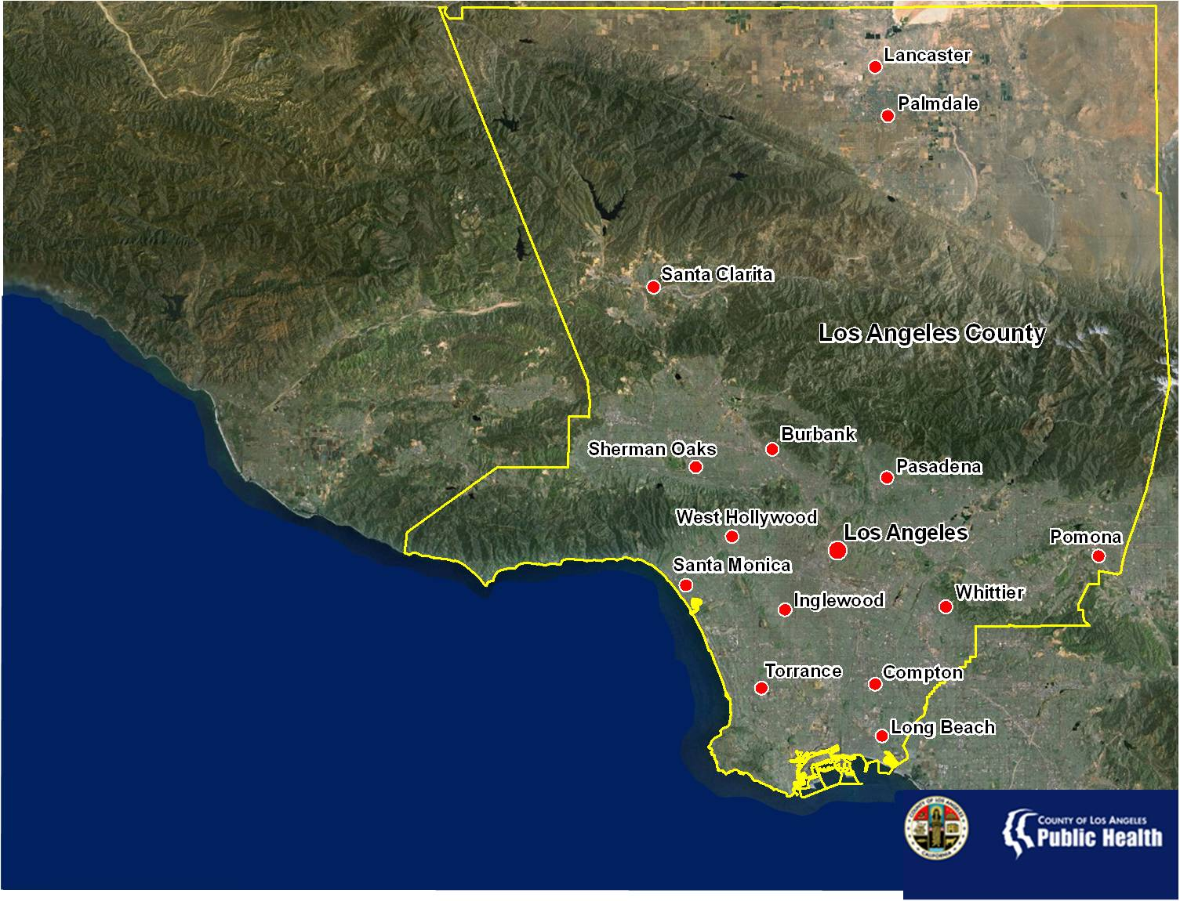
Population | Estimated HIV/AIDS Cases
9,848,011 | 61,700
Data Source: U.S. Department of Commerce, 2010; Los Angeles County Department of Public Health, HIV Surveillance, 2011
Notes:
Los Angeles County is the most populous in the United States with 9.8 million residents. The County is diverse in both it’s people and geography. There is no one majority racial/ethnic group and the County’s geography consists of urban, suburban, and rural areas divided by several mountain ranges.

Slide 7
Catalysts for Change
National HIV/AIDS Strategy
Unsustainable disease burden
Section 1115/Health Care Reform
Improved Mapping
Improved Use of Surveillance and Laboratory Information
ECHPP and 12-City Initiative

Slide 8
Changes in the Way We Develop a Response

Slide 9
National HIV/AIDS Strategy:
Three Primary Goals
Reduce New HIV Infections
Increase Access to Care and Improve Health Outcomes for People Living with HIV
Reduce HIV-Related Disparities and Health Inequities
To accomplish these goals, we must achieve a more coordinated national response to the HIV epidemic in the United States

Slide 10
Unsustainable Disease Burden
~2,000 – 3,000 annual HIV infections
~13,250 HIV-undiagnosed persons
~55,000 annual STDs diagnosed
Fewer resources
Alarming health disparities, including undiagnosed and linkage to care
Growing pharma and diagnostic costs

Slide 11
Estimated HIV Incidence, US, ‘06-’09
48,600→56,000→47,800→ 48,100
21% increase among 13-29 year olds, driven by…..
34% increase among young MSM, driven by…
48% increase among young African-American MSM!!!

Slide 12
Los Angeles County Conceptual Model for Continuum of HIV Services
No HIV,
Low Risk
High Risk for HIV
HIV+,
Unaware
PLWHA Linked to Care
PLWHA Retained in Care
HIV+ Aware, But Not in Care
Social marketing
Capacity building
Routine HIV testing
Targeted & Routine HIV Testing
HE/RR
Social Marketing
Syringe Exchange Programs
Biomedical (PEP)
Partner Services
STI Screening and Treatment
Substance use programs
Targeted & Routine HIV Testing
Social Marketing
Partner Services
Substance use programs
Outreach
Early Intervention Programs
Mental health and substance use programs
Ancillary support services
Social Marketing
STI screening and treatment
HIV medical care and ART
Treatment adherence
Ancillary services
Mental health and substance use programs
PS
HE/RR
Social marketing
Notes:
- PLWHA = People living with HIV/AIDS

Slide 13
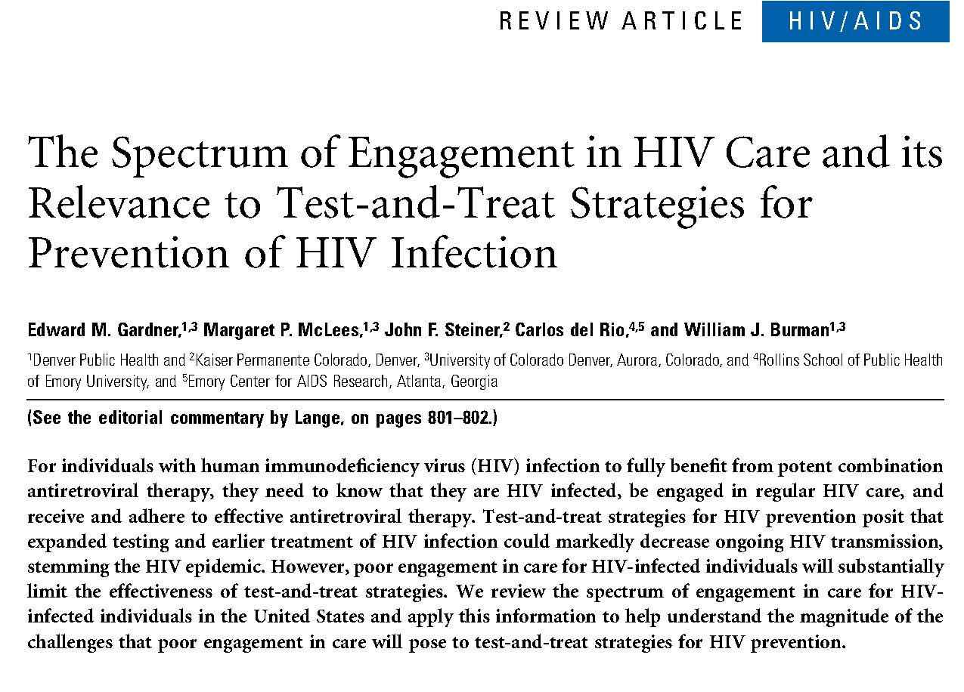

Slide 14
Spectrum of Engagement in Care in Los Angeles County
Note: Using Gardner et al. (CID 2011) treatment cascade criteria
Los Angeles County HIV Surveillance Data 2009-2010
Notes:
In LAC, there are approximately 61,700 PLWH
79% (48,450) are diagnosed; 21% are unaware of their HIV infection
44% (27,396) were linked into care.
35% (21,797) retained in care. Retained in care defined as 2 or more VL at least 90 days apart during 2009
ART coverage within LAC is currently unknown
26% (16,016) of PLWH in LAC had an undetectable viral load 2009-2010
Additional notes:
Linked to care is defined as having at least 1 VL between 2009-2010. Note, this excludes newly HIV diagnosed in 2009 or later as they may still be in the process of linking to care.

Slide 15
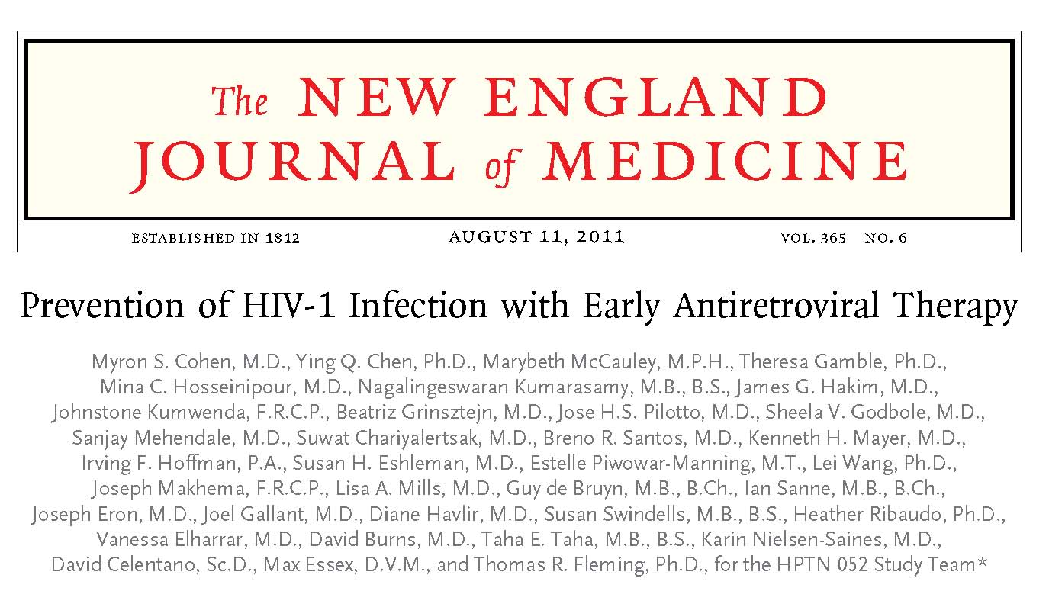

Slide 16
HIV/STD Syndemic Planning
Focuses on connections among cofactors of disease
  HIV
  Syphilis
  Gonorrhea
Considers those connections when developing health policies
Next Steps include analysis of “upstream” determinants, e.g., poverty, substance use
Notes:
Two or more afflictions, interacting synergistically, contributing to excess burden of disease in a population
Linked epidemics, interacting epidemics, connected epidemics, co-occurring epidemics, co-morbidities, and clusters of health-related crises

Slide 17
Developing a Local Response
Integrating HIV/STD prevention & treatment
Integrating the prevention/care continuum
Adopting the National HIV/AIDS Strategy
Early detection and linkage to/retention in Care
Viral suppression for individuals in HIV care
Evidence-based programming
Changes in community planning

Slide 18
The Local Epidemic
Through a Syndemic Lens

Slide 19
Estimated Number of Persons Living with HIV and AIDS in LAC
13,250
3,200
3,200
16,155
25,895
Estimate
~ 61,700 living
with HIV & AIDS in LAC
Source: LAC HIV Epidemiology Program, reported as of 12/31/2009.
Source: LAC HIV Epidemiology Program, reported as of 12/31/2010.
(1) Estimate that 21.5% of HIV+ in LA County are unaware of their infection (Campsmith et al. 2010).
(2) Of 5,100 notifications pending investigation, estimate 2,200 who have
detectable VL to be cases, as well as about 1,000 of the remaining cases.
Notes:
19

Slide 20
What’s Driving New Infections?
High levels of undiagnosis
Social and sexual networks
Drug use, particularly alcohol and methamphetamine use
Community viral load
Poor economic and environmental conditions
Homophobia, stigma, shame

Slide 21
Persons Living with HIV/AIDS in LAC
per 100,000 population* by Race/Ethnicity,
as of December 2010
*Sometimes called “Prevalence Rate”; it is really a proportion.
Source: HIV/AIDS Surveillance Summary, data as of December 2010

Slide 22
Proportion of LAC PLWH/A Cases by
Race/Ethnicity* & Diagnosis Year, 2001-10
White
Latino
39%
35%
21%
Black
Asian/PI
4%
*American Indian and Alaska Native are not presented here but consistently comprise <1% of cases, including 0.4% in 2010.
*Data are provisional due to reporting delay.
Source: HIV Epidemiology Program, LAC-DPH; data as of December 31, 2010
Notes:
22
E7 update

Slide 23
Trend in Proportion of Persons Living with AIDS by Age, 2001-2010
Data Source: HIV Surveillance Report 2009 and 2010. HIV Epidemiology Program.
Note: Data for 2008, 2009, and 2010 are provisional.

Slide 24
Trend in Proportion of Persons Living with HIV by Age, 2002-2010
Data Source: HIV Surveillance Program. Note: Data for 2008, 2009, and 2010 are provisional.

Slide 25
Percent of HIV/AIDS Diagnoses Among Adults/Adolescents, by Transmission Category* and Year of HIV Diagnosis, Los Angeles County, 1992-2010
Percent
* Persons with an undetermined transmission category are assigned a risk factor using multiple imputation (MI) methods (see technical notes in HIV/AIDS Surveillance Summary). Other risks include hemophilia or coagulation disorder, transfusion recipient, perinatal exposure, and confirmed other risk.
** Data are provisional due to reporting delay.
Source: HIV/AIDS Surveillance Summary, data as of December 2010

Slide 26
Reported STIs and HIV/AIDS Cases Los Angeles County, 2009
Over 55,000 STD /HIV were reported in 2009
  74% Chlamydia
  14% gonorrhea
  5% Syphilis
  7% HIV/AIDS
Source: STD Program/HIV Epidemiology Program Los Angeles County Department of Public Health

Slide 27
STI Rates per 100,000 Residents, 2009
Source: STD Program Los Angeles County Department of Public Health

Slide 28
Division of HIV and STD Programs
HIV Tests and New Positive Tests By Year*
Data Source: Division of HIV and STD Programs, HIV Testing Services, 2011
*Includes all HIV testing supported by Public Health, HIV and STD Programs with projected numbers based on NHAS implementation (2011-15)
Notes:
Testing increased significantly with the introduction of routine screening in 2009-10, and will further increase in 2011-12 with the implementation of “New Directions in HIV Testing” as part of the National HIV/AIDS Strategy (NHAS).

Slide 29
HIV Positivity Rates by Service Planning
Area (SPA), DHSP Testing Sites, 2007
Source: HIRS, Calendar Year 2007

Slide 30
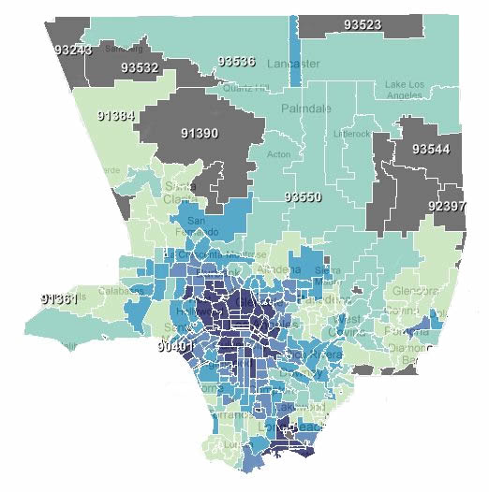
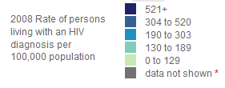

Persons Living with an HIV Diagnosis in 2008, by Zip Code
Los Angeles County, CA
AIDSVu is an interactive, online map that allows users to visually explore the HIV epidemic in the U.S. alongside critical resources such as HIV testing center locations.
www.AIDSVu.org

Slide 31
HIV Case Density, 2009, SPA 8
Very Low Density
Very High Density
Source: 2009 New HIV Cases, HIV Epidemiology Program

Slide 32
Nearest Neighbor Hierarchical Clustering
Summary¹
83.9% of HIV Cases in LAC
¹Nearest Neighbor Hierarchical Clusters output at 1.0 standard deviations using fixed-distance band threshold

Slide 34
Central Cluster Area
Disease Burden Summary
 | n | %
HIV | 861 | 46.3%
Syphilis + HIV | 642 | 58.5%
Syphilis no HIV | 712 | 44.6%
Gonorrhea | 3,330 | 42.1%
HIV Cases per 2 Square Miles
Notes:
This is an optional map slide. This map was developed from the HIV Epidemiology Program’s Semi Annual Surveillance Report and shows AIDS cases identified in CY2007 by Health District.

Slide 35
Source: HIRS, Calendar Year 2007
Data Source: eHARS as of September 30, 2011

Slide 36
New HIV Cases by Resident Zip Code, 2009
Source: HIRS, Calendar Year 2007
Data Source: eHARS as of January 1, 2011

Slide 37
New Syphilis Cases by Resident Zip Code, 2009
Source: HIRS, Calendar Year 2007
Data Source: STD Surveillance, 2011

Slide 38
New Gonorrhea Cases by Resident Zip Code, 2009
Source: HIRS, Calendar Year 2007
Data Source: STD Surveillance, 2011

Slide 39
New Chlamydia Cases by Resident Zip Code, 2009
Source: HIRS, Calendar Year 2007
Data Source: STD Surveillance, 2011

Slide 40
Examining Care and Treatment from Multiple Data Sources

Slide 41
Los Angeles County Treatment Cascade among PLWH in Care, 2009
Los Angeles County HIV Surveillance Data 2009-2010
Notes:
In 2009 there were 41,059 PLWH
Of those diagnosed PLWH, 67% (27,396) were in care in 2009 (had at least 1 VL reported to HIV surveillance).
Of the 27,396 clients in care, 80% (21,797) were retained in care. Retained in care defined as 2 or more VL at least 90 days apart during 2009
ART coverage within LAC is currently unknown
58% (16,016) of PLWH in care in LAC had an undetectable viral load 2009-2010
Additional notes:
In care is defined as having at least 1 VL between 2009-2010. Note, this excludes newly HIV diagnosed in 2009 or later as they may still be in the process of linking to care.

Slide 42
Ryan White “in Care” Treatment Cascade, 2009
Ryan White Casewatch Data, January – December 2009 (CY2009)
Notes:
In Calendar year (CY 2009), there were 18,345 PLWHA in RW System of Care.
of whom 12,752 (70% ) were in medical care (defined as having at least 1 medical outpatient visit and a VL within CY 2009)
- Of those who were in medical care, as defined earlier, 90% (11,424) were on ART
- 74% (9,412) were retained in medical care (2 or more visits at least 3 months apart) in 2009
-65% (8,247) had an undetectable VL in comparison to 58% LAC county-wide known PLWH in care.
- Note: among RW clients in medical care and on ART, 72% (8,247/11,424) have an undetectable VL.

Slide 43
Ryan White “in Care” Treatment Cascade, FY2010
Ryan White Casewatch Data, March 2010 – February 2011 (Year 20)
Notes:
In Calendar year 20, there were 19,228 PLWHA (includes CIC (number may have gone up – number from June 2011)) in RW System of Care.
of whom 14,753 (76.7% ) were in medical care (defined as having at least 1 medical outpatient visit and a VL within YR20)
- Of those who were in medical care, as defined earlier, 89.5% (13,201) were on ART
- 86.5% (12,763) were retained in medical care (2 or more visits at least 3 months apart) in year 20 out of those in medical care.
-74.6% (11,008) had an undetectable VL in comparison to 58% LAC county-wide known PLWH in care.
- Note: among RW clients in medical care and on ART, 83% (11,008/13,201) have an undetectable VL.

Slide 44
Linkage to Care by Test Year, 2006-08
Linked to Care by Test Year, Jan 2006 -Dec 2008¹ (n = 807)
Characteristic | No. | %
Linked to Care² | 528 | 65.4%
2006 (n=273) | 164 | 60.1%
Within 3 months | 123 | 45.1%
Within 6 months | 18 | 6.6%
Within 1 year | 23 | 8.4%
2007 (n=237) | 163 | 68.8%
Within 3 months | 138 | 58.2%
Within 6 months | 17 | 7.2%
Within 1 year | 8 | 3.4%
2008 (n=297) | 201 | 67.7%
Within 3 months | 177 | 59.6%
Within 6 months | 13 | 4.4%
Within 1 year | 11 | 3.7%

Slide 45
Not Linked to Care: Demographics
Data Source: OAPP, HIV Information Resources System (HIRS) and HIV Epidemiology, HIV/AIDS Reporting System (HARS), 2006-2008. *Represents lab data collected through December 31, 2009

Slide 46
HIV-positive Individuals¹ Linked to Care², 2006-08 by Zip Code
¹Newly-diagnosed individuals tested at OAPP-funded sites, identified in HIV surveillance data
²Matched cases in surveillance data not having a CD4 or viral load laboratory record, zip codes with small numbers not included in analysis
Data Source: HIV Epidemiology Program, 2010
1Newly-diagnosed individuals tested at OAPP-funded sites, identified in HIV surveillance data 2Matched cases in surveillance data not having a CD4 or viral load laboratory record

Slide 47
Summary: Not Linked to Care in LAC
Characteristics/factors associated with being unlinked to care¹:
  African American and Latino
  Homeless
  Transgender
  Tested at Mobile Testing Unit (vs. fixed)
Only 2/3 of those diagnosed w/ HIV in LAC are linked to care within 1 year of diagnosis
Improving linkage to care = strategy to improve individual health outcomes as well as reduce HIV transmission
Data Source: OAPP, HIV Information Resources System (HIRS) and HIV Epidemiology, HIV/AIDS Reporting System (HARS), 2006-2008. *Represents lab data collected through December 31, 2009

Slide 48
Source: HIRS, Calendar Year 2007
Data Source: eHARS, ADAP, Medicare, and MediCal and Casewatch, Jul09-Jun10

Slide 49

Reasons Not In Care For Those Who Never Enter Care
Why They Never Enter Care
Unstable housing; Good health/don’t feel a need to see a doctor; Unaware of free medical care; Not ready to deal with HIV; Fear of discrimination/stigma
Data Source: Los Angeles Coordinated HIV Needs Assessment, 2007-2008.

Slide 50
Reasons Not In Care For Those Who
Left and Returned to Care
Why They Left | Why They Returned
Substance abuse; Unstable housing; Good/improved health; Incarceration. | Illness; Substance abuse treatment; Overcoming depression; Ready to deal with HIV; Housing situation stabilized; Heard about a new doctor or clinic; Discovered different meds or treatments are available Encouraged by family and friends.
Data Source: Los Angeles Coordinated HIV Needs Assessment, 2007-2008.

Slide 51

Cost of Care for Persons Living with HIV/AIDS
CD4 Count | <50 | 51-200 | 201-500 | >500
Annual Cost* | $60,000 | $30,000 | $23,000 | $20,000
*Annual Cost of Care includes inpatient care, HIV medications, clinical visits, some ancillary services (home care)
Data Source: HIV Research Network, 2006.

Slide 52
Testing and Linkage to Care Plus (TLC+)
TLC+ is a holistic approach to HIV prevention, medical care, and supportive services that aims to…
Testing
Linkage to Care
+ Treatment
Increase proportion of HIV+ individuals aware of their status
Immediate linkage to HIV care and social services/re-engagement of those fallen out of care
Improve retention in care, access to antiretroviral therapy, and treatment adherence
Source: The Report of a U.S. Think Tank on HIV Treatment as Prevention - February, 2010
http://www.projectinform.org/testandtreat/index.shtml

Slide 53
Elements of TLC+
Assuring HIV+ individuals know their status
Effective and timely linkage to care for newly identified HIV+ individuals
Re-engage individuals who have been lost to the system of care
Evaluation of eligibility for ART
Effective efforts to support retention in care and ART adherence
Reduce HIV Transmission
Notes:
- * This is ultimately the client’s choice, and should not be mistaken as coercion into care. Patients should be evaluated for their readiness to initiate treatment and linked to needed services that will support them to take medications, if they wish. HIV-positive people should also be counseled that, in addition to improving their HIV health outcomes, treatment combined with safe behaviors can support them in their efforts to avoid transmitting HIV to others.

Slide 54
A MOMENT OF SILENCE TO COMMEMORATE
WORLD AIDS DAY 2011

Slide 55
BREAK

Slide 56
Blending Planning for the Health Continuum

Slide 57
What is ECHPP?
CDC-funded initiative intended to enhance the impact of HIV prevention efforts in 12 MSAs that represent 44% of the domestic epidemic
Expectations of ECHPP grantees:
  Align their prevention strategies with the NHAS
  Develop a plan that addresses gaps and better supports strategies that have the greatest impact on reducing HIV incidence
Notes:
This is phase 1 of a potential two-phase initiative:
Phase 1 – planning and implementation (1 year project period) – 12 MSAs
Phase 2 – implementation and evaluation (2 year project period) this will be a competitive application funding up to 2 MSAs

Slide 58
What is the 12-Cities Project?
A DHHS-supported project to accelerate comprehensive HIV/AIDS planning and cross-agency response in the 12 jurisdictions that bear 44% of HIV burden.
Will serve as a proving ground to demonstrate how broad range of federally-supported HIV prevention, care and treatment activities can work together more effectively across organizational and program boundaries.
Notes:
This is phase 1 of a potential two-phase initiative:
Phase 1 – planning and implementation (1 year project period) – 12 MSAs
Phase 2 – implementation and evaluation (2 year project period) this will be a competitive application funding up to 2 MSAs

Slide 59
ECHPP Prevention Plan
Does not replace the community prevention planning process
Must address biomedical, community and structural interventions to better ensure LHJs are reaching communities at highest risk
  14 required strategies
  10 recommended strategies
Notes:
Examples of the list of required strategies: routine testing, targeted testing, PEP, condom distribution, needle exchange programs.
required and recommended strategies involve testing, linkage to care and retention in care activities.

Slide 60
Local ECHPP Activities
Syndemic Planning
  Integrated use of HIV and STI surveillance data
Identify optimal mix of HIV programming
  Robust Decision Making to inform prioritization, scale, and optimal mix of HIV prevention interventions for LAC
Where should we focus our prevention efforts to make the largest impact with resources we have?

Slide 61
Local ECHPP Activities
Detailed local ECHPP plan and workbook available at:
Http://publichealth.lacounty.gov/aids/ECHPP.htm
Notes:
The integration of programs is intended to reduce duplication of services, maximize all available resources, and see clients holistically rather than through the disparate lenses of disease prevention and treatment. Integration activities are expected to become finalized within the next 18 months.

Slide 62
Early Identification of Individuals with HIV/AIDS (EIIHA)*
Identifying, counseling, testing, informing, and referring of diagnosed and undiagnosed individuals to appropriate services, as well as linking newly diagnosed HIV positive individuals to care.
*HRSA

Slide 63
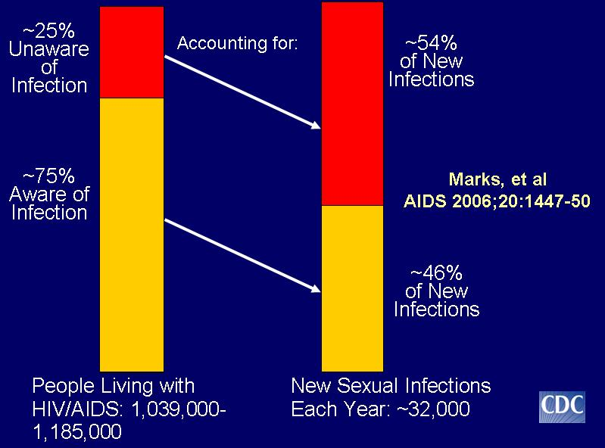
Awareness of Serostatus Among People with HIV and Estimates of Transmission

Slide 64
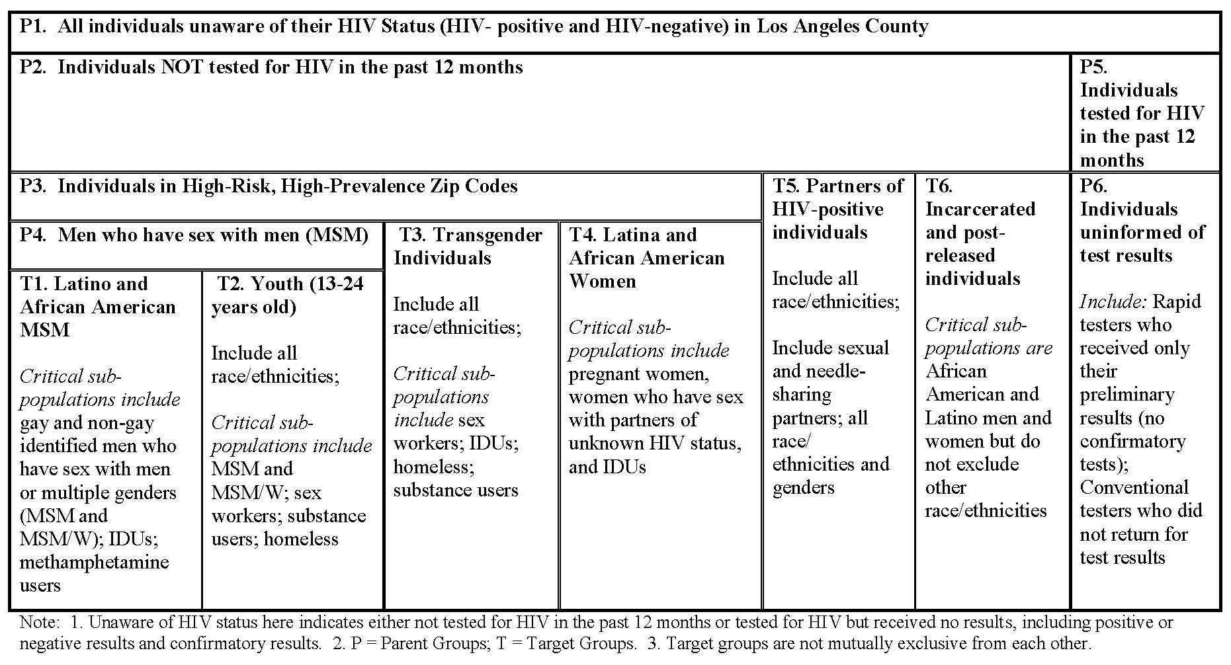
Los Angeles County EIIHA Matrix

Slide 65
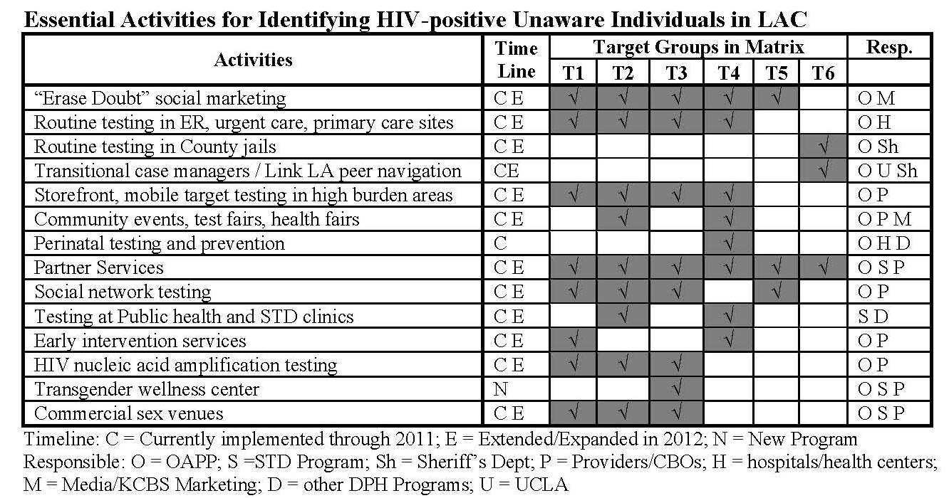
Los Angeles County EIIHA Activities

Slide 66
Planning for Testing Services Using Multiple Data Sources

Slide 67
DPH HIV Testing Projections 2010-2015,
Former HIV Testing Model
Data Source: Office of AIDS Programs and Policy, HIV Counseling and Testing Data, 2009

Slide 68
DHSP HIV Testing Projections 2010-2015,
New Directions in HIV Testing
Data Source: Division of HIV and STD Programs, HIV Testing Services Data, 2011

Slide 69
Changes in Community Planning
Planning for the entire continuum
Increased evidence-based planning
More data=more sophisticated plans
Combining the prevention and care plans into one document
Examining both co-factors and syndemics
Involvement of experts is crucial
Looking through new lenses
Notes:
The integration of programs is intended to reduce duplication of services, maximize all available resources, and see clients holistically rather than through the disparate lenses of disease prevention and treatment. Integration activities are expected to become finalized within the next 18 months.

Slide 70
Changes in the Way We Finance Our Response

Slide 71
Changes in the Way We Finance Our Response
CDC FOA-mandated shifts
Section 1115 Medicaid Waiver
  Low Income Health Programs (LIHPs)/Healthy Way LA
Redistribution of RW resources
Blending of service categories across funding streams

Slide 72
CDC FOA Funding Shifts
Redistribution of funding
  Increased allocation to MSA
  Discontinue MSA funding via State
75% funding for required core components
  HIV testing
  Comprehensive Prevention with Positives
  Condom distribution
  Policy initiatives

Slide 73
California’s Section 1115 Medicaid Waiver and
Federal Health Care Reform

Slide 74
Section 1115 Waiver Overview
November 2010: 1115 Waiver approved by CMS
Waiver is designed to be a bridge to implementation of health care reform in 2014
Attempts to stabilize safety net provider systems
Improves care coordination for certain vulnerable populations
Expands coverage to uninsured adults

Slide 75
Low Income Health Programs: Overview
The Low Income Health Programs, or LIHPs, are health initiatives designed to extend health coverage to uninsured or underinsured adults;
The focus of the LIHPs are to help counties identify their uninsured populations and to move these individuals into care prior to 2014;
LIHP beneficiaries will transition to Medi-Cal in 2014;
Programs vary by county;
Los Angeles County’s LIHP is called “Healthy Way LA”;
Healthy Way LA is administered by LA County Department of Health Services (DHS).
Notes:
Explain that LA County was part of an old health initiative also called HWLA. New initiative started on July 1, 2011.

Slide 76
Healthy Way LA
Eligibility
Uninsured
Ages
19-64
Income at or below
133% FPL
US Citizen or legal resident 5+ years
Los Angeles County Resident
Individual must meet all of the eligibility requirements
Federal Poverty level: Income based on family size
<133% FPL for a single individual in 2011=
$14,484 yr/$1207 month
Uninsured persons with HIV who do not meet the eligibility criteria for HWLA will remain eligible for Ryan White supported care and ADAP

Slide 77
Transition Planning
DHSP is preparing to transition approximately 5000 individuals from Ryan White supported medical care and ADAP to Healthy Way LA
Start date has yet to be determined. DHS needs time to develop key functions including pharmacy systems
Division of HIV and STD Programs (DHSP) internal workgroup
Department of Public Health, Department of Health Services, Department of Mental Health joint workgroup
Community meetings with Ryan White funded medical providers, case managers and benefits counselors
Transition plan submitted to California Office of AIDS November 15, 2011

Slide 78
Health Way LA
Service Delivery
Medical Specialty Services
Medical Home
Prescription Drug Coverage
Psychiatric Services*
HIV Clinic
HIV Physician & Healthcare Team
Medical Transportation
Notes:
Labs:
VL Resistance Testing: Public Health Lab Ryan White Funded
Some labs done in house as part of HWLA contract
Some labs done as part of medical specialty ref.

Slide 79
Ryan White Wrap Around
Ryan White will continue to be the payer for services not covered under Healthy Way LA:
  Dental
  Case management
  Certain mental health services
  Substance abuse treatment

Slide 80
Healthy Way LA Transition
Review
Medical Provider
We expect that clients will be able to continue to be seen by their current HIV medical providers
Medical Home
Prescription Drug Coverage
Clients will have expanded access to medications
Some clients will have to change pharmacies
Improved access to medical care
Medical specialty
Inpatient (hospital) coverage
DHS is creating an HIV pharmacy program (clinic and community pharmacies)
Access to non-HIV related care and treatment
Emergency Care
Urgent Care
Ambulance

Slide 81
Implementation of the Patient Protection and Affordable Care Act
<133% FPL
Full Scope Medi-Cal
134%-400% FPL
Subsidized insurance coverage through the insurance exchange
>401% FPL
Insurance coverage through the insurance exchange(No Subsidy)
Notes:
2014 (2 years)

Slide 82
Preparing for 2014
Examine lessons learned 1115 Waiver
  HIV and managed care
  Medical homes and HIV
  Pharmacy networks
  Mental Health
  Data retention
Identify ongoing function of Ryan White:
  Wrap-around support
  Navigation
  Gaps: Dental, Vision, Care Coordination
  Best models of comprehensive care
  Residual populations will remain

Slide 83

HIV Provider Questions
HIV providers may e-mail their Healthy Way LA transition question to the following address:
hwlaproviderquestions@ph.lacounty.gov
Questions will responded to via a “frequently asked question” document that will be posted on DHSP’s website.

Slide 84
Putting Data to Work:
Pilot Projects

Slide 85
Pilot Projects
TLC+
Delivering Partner Services through multiple models (ARTAS, CEDIS)
Antiretroviral Post-exposure Prophylaxis (nPEP)
Jails Peer Navigation
Integrating Mental Health and Substance Use Treatment into Primary Care Settings

Slide 86
Key Steps Moving Forward
Program integration
  At DPH and community agencies
Goals for the next 18 months
  New solicitations
  Program redesign
Plea for experts
New kinds of partnerships

Slide 87
Division of HIV and STD Programs (DHSP) Integration Update
Announced February 2011
Integrates HIV Epi, STDP and OAPP
Efficiency and evidence-based driven
Fully integrated structure in development

Slide 88
HIV/STD Co-morbidity Among HIV Cases Reported for Partner Services: LAC, 2009
HIV_SY_CT
240
HIV
2,911
Early Syphilis
1,032
HIV_SY_GC
219
HIV_SY_GC_CT
34
Gonorrhea
Chlamydia
445
Total HIV/AIDS =2,911
Total Early Syphilis = 1,032 (36%)
Total Chlamydia = 445 (15%)
Total Gonorrhea = 400 (14%)
400
HIV_CT_GC
105
Data Source: Sexually Transmitted Diseases Program , Partner Services Data 2009
Notes:
- A total of 2,911 HIV positive reported to STD Program for PS in 2009, 1,032 (36%) had HIV and syphilis co-infection; 445 (15%) had HIV and Chlamydia co-infection;400 (14%) had HIV and Gonorrhea co-infection; 105 (4%) had HIV, Chlamydia and Gonorrhea co-infection; 66 (2%) had HIV, Chlamydia and syphilis co-infection, 42 (1.4%) had HIV, syphilis and Gonorrhea co-infection; and 34 (1.2%) had all HIV, Chlamydia, Gonorrhea, and syphilis co-infection.

Slide 89
Department of Public Health
L.A. County Board of Supervisors
Department of Public Health
Jonathan E. Fielding
Director and Health Officer
Jonathan E. Freedman
Chief Deputy Director for Department of Public Health
NEW
Mario J. Pérez
Director
DIVISION OF HIV AND STD PROGRAMS

Slide 90
Goals for Next 18 Months
Program redesign/evolution
  Multiple morbidity screening and treatment
  Improved casefinding capacity
  Oral health expansion
  Improved medical care coordination and other care wrap-around services
  Holistic substance abuse treatment
  Improved mental health treatment access

Slide 91
Goals for Next 18 Months
System Changes
  RWP/HWLA Migration
  RWP Investment Refinement
  Integrated Care, Prevention and Housing Planning
Policy Items
  RWP Continuation
  Preservation of CA Investment Levels

Slide 92
Thank You!
Division of HIV and STD Programs
600 South Commonwealth Avenue, 10th Floor
Los Angeles, California 90005-4001
Phone: (213) 351-8000

Slide 93
Questions and Answers

