Slide 1
The Public Health Applications of Molecular Epidemiology:
Use of HIV-1 Pol Sequences to Identify HIV Transmission Networks in Los Angeles County
Jennifer Sayles, Jacqueline Rurangirwa,
Jeannette Aldous, Sergei Kosakovsky-Pond,
Jan King, Davey Smith
National HIV Prevention Conference
August 17, 2011
Atlanta, GA

Slide 2
Collaborators/Acknowledgements
Los Angeles County Department of Public Health
Jennifer Sayles, MD, MPH
Jacqueline Rurangirwa, MPH
Jan King, MD, MPH
University of California, San Diego
Jeannette Aldous, MD, MAS
Sergei Kosakovsky-Pond
Davey Smith, MD

Slide 3
Molecular Epi: A Public Health Tool
Molecular epidemiology plays a critical role in public health activities
  Outbreak Investigations: commonly used to Identify transmission in bacterial foodborne outbreaks
  Used to identify and contain other communicable disease networks (e.g.cluster of TB cases for strain PCR 08263 in homeless in LAC)
New roles for molecular epidemiology in other fields are emerging
Notes:
- One common application for molecular epidemiology is in communicable diseases for example TB network tracing

Slide 4
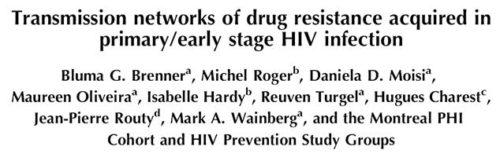
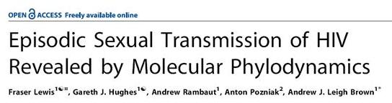
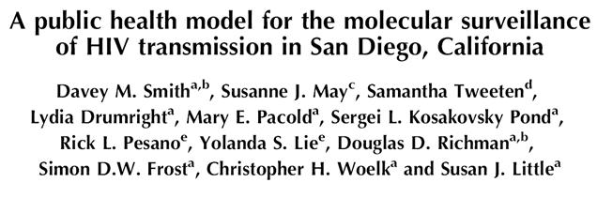
Molecular Epi: HIV
Recent studies show how molecular epidemiology can also be applied to study HIV transmission networks and may inform screening activities
AIDS 2008
PLOS Medicine 2008
AIDS 2009

Slide 5
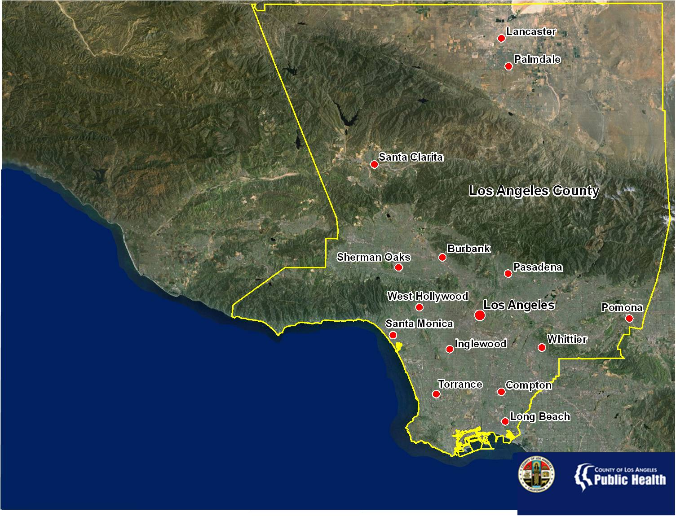
Population | Estimated HIV/AIDS Cases
9,848,011 | 61,700
Data Source: U.S. Department of Commerce, 2010; Los Angeles County Department of Public Health, HIV Surveillance, 20111
Notes:
Los Angeles County is the most populous in the United States with 9.8 million residents. The County is diverse in both it’s people and geography. There is no one majority racial/ethnic group and the County’s geography consists of urban, suburban, and rural areas divided by several mountain ranges.

Slide 6
Study Objective
Examine demographic, geographic, and clinical factors associated with transmission networks or “clusters”among patients in the Los Angeles County (LAC) Ryan White system of care between 2001 – 2008

Slide 7
Methods
Sample: 3,201 HIV+ patients in the LAC Ryan White system who received a genotype test between 2001 – 2008
  Cohort represented patients with detectable viral load and a genotype test
  Includes individuals failing therapy and newly diagnosed patients entering care
Using unique HIV pol sequences, analysis of genetic relatedness was used to define clusters (ref: Pond 2005)
Notes:
Cohort represented patients with detectable viral load and a genotype test including individuals failing therapy and newly diagnosed patients entering care

Slide 8
Methods Cont’d
Clustering was conservatively defined at a genetic distance of <1% (ref: D. Smith 2009, AIDS)
Identified clusters were then examined by:
  Gender, race/ethnicity, age at time of specimen collection, most recent CD4 count, most recent viral load, and one of 8 service planning areas (SPAs) within LAC
Clusters were then mapped using reported SPA of residence (ArcGIS)
Notes:
Note we are not measuring direct transmission.
For this analysis, transmission clusters were then conservatively defined when pol sequences from any two people were >99% genetically similar (i.e. <1% genetic distance between sequences). The San Diego study (D Smith et al 2009, AIDS) found that the 1% is cut-off is a good cut-off for very close if not direct connections. For example, all epidemiologically linked partner pairs in their study had a genetic distance of pol sequences <1%

Slide 9
Demographic Characteristics of Sample
Characteristic | N | %
All Clients | 3,201
Male | 2,732 | 85%
Female | 429 | 13 %
Transgender | 38 | 1%
Unknown | 2 | 0.1%
White | 602 | 19%
African American | 660 | 21%
Latino | 1,807 | 56%
Asian Pacific Islander | 77 | 2%
Other/Unknown | 55 | 2%
≤18* | 39 | 1 %
19-24* | 179 | 6%
25-29* | 350 | 11%
30-39* | 1,220 | 38%
40-49* | 1,052 | 33%
50+* | 361 | 11%
Mean Age (Range)* | 38.3 years (0-77)
Median Age* | 38 years
*Age at time of specimen collection
Notes:
Other/unknown race includes Native American, other, and unknown race ethnicities. They were combined due to small numbers.
CD4 pie chart: People across a range of CD4 counts received genotype testing, including those with well preserved immune function, and those at later stages of the disease (16% 0-200 CD4)
-Viral load levels are indicated in the second pie chart and ranged from X to X.

Slide 10
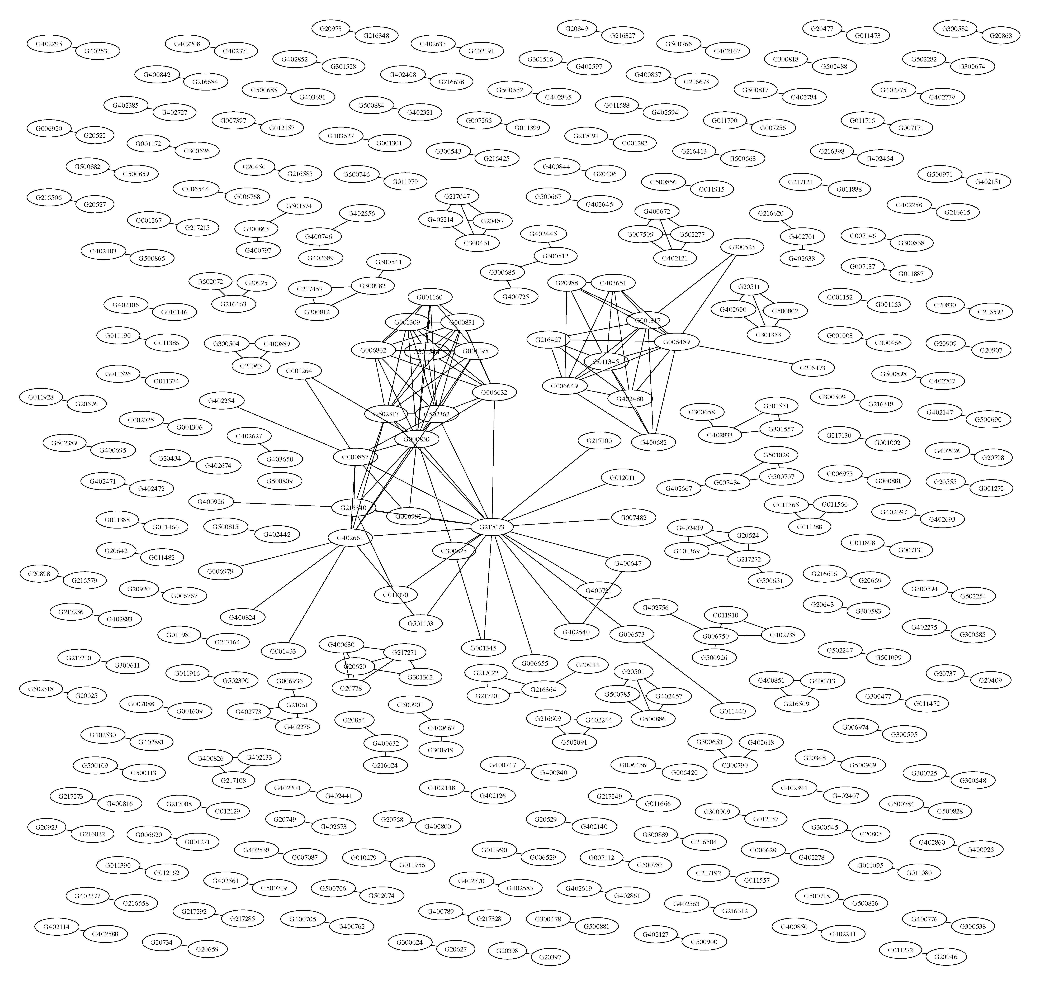
Clusters Identified
3,201 sequences were analyzed
165 unique clusters were identified
Represents 13% (N=413) that clustered into highly related HIV sub-populations
Cluster Size (# of sequences in a cluster) | # of Clusters at 1% N(%)
2 | 137 (4.6%)
3 | 13 (0.44%)
4 | 10 (0.34%)
5 | 3 (0.1%)
11 | 1 (0.03%)
34 | 1 (0.03%)
Total # of Clusters Identified | 165
Notes:
The sequences and we analyzed them using a synonymous procedure, so resistance mutations would not bias the clustering.
At the 1% genetic distance cut-off, we found 165 clusters of 2 or more sequences representing 413 patients (13% of the study cohort).
Of the 165 clusters: 137 had only 2 sequences in them, 13 had 3 sequences, 10 had 4 sequences, 3 had 5 sequences, 1 had 11 sequences, and 1 had 34 sequences.
Demographic characteristics were then analyzed for clusters with 5 or greater sequences

Slide 11
Cluster Characteristics and Distribution by SPA
Characteristic | Cluster A
N | 34
Male | 97%
White | 41%
African American | 12%
Latino | 41%
Asian Pacific Islander | 3%
Other/Unknown | 3%
Mean Age (Range)* | 40.6 yrs (26-57)
Mean CD4 (Range) | 269.5 (2-775)
Mean Viral Load (Range) | 84,276.5 (1,085-750,000)
Characteristic | Cluster B
N | 11
Male | 100%
White | 9%
African American
Latino | 91%
Asian Pacific Islander
Other/Unknown
Mean Age (Range)* | 37.2 yrs (25-49)
Mean CD4 (Range) | 290.5 (53-782)
Mean Viral Load (Range) | 74,668.2 (2,445-240,000)
Characteristic | Cluster C
N | 5
Male | 100%
White
African American | 100%
Latino
Asian Pacific Islander
Other/Unknown
Mean Age (Range)* | 25.6 yrs (16-47)
Mean CD4 (Range) | 237.6 (67-498)
Mean Viral Load (Range) | 264,061.8 (51,731-750,000)
Characteristic | Cluster D
N | 5
Male | 100%
White | 20%
African American
Latino | 60%
Asian Pacific Islander
Other/Unknown | 20%
Mean Age (Range)* | 44.4 yrs (35-60)
Mean CD4 (Range) | 480.8 (287-780)
Mean Viral Load (Range) | 101,042.6 (10,420-201,921)
Characteristic | Cluster E
N | 5
Male | 100%
White | 80%
African American
Latino | 20%
Asian Pacific Islander
Other/Unknown
Mean Age (Range)* | 31.2 yrs (25-37)
Mean CD4 (Range) | 328.4 (142-578)
Mean Viral Load (Range) | 231,483.2 (77,205-750,000)
C05
B11
E05
A34
NOTE: Locations do not represent actual residence. Locations were randomly selected within each SPA.
D05
*Age at time of specimen collection
Source: Annual HIV Surveillance Report; Reported cases through 12/31/10
Notes:
Clusters A – spans a wide range of race ethnicities. It is the only cluster that included 1 female.
Cluster B – mainly among Latino
Cluster C – only among African American males, a younger cluster – mean age 25.6 range 16-47, SPA 6 centered with 1 in SPA 8
Cluster D – older cluster mean age 44.4 (age 35-60). 3 of 5 in SPA 3
Cluster E – cluster consisted of 4 white males and 1 Latino male: predominantly SPA 2
Cluster C and E mean viral loads were higher than other 3 clusters

Slide 12
Cluster Characteristics and Distribution by SPA
C05
Characteristic | Cluster A | Cluster B | Cluster C | Cluster D | Cluster E
N | 34 | 11 | 5 | 5 | 5
Male | 97% | 100% | 100% | 100% | 100%
White | 41% | 9% |  | 20% | 80%
African American | 12% |  | 100%
Latino | 41% | 91% |  | 60% | 20%
Asian Pacific Islander | 3%
Other/Unknown | 3% |  |  | 20%
Mean Age (Range)* | 40.6 yrs (26-57) | 37.2 yrs (25-49) | 25.6 yrs (16-47) | 44.4 yrs (35-60) | 31.2 yrs (25-37)
Mean CD4 (Range) | 269.5 (2-775) | 290.5 (53-782) | 237.6 (67-498) | 480.8 (287-780) | 328.4 (142-578)
Mean Viral Load (Range) | 84,276.5 (1,085-750,000) | 74,668.2 (2,445-240,000) | 264,061.8 (51,731-750,000) | 101,042.6 (10,420-201,921) | 231,483.2 (77,205-750,000)
B11
E05
A34
NOTE: Locations do not represent actual residence. Locations were randomly selected within each SPA.
D05
Source: Annual HIV Surveillance Report; Reported cases through 12/31/10

Slide 13
Summary of Results
Molecular epidemiology can be used to study transmission networks in LAC
Larger clusters were overwhelmingly comprised of men, and each cluster contained a unique combination of dominant race/ethnicity, age range, and geographic location

Slide 14
Limitations
Available sequences were from a small subset of Ryan White medical clients (3,200 out of 13,000 patients/yr)
The sample is limited to Ryan White patient sequences. Other individuals who may be in cluster but not in the Ryan White system would not be represented in this analysis
Notes:
-There is likely an inherent bias in only using Ryan White Medical Clients sequences, and other wealthier clusters or clustering individuals would not be represented.

Slide 15
Public Health Implications
Transmission networks and their characteristics can inform prevention strategies that target high risk networks
  Partner Services, ART expansion, targeted condom distribution, social marketing
Knowledge about transmission networks can improve social and sexual network tracing to identify HIV+ persons unaware of status

Slide 16
Los Angeles County Next Steps
Examine transmission clusters using Los Angeles County surveillance data
Analysis of resistance patterns within networks

Slide 17
For More Information
Jennifer Sayles, MD, MPH
Medical Director
Office of AIDS Programs and Policy
County of Los Angeles Department of Public Health
E-mail: jsayles@ph.lacounty.gov

