Slide 1





COMPREHENSIVE HIV AND STD PREVENTION SERVICES IN LOS ANGELES COUNTY
RFP No. 2024-014
Proposers' Conference December 17, 2024

Slide 2


Welcome and Introductions
Brenda Gonzalez Camacho, Contract Analyst Division of Contracts and Grants
Department of Public Health

Slide 3

Agenda
Conference Guidelines and Housekeeping
Addendum 1
Proposer’s Conference Overview
Director’s Remarks
Overview of Services
Proposal Submission Tips
Selection Process and Evaluation Criteria
Proposal Submission/Delivery Guidelines
RFP Timeline – Next Events
Conclusion

Slide 4
Proposers’ Conference Housekeeping
The virtual proposers’ conference will be recorded and the link to the recording will be available in an Addendum to the RFP on Public Health’s Contracts and Grants website http://publichealth.lacounty.gov/cg/index.htm
Please ensure each agency representative has filled out the conference attendance form.

Slide 5
Addendum 1
Addendum 1 was released on December 16, 2024.
Changes were made to the following:
Two-week extension on proposals due date;
Removed Category 2 Eligibility to Bill Third-party Payer MMR; and
Services to Category 2 including removing STD screening and testing and adding linkage to STD screening and testing.

Slide 6
How to Submit Questions
Additional questions may be submitted via the Q&A box.
Questions and Answers Addendum: All questions received prior to and during the Proposer’s Conference will be responded to in an addendum. Note: Written questions should be submitted to the County representative identified in RFP Section 8.2 (Proposers’ Questions).
Addendum Release and Posting: Addendum #2 is scheduled for release 1/6/25. Addenda released will be provided via e-mail transmission and also posted on the following link: http://publichealth.lacounty.gov/cg/index.htm

Slide 7

Proposers' Conference Overview
Conference Goals
Provide Proposers insight into the rationale and need for the requested services
Provide an overview of the services
Review requirements to assist Proposers in developing their proposals
Address common issues that occur when submitting proposals
Allow for questions from Proposers regarding the RFP and associated documents and/or process. Not all questions will be addressed during the conference but will be included in Addendum 2.
r

Slide 8

Director’s Remarks
Mario J. Pérez, MPH
Director
Division of HIV and STD Programs (DHSP)
County of Los Angeles Department of Public Health

Slide 9


Purpose of Request for Proposals (RFP)
To solicit proposals from interested and qualified Proposers throughout
Los Angeles County to provide Comprehensive HIV and STD Prevention Services comprised of 3 categories:
Category 1: Comprehensive HIV and STD Testing, Screening and Treatment in Clinic Based Settings (Clinic-Based Prevention) Services
Category 2: HIV Testing and Linkage to HIV Treatment and Linkage to STD Screening, and Treatment in Non-Clinic-Based Settings (Non-Clinic-Based Prevention Services)
Category 3: High Impact Prevention Programs (HIPP)

Slide 10

Comprehensive HIV and STD Prevention Services (Prevention Services)
PROPOSERS ARE PERMITTED TO APPLY FOR EITHER CATEGORY 1 OR CATEGORY 2, BUT NOT BOTH.
TO BE ELIGIBLE TO APPLY FOR CATEGORY 3, PROPOSERS MUST APPLY AND QUALIFY FOR EITHER CATEGORY 1 OR CATEGORY 2.

Slide 11
Available Annual Funding
The total estimated funding available for Prevention Services under this RFP is approximately $30 million annually which will be distributed across LAC.
Prevention services are structured as cost reimbursement services.
The County expects to distribute available funds in the following manner:
$15 million annually for Clinic-Based Prevention Services
$5 million annually for Non-Clinic-Based Prevention Services
$10 million annually for HIPP

Slide 12
Julie Tolentino, MPH
Senior Program Manager
Ending the HIV/STI Epidemics
Division of HIV and STD Programs (DHSP)
County of Los Angeles Department of Public Health

Slide 13
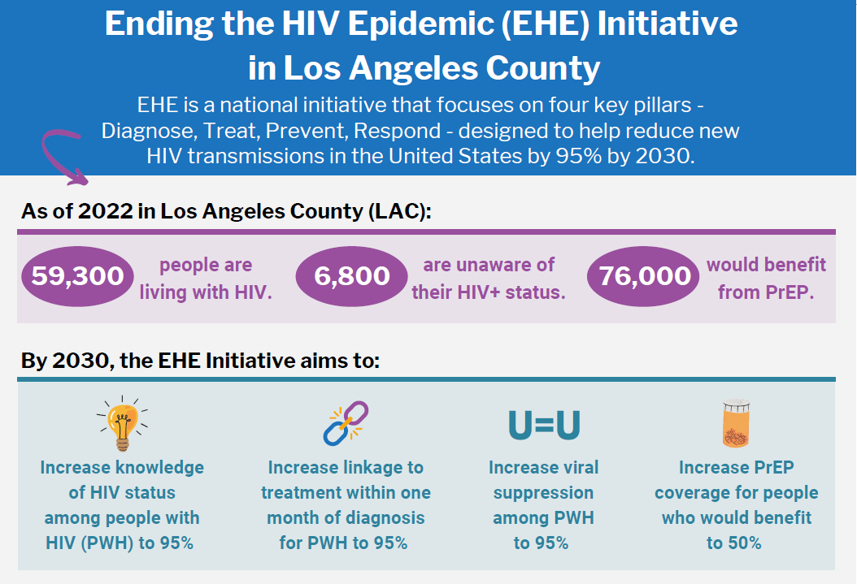

Slide 14
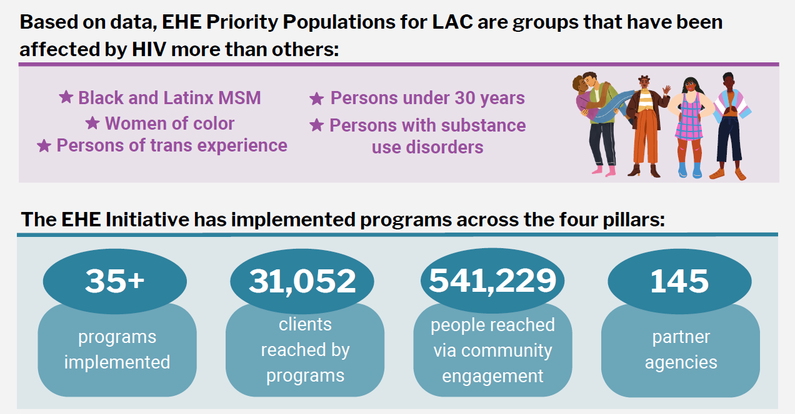

Slide 15
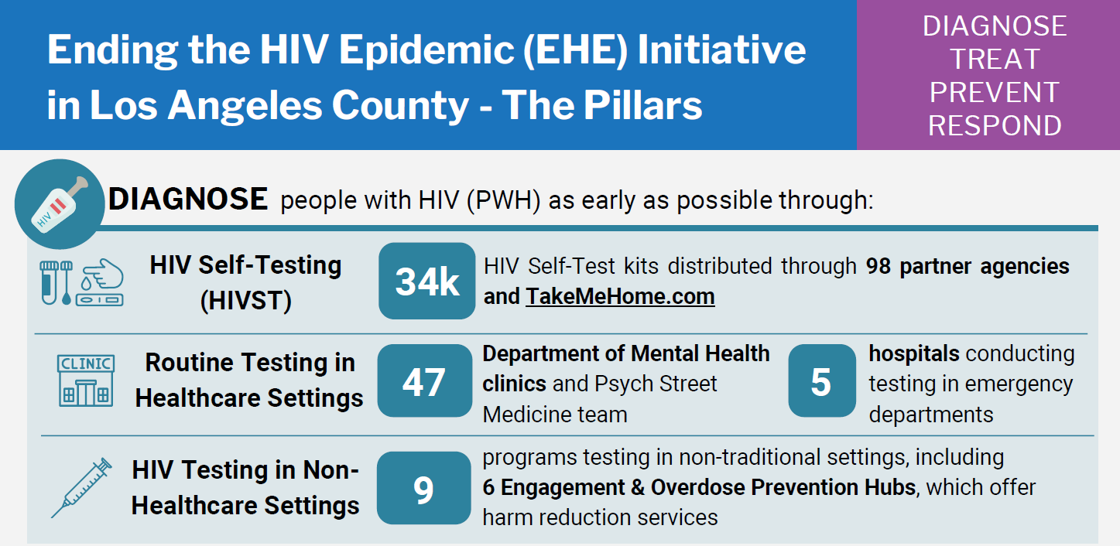
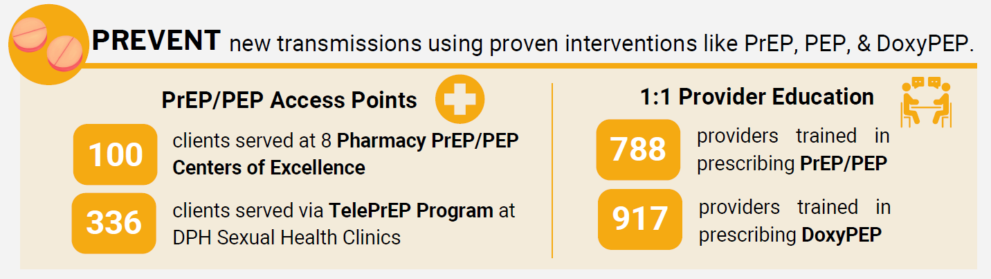

Slide 16
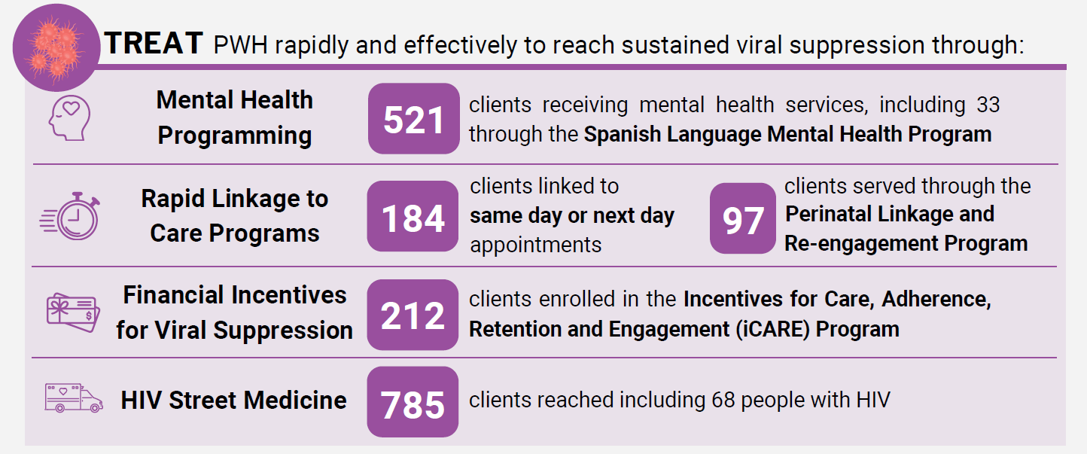
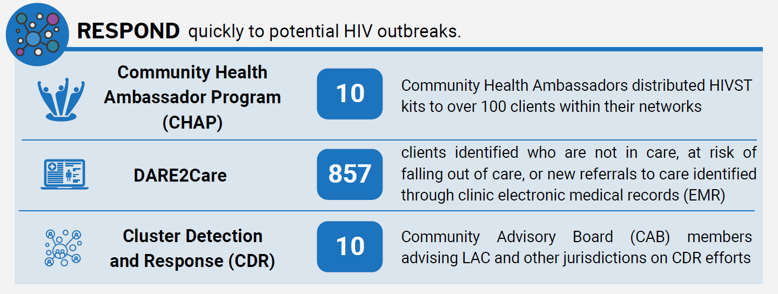

Slide 17
Ending the HIV Epidemic Indicators
Ending the HIV Epidemic Indicators
Ending the HIV Epidemic Indicators
Indicator | LAC current | EHE Targets for 2025
Number of new transmissions¹ | 1,400 [900 – 1,900] (2021) | 380
Number of new HIV diagnoses² | 1,641 (2022) | **
Knowledge of HIV-status among PLWH¹ | 89% [85%-91%] (2021) | 95%
Linkage to HIV care among PLWDH² | 76% (2022) | 95%
Viral Suppression among PLWDH² | 64% (2023) | 95%
Percentage of persons in priority populations prescribed PrEP³ Latinx MSM 50% Cisgender Women 17% Black MSM 32% Transgender Persons 12% | 35% (2021) | 50%
PLWH= People living with HIV (includes those unaware of HIV infection); PLWDH= People living with diagnosed HIV
Using Los Angeles County HIV surveillance data in the CDC Enhanced HIV/AIDS Reporting system (eHARS).
Using the CD4-based model developed by the Centers for Disease Control and Prevention, modified for use by Los Angeles County.
Using Los Angeles County data from the National HIV Behavioral Surveillance system, STD clinic data, online Apps survey, COE program data, and AHEAD dashboard.
Notes:
Here is a snapshot of our EHE Indicators, you’ll see at the top that we have over 59,000 PLWH in our jurisdiction and the linkage to care and viral suppression indicators are highlighted given this is the HRSA RW conference. Our linkage to care is at 76% and VS is 64%, but we know disparities exist when stratified among our priority populations with some of the percentages being much lower.

Slide 18
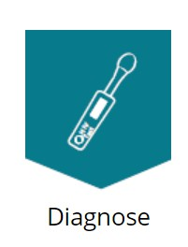






Current LA County STD Prevention and Control Strategies
Range of STD Screening and Testing Services Emergency Departments, non-traditional settings such as syringe service programs, jails, street-based
School Wellbeing Center-based Services
Syphilis Screening as part of Prenatal Care and During Delivery
Treatment Verification
Bicillin Delivery Program for Congenital Syphilis Control
Intensive Case Management for Pregnant Persons with Syphilis
Street Medicine efforts
Expedited Partner Therapy
Biomedical Prevention (DoxyPEP)
Provider Outreach and Education
Condom Distribution
Community and School-Based Sexual Health Education
Partner Elicitation and Notification through Public Health Investigators
Specialized Investigation Team for Congenital Syphilis
Community Embedded Disease Investigation Specialists
Data to Action Efforts
Health Plan and FQHC Engagement
Clinical Provider Education and Training, including 1:1 provider education visits
Community Engagement
Media and Communications, including Social Marketing
Workforce Development
Syndemics planning with County Partners
Policy and Leadership
HIV, Syphilis, Meth Use Disorder Syndemic Programming

Slide 19
Overview of Services
Paulina Zamudio, MPA
Chief
Contracted Community Services
Division of HIV and STD Programs (DHSP)
County of Los Angeles Department of Public Health

Slide 20
Category 1: Clinic-Based Prevention Services
Services to be Provided:
HIV Testing & Medical Care Linkage
STD Testing, Screening, & Treatment
STD testing and screenings.
Treatment for individuals diagnosed with one or more STDs.
Prevention Navigation Services
Linkage to resources and care for individuals at high risk of STDs and HIV infection.
Biomedical Services
Access to Pre-Exposure Prophylaxis (PrEP), Post-Exposure Prophylaxis (PEP), and
Patient-Delivered Partner Therapy (PDPT)
PDPT services for the treatment of STDs.
Benefits Screening
Screening to identify available benefits for individuals.
Linkage to medical care for individuals diagnosed with HIV.
HIV testing services.
Doxycycline Post-Exposure Prophylaxis (DoxyPEP).

Slide 21
Category 1: Clinic-Based Prevention Services
Services will target individuals at high risk for HIV infection in LAC, with an emphasis on:
MSM;
Transgender persons;
Cisgender women of color;
African American persons of all ages;
Latinx persons of all ages;
American Indian/Alaskan Native persons of all ages;
Youth and young adults (under 30 years of age);
Persons who use/inject drugs (PWUID); and
Persons aged 50 and older
Services will be provided in licensed medical clinics and affiliated satellite locations convenient to the populations served.

Slide 22
Clinic-Based Prevention Services Personnel
Community Embedded Disease Intervention Specialist (CEDIS) (when applicable)
Clinics with 40 or more HIV-positive individuals diagnosed over the last five years and 100 syphilis cases diagnosed annually must include a minimum of one CEDIS as part of the Clinic-Based Prevention Services team to facilitate Partner Services, PDPT, and other necessary services, as needed.
Clinics diagnosing over 150 syphilis cases per year are required to provide an additional CEDIS to support these services.
Minimum Qualifications:
The CEDIS must work closely with HIV-positive clients and at-risk populations to prevent the spread of HIV and other STDs.
Bachelor’s degree in Public Health, Social Work, Nursing, or a related field. Preferred: Master’s degree in Public Health (MPH), Social Work (MSW), or equivalent.

Slide 23
Clinic-Based Prevention Services Personnel
CEDIS Liaison (optional)
The CEDIS Liaison is an optional staffing position available if Contractor does not meet the minimum client threshold required for a CEDIS.
Contractor may hire a CEDIS Liaison to help ensure effective disease intervention and fostering a collaborative approach to public health challenges.
Minimum Qualifications:
Bachelor’s degree in Public Health, Nursing, Social Work, or a related field.

Slide 24
Category 2 - Non-Clinic-Based Prevention Services
Services to be Provided:
HIV Testing & Linkage to Care
Prevention Navigation Services
Connecting high-risk individuals to essential resources and care for HIV & STD prevention.
Biomedical Services
Access to PrEP, PEP, and DoxyPEP for prevention and treatment.
Benefits Screening
Helping individuals access available benefits for better health outcomes.
Ensuring timely diagnosis and access to medical care for those diagnosed with HIV.
Linkage to STD Screening, & Treatment
Providing linkage to comprehensive care for individuals diagnosed with one or more STDs

Slide 25

Category 2 - Non-Clinic-Based Prevention Services
Services will be provided in non-clinic-based settings (with drop-in service) convenient to the populations served. Services will target individuals at high risk for HIV infection in LAC, with an emphasis on:
MSM;
Transgender persons;
Cisgender women of color;
African American persons of all ages;
Latinx persons of all ages;
American Indian/Alaskan Native persons of all ages;
Youth and young adults (under 30 yrs. of age);
PWUID; and
Persons aged 50 and older

Slide 26
Category 3: High Impact Prevention Programs (HIPP)
High Impact Prevention Programs (HIPP) are intended to supplement Clinic-Based and Non-Clinic-Based Prevention Services.
Contractor can select up to two of the following prevention supportive services to enhance prevention activities conducted as a part of Clinic-Based Services or Non-Clinic-Based Services:
Social connectedness: Facilitate social gatherings or events that promote interpersonal communication and encourage relationship building.
Job skills development/job training: Conduct job skills development and training sessions to equip individuals with essential skills for the workforce.
Financial literacy: Educate individuals on financial literacy to help them understand and manage their finances effectively.

Slide 27
Category 3: High Impact Prevention Programs (HIPP)
Continued…
Educational/English as a Second Language classes: Teach educational classes, including English as a Second Language, to enhance language proficiency and learning opportunities.
Contingency management: Implement contingency management strategies to motivate positive behavior changes.
Emergency Housing/(hotel) vouchers: Distribute emergency housing and hotel vouchers to provide immediate shelter for individuals in crisis situations.

Slide 28
Category 3: High Impact Prevention Programs (HIPP)
Services will be provided in a location (with drop-in service) that is convenient to the populations served.
African American and Latinx MSM with emphasis on young MSM (YMSM);
Transgender persons with emphasis on transgender women;
Cis-gender women experiencing homelessness, who use/inject drugs or have experienced intimate partner violence;
PWUID with emphasis on opioids and/or stimulants; and
Youth and young adults (under 30 years of age).
Services will target individuals at high risk for HIV infection in LAC, with an emphasis on:

Slide 29
Overview of Program & Technical Requirements
Michael Green, PhD, MHSA
Chief
Planning, Development and Research
Division of HIV and STD Programs (DHSP)
County of Los Angeles Department of Public Health

Slide 30

Location of Services
To ensure that services are available and accessible to individuals at high-risk for HIV infection in LAC, DHSP is prioritizing services provided in Health Districts (HD) with high HIV/STD morbidity.
Proposers must indicate in the Proposal in which HD and Service Planning Area (SPA) within the County the Proposer’s services will be provided.

Slide 31

Location of Services
DHSP identified high HIV/STD morbidity areas:
Tier 1 - HDs experiencing high HIV and/or syphilis morbidity:
Hollywood/Wilshire (HD 34)
Central (HD 9)
Southeast (HD 72)
South (HD 69)
Southwest (HD 75)
Tier 2 - HDs experiencing high HIV and/or syphilis morbidity:
Northeast (HD 47)
Inglewood (HD 37)
East Valley (HD 19)

Slide 32
Location of Services
To determine Proposer’s health district visit: http://publichealth.lacounty.gov/dhsp/HealthDistricts.htm
To determine which SPA your agency is located in visit: http://gis.lacounty.gov/districtlocator/

Slide 33
Health District Profiles
Provide a snapshot of the STD and HIV epidemics broken down into 26 health districts
Provide more detail than the Service Planning Area (SPA) model
Proposers can visit DHSP’s website to view the data in their health district
http://publichealth.lacounty.gov/dhsp/HDEpiProfiles.htm

Slide 34
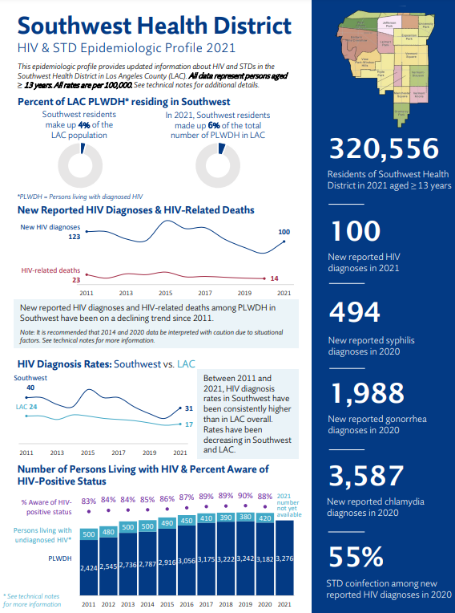
Health District Profile Example

Slide 35
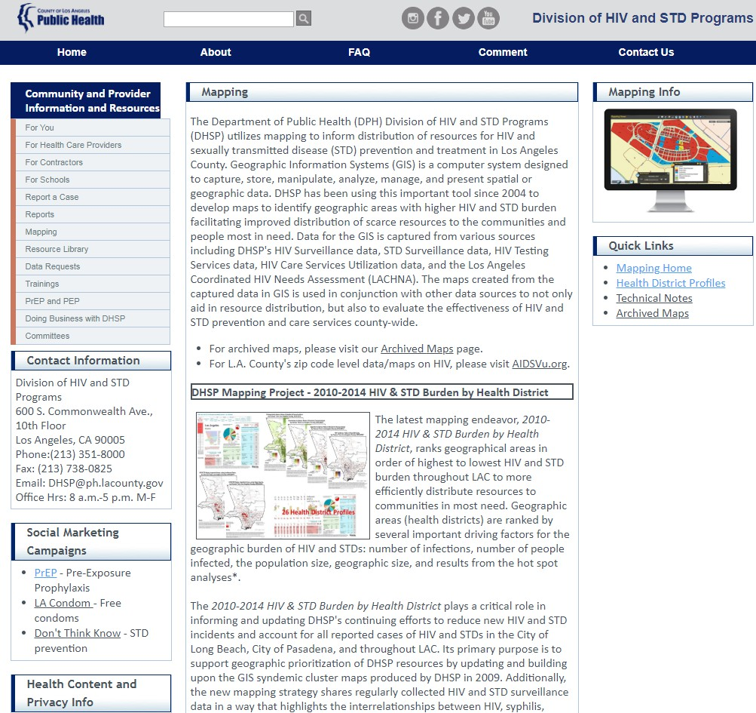
Health Districts on the DHSP Website
Health Districts: http://publichealth.lacounty.gov/dhsp/Mapping.htm

Slide 36
Selection Process and Evaluation Criteria
Brenda Gonzalez Camacho, Contract Analyst
County of Los Angeles Department of Public Health
Division of Contracts and Grants

Slide 37

Proposal Submission Tips
Read and Follow Instructions
Carefully review all instructions in RFP
Ensure to include all required documents
with your proposal
Complete all forms in Appendix B and sign where applicable
Use only the Excel template for Community Business Enterprise (CBE)
Check Public Health Contracts and Grants Division website for RFP Addendums and Excel template http://publichealth.lacounty.gov/cg/index.htm

Slide 38
Applying for Service Category(ies)
Read and Follow Instructions
Select the service category(ies) you are applying for in Appendix B, Required Forms, Exhibit 6 Minimum Mandatory Requirements
Proposers are permitted to apply for Category(ies) 1 or 2 and 3, if applicable.
Answer the questions applicable for your service category(ies)
Submit an organizational chart per service delivery site, detailing the positions to be funded for each service category

Slide 39

Common Proposal Submission Issues
MINIMUM MANDATORY REQUIREMENTS
Adherence to Minimum Mandatory Requirements – Exhibit 6. Make sure relevant information is included. Dates of experience must be listed. Sign and complete form.
Each service category has additional MMRs.
FINANCIAL CAPABILITY
Provide complete set of Financials with the correct years requested (last 3 years of financials available, e.g. CY 2021, CY 2022, CY 2023 or FY
2021-22, 2022-23, 2023-24. Tax documents are not acceptable)
REQUIRED FORMS/DOCUMENTS
Provide your organization’s Certificate of Good Standing, Statement of Information, and, if applicable, IRS 501(c)(3) Determination Letter.
FOLLOW INSTRUCTIONS
Follow instructions according to the RFP guidelines when answering questions. Use Public Health provided docs only. No other formats.
Only the information submitted will be considered. No outside information will be considered.

Slide 40
New Insurance Requirement for Contracts
Cyber Liability Insurance
Cyber Liability Insurance is a new requirement on all contracts
No less than $2 million per occurrence and in the aggregate
Refer to Appendix A, Sample Contract, Paragraph 6.8.6

Slide 41
Selection Process and Evaluation Criteria
The proposal will be evaluated per RFP Section 9.0, Selection Process Overview
Stage 1: Adherence to Minimum Mandatory Requirements (Pass/Fail Review)
Stage 2: Proposal Evaluation (1,050 possible points for each category)
Proposer’s Qualifications – Proposal Section A (50 possible pts)
Contractor Alert Reporting Database
References
Debarment History and Terminated Contracts
Financial Capability (30 pts deduction maximum)
Pending Litigation and Judgments
Required Forms and Corporate Documents

Slide 42
Selection Process and Evaluation Criteria
Stage 2: Proposal Evaluation – Continued
Proposer’s Background and Experience – Section C (100 pts)
Proposer’s Approach to Providing Required Services – Section D (850 pts for each category)
Proposer’s Staffing Plan – Section E (50 pts for each category)
Stage 3: Final Review and Selection
Scoring and Ranking for each service category
A separate score is given for each service category applied

Slide 43
Proposal Submission and Delivery Guidelines
Proposers are required to submit by email, one electronic copy of the entire proposal in Adobe Acrobat or Portable Document Format (PDF), with no security provisions, by the deadline identified in RFP, Section 1.0, Solicitation Information, to the person and e-mail address identified in RFP, Section 6.2, Contact with County Personnel.
Email subject line must be clearly marked: “Proposal Submission for Comprehensive HIV and STD Prevention Services in Los Angeles County, RFP #2024-014”.
All proposals must be submitted in the prescribed format and order (RFP Section 8.4). Any proposal that deviates from this format may be rejected without review at the Director of Public Health’s sole discretion.

Slide 44
Proposal Deadline
Be mindful of the due date and time
Recommendation: submit a day early to allow for contingencies
Please don’t be late!

Slide 45
RFP Timeline - Next Events
Key Event | Due Date /Time | Resource/Reference
Addendum 1 Released | 12/16/24 | RFP Section 1.0
Revised Written Questions Due | 3:00 PM on 12/23/24 | RFP Section 1.0
Revised Questions and Answers Addendum to be Released | 1/6/25 | RFP Section 1.0
Revised Proposals Due By | 5:00 PM on 1/21/25 | RFP Section 1.0

Slide 46

Conclusion
Thank you for your interest in responding to the COMPREHENSIVE HIV AND STD PREVENTION SERVICES IN LOS ANGELES COUNTY RFP No. 2024-014
For updates and additional funding opportunities, please visit: http://publichealth.lacounty.gov/cg/index.htm
Thank you!

